Slide 1

Title slide
What remains
Using animation to engage audiences with after-death practices
Prof Erica Borgstrom
Bsky: @ericaborgstrom.bsky.social
LinkedIn: Erica Borgstrom
Insta: @professorborgstrom
X: @ericaborgstrom

Slide 2

Slide providing overview of the presentation structure
Overview
Bit about me
Assumptions about death and society
History of the animation
Watch the animation
The making of
Edutainment
Opening up minds and conversations
Other OU resources

Slide 3

Personal introduction
Bit about me
Prof Borgstrom
Anthropologist
Death Studies scholar
Open Thanatology at the OU
Critical thinking and enabling lightbulb moments

Slide 4
Background
Assumptions about death and society
Let’s explore these…
Death and bereavement a ‘taboo’
  Media
  Dominant scripts
More death education or death/grief literacy is needed
  Lack of knowledge or lack of connecting with what they know?

Slide 5

Open University and BBC background
OU-BBC Partnership
Co-producing award-winning content
Long-standing partnership
Academics as consultants
Stacey Dooley: Inside the Undertakers
OU Connect
https://connect.open.ac.uk/society-psychology-and-criminology/inside-the-undertakers/

Slide 6
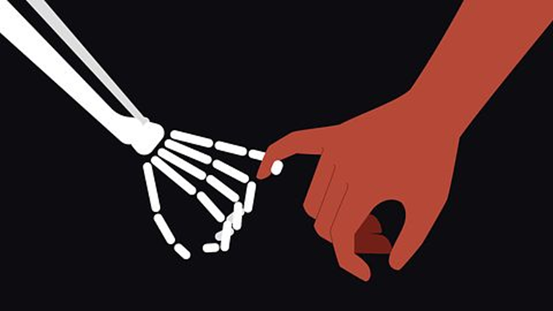
Making the animation
The making of
Inspiration
What questions might viewers have?
What questions do we want them to ponder further?
Encourage ‘new’ ideas on ‘sensitive’ topic
Academic expertise – social constructions, diversity of practices
Note: images on the following slides are from the animation

Slide 7
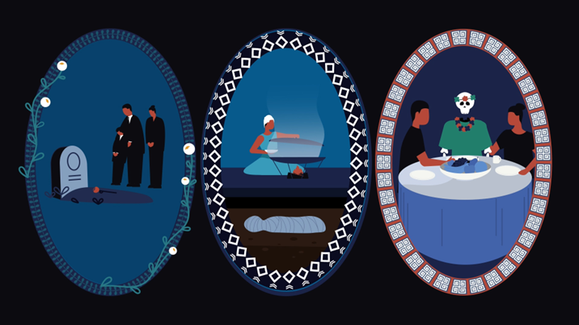
Making the animation – slide 2
The making of
OU Connect magic
From facts to script
Animator
Music
Pacing and Timing
Sensitivities and pushing boundaries
Compromises

Slide 8
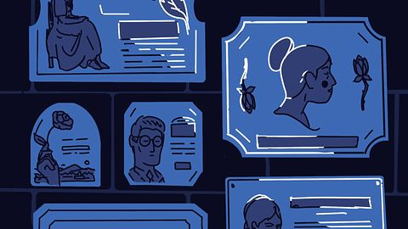
Theory
Edutainment
Educational entertainment
What is it?
What makes for successful edutainment?
Uses in public education
Transformative

Slide 9
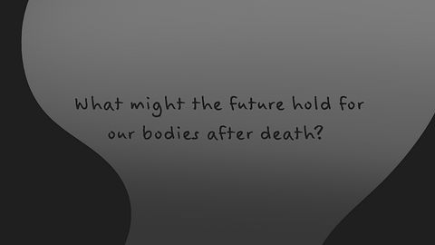
Animation and bereavement
How the animation can support bereavement
Beyond just a short film
Opens up questions
Showcases diversity in practices and ability to re-think ‘tradition’
Training
Social Media

Slide 10
Open University resources
More from the OU
Extensive open education resources
OU Connect
  This animation
  Interactive about assisted dying
  Exclusive interviews
OpenLearn
  Open Thanatology Hub
  Articles, interactives, animations, courses

Slide 11
Key messages from the presentation
Take aways
What humans do with the dead is varied
Animation can be used for public education: ideas, reflection, conversation starter
Multimedia edutainment can enable us to broach big life questions in engaging ways
And if you are looking for free resources – check out what the OU has to offer via OU Connect and OpenLearn

Slide 12

End slide
Thank you
Bsky: @ericaborgstrom.bsky.social
LinkedIn: Erica Borgstrom
Insta: @professorborgstrom
X: @ericaborgstrom

