Slide 1
Calm in the Chaos
Harnessing the Power of Self Compassion
NES Bereavement Education Conference
Dr Wendy Simpson
NHS Fife

Slide 2
What made you smile today?

Slide 3
Outline of Talk
Reflection on our response to grief
The need for self compassion
Defining self compassion
Putting self compassion into action

Slide 4
Grief is normal and personal
‘Everybody hurts’ R.E.M.
Personal experience of grief
My experience of mindful compassion

Slide 5
‘ As humans we naturally try to avoid suffering, but contrary to all our instincts, to heal our grief we need to allow ourselves to feel the pain; we need to find ways to support ourselves in it, for it cannot be escaped.’
Julia Samuel – Grief Works

Slide 6
Reflection
Think about a time when a close friend was grieving/feeling loss. How would you respond to your friend?
Think about a time when you were grieving/feeling loss. How do you typically respond to yourself?
Did you notice a difference? How might things change if you responded to yourself like a good friend?

Slide 7
“It isn’t what happens to us that causes us to suffer; it’s what we say to ourselves about what happens”
Pema Chodron

Slide 8
The need for self-compassion
If there was ever a time to be kind to ourselves, it would be during the experience of our grief.
It is not uncommon that we become highly self-critical and particularly unforgiving to ourselves while we are grieving.

Slide 9
Self-criticism during grief
that we are grieving incorrectly
that our grief is taking too long
that something is wrong with us
that we handled things poorly with our loved one
we should or shouldn’t have done certain things

Slide 10
The work we need to do to help us grieve
‘As our relationship with the world and others is changed by grief, so does our relationship with ourselves change. We need to show ourselves self compassion, to listen to our own needs, to be kind and to avoid self attack in the form of constant self-criticism.’
  Julia Samuel ‘Grief Works’

Slide 11
Compassion definition
Being sensitive to the suffering of self and others....
with a deep commitment to try to prevent and relieve it

Slide 12
Research on Self Compassion
Self-compassion is one of the most powerful sources of coping and resilience we have available to us, radically improving our mental and physical wellbeing.
Self-Compassion – Dr. Kristin Neff

Slide 13
Three elements of Self- Compassion
Mindfulness - Aware that we are suffering
Common Humanity - Realising that we are not alone – we’re human, and everyone suffers
Kindness - Being kind to ourselves - friendly, generous, gentle, caring and helpful
Self-Compassion – Dr. Kristin Neff

Slide 14
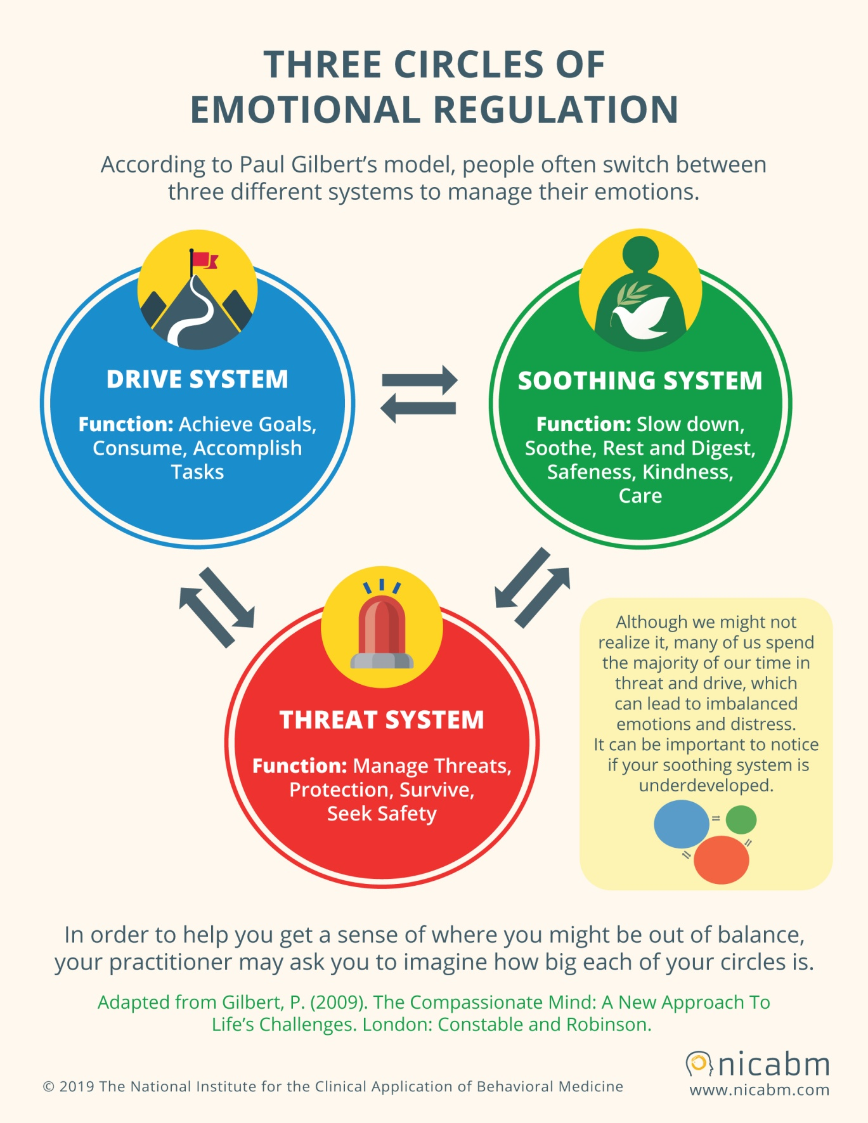

Slide 15
What self compassion is not
Self pity
Self indulgence
Self esteem

Slide 16
How can you train your mind to be more self-compassionate?

Slide 17
Being mindful
Wandering mind not a happy mind – Harvard Gazette

Slide 18
Breathing Space

Slide 19
Developing a compassionate mind
Tricky brains – not our fault
Accepting ourselves as we are
Holding our feelings
Taking care of ‘our human’

Slide 20
Compassionate Self Imagery
  Soothing colour
  Safe place
  Memory of feeling cared for

Slide 21
Soften, soothe, allow
Soften – physical compassion
Soothe – emotional compassion
Allow – mental compassion
  Self-Compassion – Dr. Kristin Neff

Slide 22
Loving Kindness Practice
May I be well today
May I be happy today
May I be at ease today
May you be well today
May you be happy today
May you be at ease today
Find on Insight Timer App

Slide 23
Allowing yourself to be yourself
Learn
Connect
Transcend
Help
Play
Corey Keyes

Slide 24
Practicing Self Compassion
Breathing space / body scan
Speak to yourself like a best friend
Soften, soothe, allow
Practice Loving Kindness
Commit to doing something that you truly love to do, every day

Slide 25
Daily authentic compassion
Kind regards
Have a wonderful day / weekend
Have a lovely day
Best wishes
Take care of yourself

Slide 26
Give yourself the gift of self compassion
We often wait for kindness, but being kind to yourself can start now.
Charlie Mackesy, The boy, the mole, the fox and the horse

Slide 27
Calm in the Chaos
Harnessing the Power of Self Compassion
Everybody Hurts sometimes
So Hold on, hold on, hold on
R.E.M.

Slide 28
Reading and Resources
Mindful Compassion by Paul Gilbert and Choden
Self Compassion by Kristin Neff
Radical Compassion by Tara Brach
The Mindful Path to Self-Compassion by Christopher Germer
The Mindful Self Compassion Workbook by Kristin Neff and Chris Germer
The Compassionate Mind Workbook by Chris Irons and Elaine Beaumont
Languishing by Corey Keyes
Grief Works by Julia Samuel
Insight Timer App

