Slide 1



International Bereavement Education Conference 2024 - Bereavement in the modern world: Kindness in the chaos
Help researchers from the University of Glasgow develop a bereavement toolkit for care home staff
Professor Bridget Johnston
Dr Maria Drummond

Slide 2
AGENDA
This workshop will cover:
01
What Patient and Public Involvement is
02
Why bereavement support is important for care home staff
03
Case studies from care homes
03
Overview of our research and how you can help us

Slide 3
What is Patient and Public Involvement?
  Research that involves members of the public, rather to ensure the public influences and shapes research.
  PPI Improves relevance, usability, and outcomes.
  Why it matters in bereavement care: Making support practical and empathetic.

Slide 4
Why bereavement support is important for care home staff
  Factors like age, health, cultural background, and personal coping mechanisms require nuanced support tailored to individual needs.
  Helps care home team identify people who may need additional support.
  Ensures care home teams have the skills to process their own grief and continue to provide compassionate care
  Unadressed grief can lead to emotional burnout.
Bereavement support ensures a compassionate and emotionally healthy environment for all.

Slide 5
A co-production study of bereavement support interventions in care homes
  Aim: To develop and evaluate a toolkit of bereavement support interventions to help bereaved family members, staff and residents.
  Participants: Care home staff.
  Process: One focus group in each care home followed by workshops to refine toolkit draft and then testing toolkit in a selection of care homes.
  Outcome goal: Share best practice and close common gaps in practice.

Slide 6

Case study one
Betty and Joan had become inseparable friends during their time as residents at the care home. They spent most of their days together, sharing meals, attending activities, and reminiscing about their lives. Joan’s health declined following a chest infection. She received end of life care and died with family in attendance. The family expressed their gratitude to staff at the care Joan received. However, Betty was inconsolable. She refused to leave her room, skipped meals, and stopped participating in activities. The care team noticed a significant decline in her physical and emotional well-being.

Slide 7

John lives in Australia. His mother, Mrs. Clark, has lived in the care home for 9 months. He was her only child and had taken on the responsibility of managing her care but from a distance. When Mrs. Clark died following a brief illness, John was devastated. He felt an overwhelming sense of loss, coupled with concerns about whether he had made the right decisions regarding her care. He returned to Scotland for her funeral and during this time, contacted the care home regularly to discuss care decisions and the contents of care records.
Case study two

Slide 8

Margaret and Harold had been married for 55 years. Harold had been a resident in the care home for two years due to his declining health, while Margaret visited him every day, often spending hours by his side. Harold died peacefully in his sleep one night. He was found by night staff in the morning. Care staff phoned Margaret to ask her to visit the care home urgently. Upon hearing the news, she was visibly devastated and struggled to process the loss, remaining in Harold’s room for several hours, clutching his belongings.
Case study three
Margaret and Harold had been married for 55 years. Harold had been a resident in the care home for two years due to his declining health, while Margaret visited him every day, often spending hours by his side. Harold died peacefully but unexpectedly in his sleep one night. He was found by night staff in the morning. Care staff phoned Margaret to ask her to visit the care home urdently. Upon hearing the news, she was visibly devastated and struggled to process the loss, remaining in Harold’s room for several hours, clutching his belongings.

Slide 9

Case study four
Emily, a care assistant, had developed a close bond with Mr. Thompson, a resident she had been caring for over the past year. They shared daily conversations, and Emily got to know his family well. Mr. Thompson died one morning, and Emily was the one who found him. She was deeply affected, feeling both grief and guilt, wondering if there was more that she could have done.

Slide 10

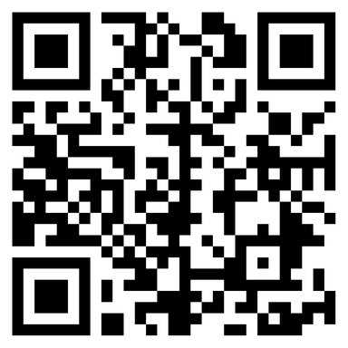
Now we need your help
What should be in the toolkit?
What should care home staff know to support bereaved families, residents and other staff effectively?
1
2
Which formats would be most practical for care home staff?
3
What tools or technologies could make it engaging?
https://padlet.com/mariadrummond2/031224

Slide 11
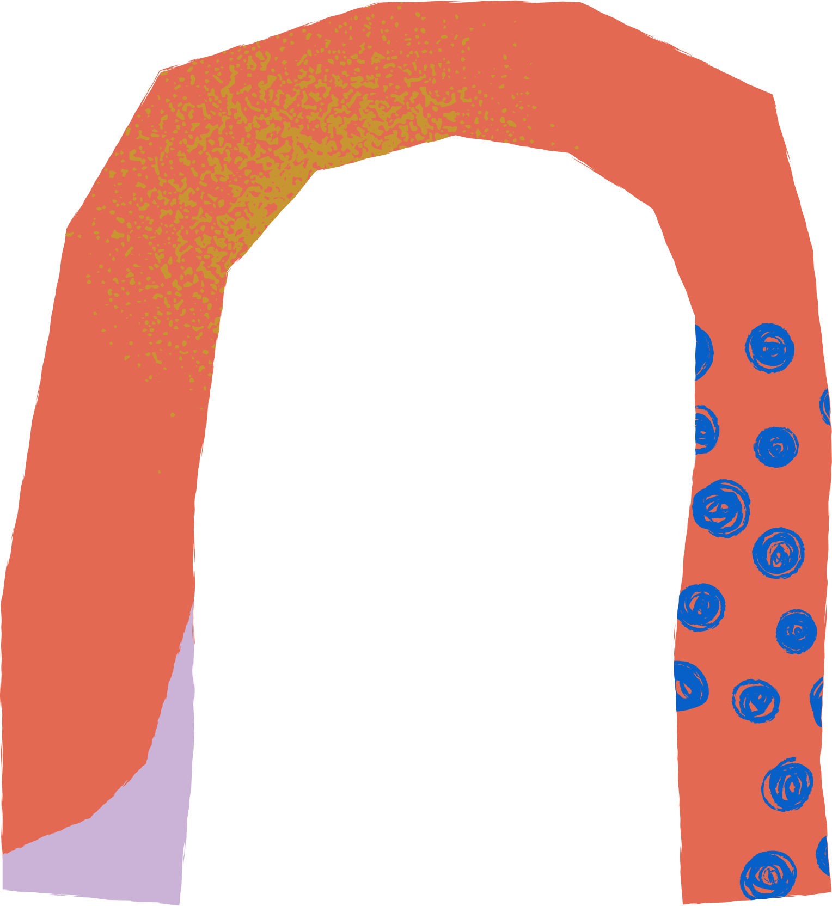

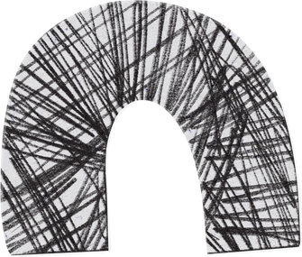




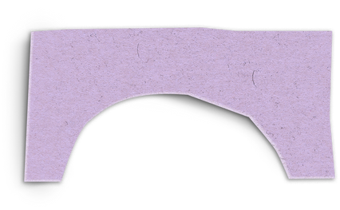
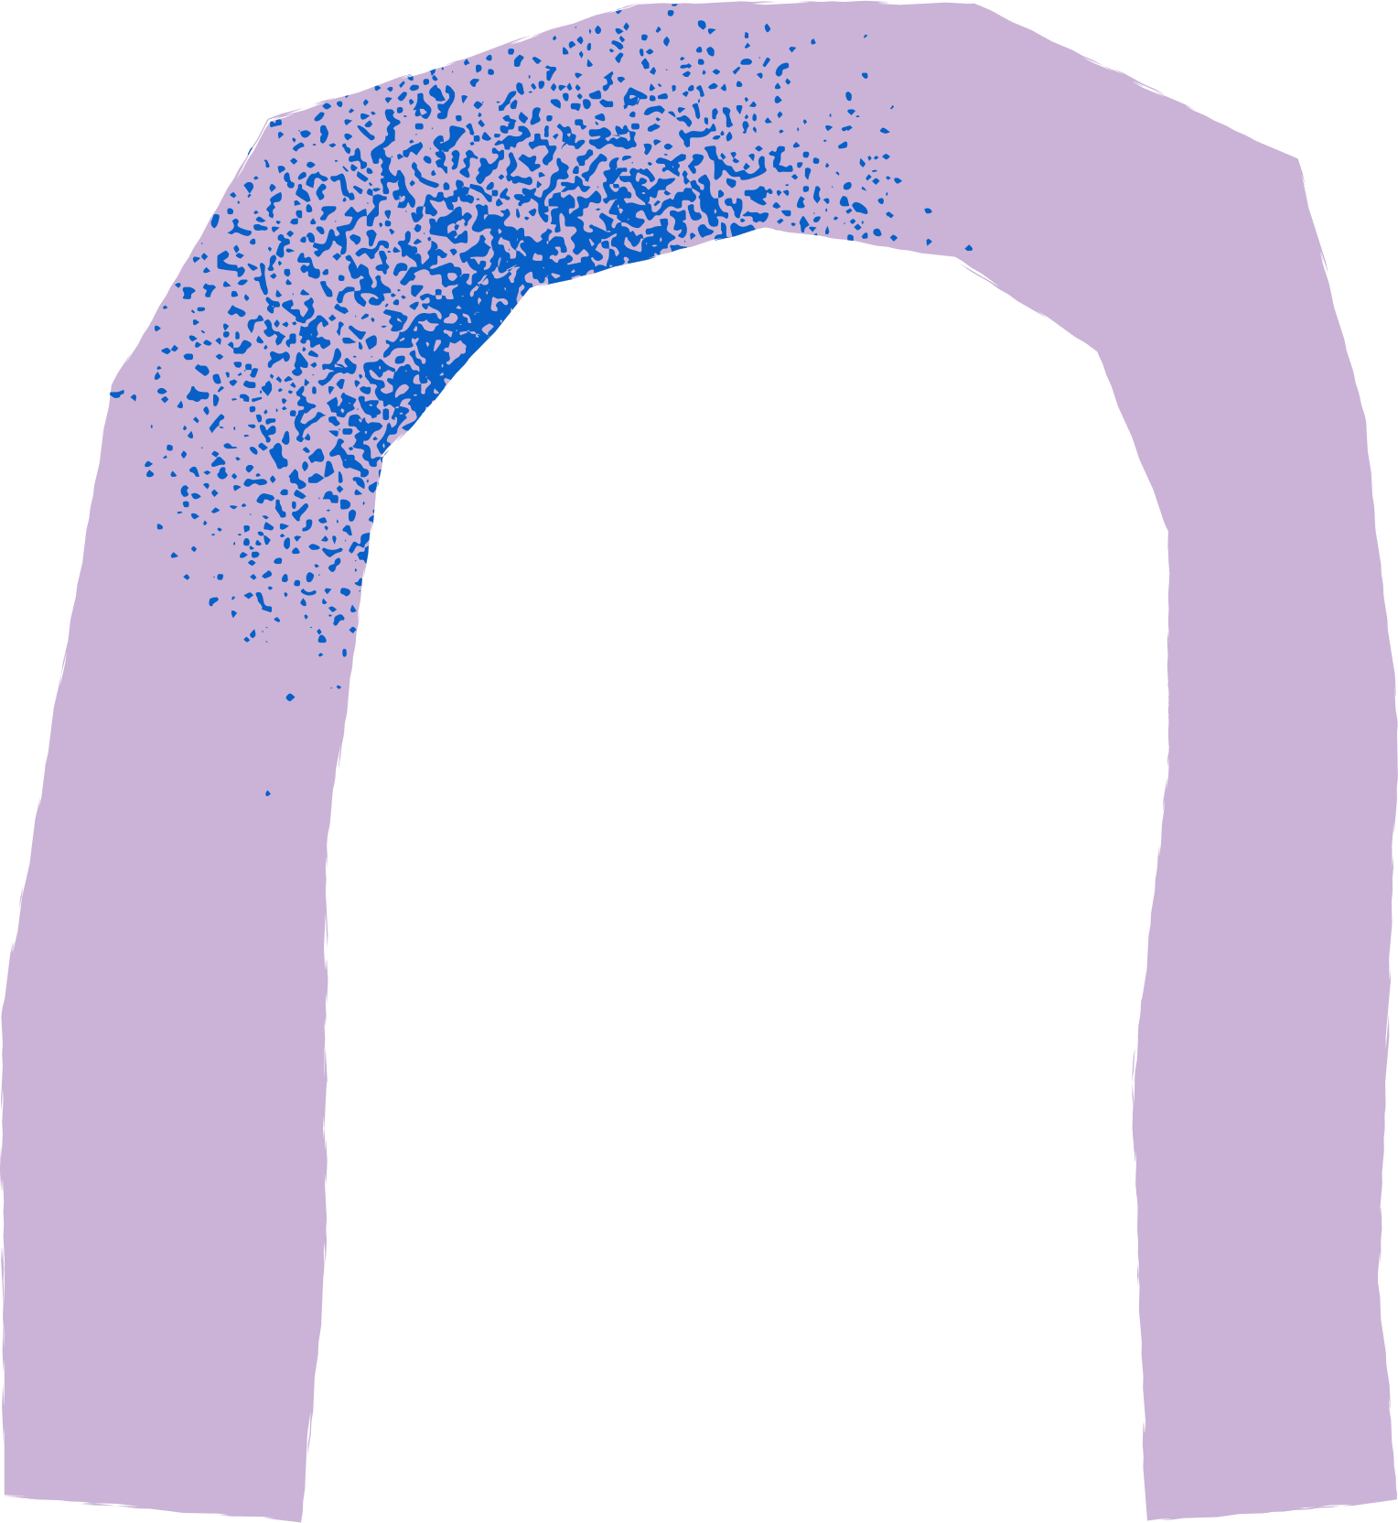



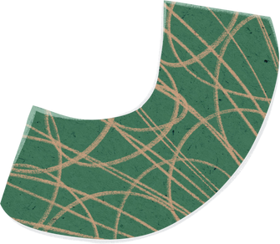


Breakout Session
  One person to be scribe
  Start with introductions
  Answer each question through discussion
  Scribe then inputs answers onto Padlet
  Then return for feedback
APPROXIMATELY 30 MINUTES
https://padlet.com/mariadrummond2/031224

Slide 12
Contact Us
Professor Bridget Johnston
bridget.johnston@glasgow.ac.uk
Dr Maria Drummond
maria.drummond2@nhs.scot
tay.enrichscotland@nhs.scot
Thank
You

