Slide 1
Developing a bereavement competency framework.
An evidence base for an eLearning resource for
bereavement service providers in the community.

Slide 2
Test question

Slide 3
Question 1
What is your current role/job title?

Slide 4
Question 2
What country do you/your service operate?

Slide 5
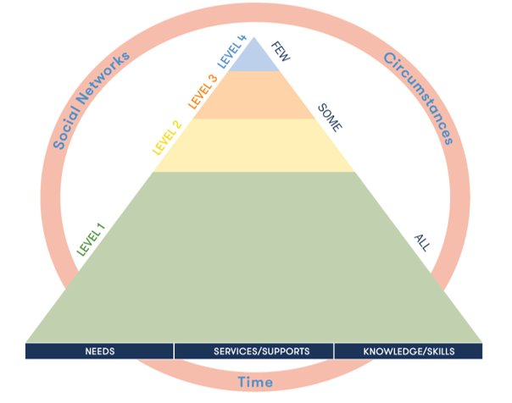
The Public Health Approach to Bereavement Care
2

Slide 6
Framework for Adult Bereavement Care - Pyramid Animation on Vimeo

Slide 7
Question 3
What level do you/your service operate at?

Slide 8
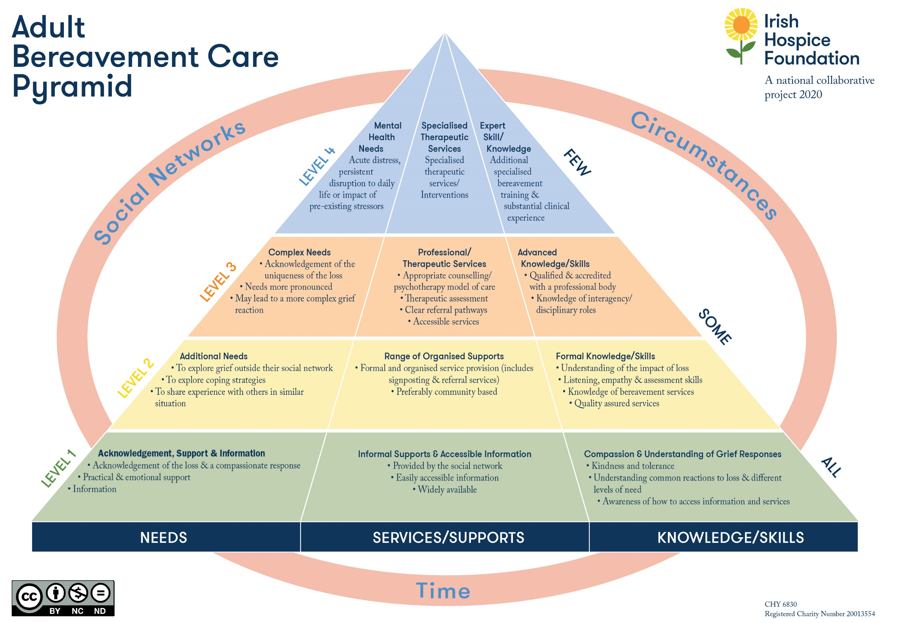
4

Slide 9
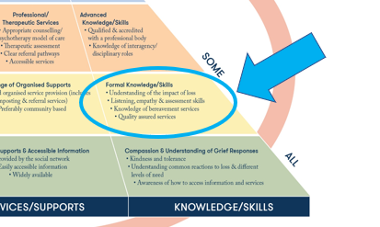
Who is a LEVEL 2 bereavement service provider?
provide emotional and/or practical support
commonly provided by a bereavement support volunteer
some professionals who may provide this emotional/practical support in the context of their role
GP’s, Public Health Nurse, family resource centre project worker, social work, social prescriber.....
while some of the skills of counselling may be employed (e.g. active listening), this is not a counselling intervention.
5

Slide 10
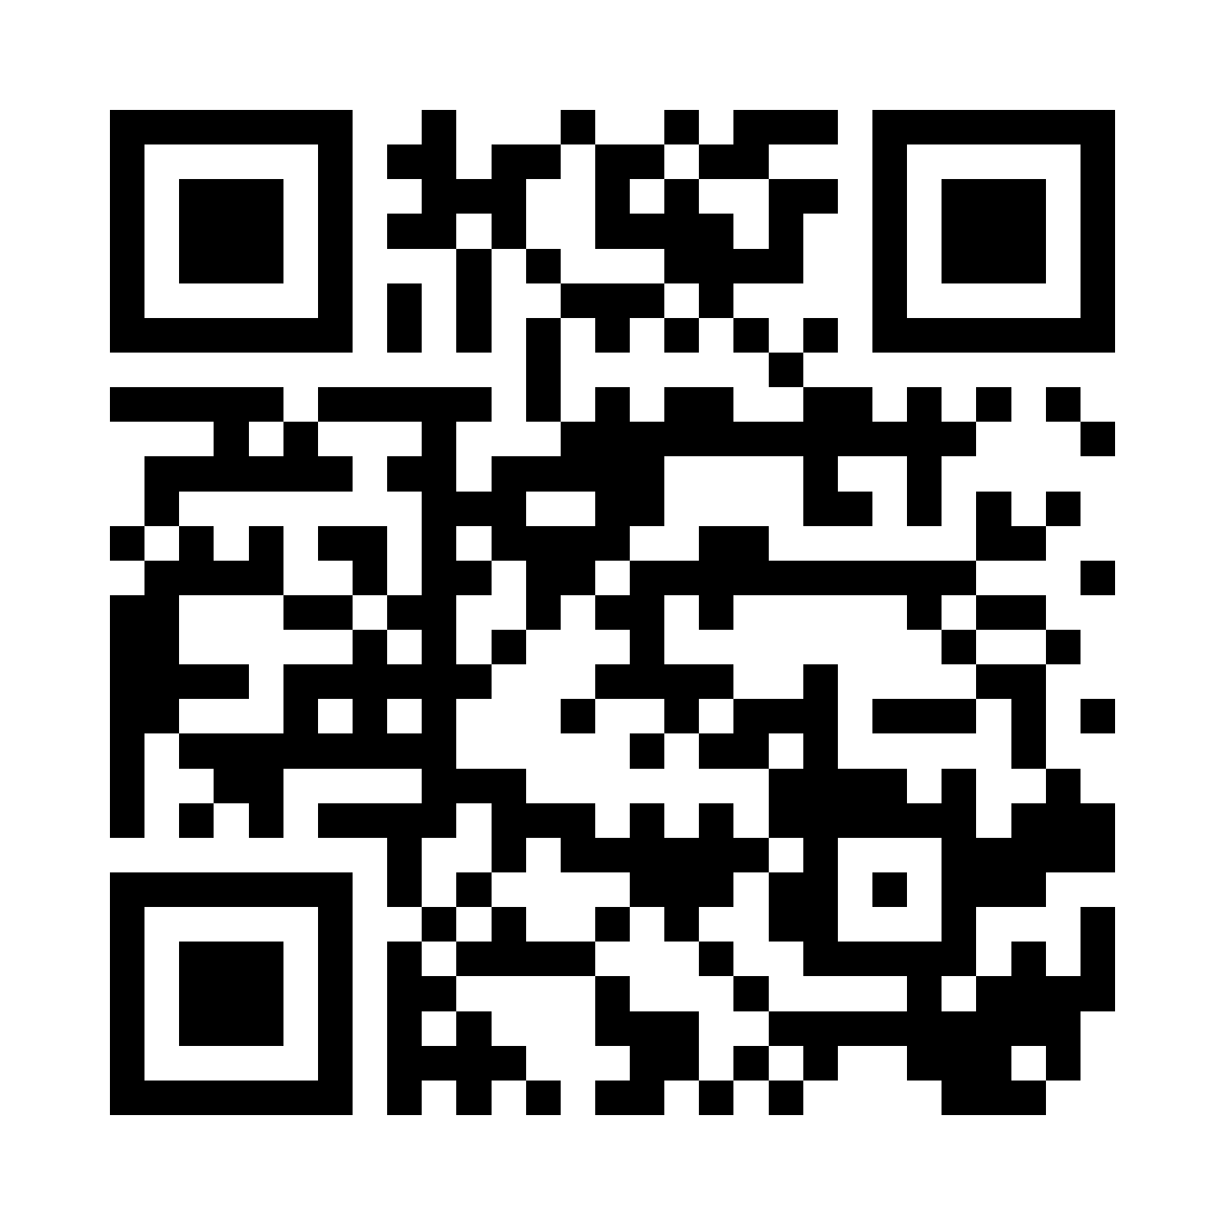
At LEVEL 2 there is…..
No agreed baseline of knowledge and skills (no standard)
Varying level of training among services
This project will…..
Develop an evidence-based and agreed standard of core skills and knowledge for the Level 2 service provider (i.e. competency framework)
Develop an eLearning resource which will provide the learner with the first step towards meeting the competencies outlined in the Competency Framework*
For information about
The Adult Bereavement Care Pyramid
6

Slide 11
Advisory Group (n=13)
Alliance of Age Sector NGO's - ALONE | Natalie Johnson (left post) Replaced by Anne Cowley
AWARE | Amanda Vaughan, Recruitment, Learning & Development Manager (left post)
Hospice and palliative care social work group / St Francis Hospice, Dublin | Niamh Finucane, Co-Chair / Coordinator of Social Work & Bereavement Services
HSE National Counselling Service | Sharon Cunningham, CIPC Coordinator, Midlands
HSE National Palliative Care Programme | Maurice Dillon, National Lead for Palliative Care, Integrated Operations – Planning
Irish Association of Social Workers - Hospital | Eibhlin McNamara, Bereavement Care Coordinator / Palliative care social worker
Irish Childhood Bereavement Network | Maura Keating (left post), Replaced by Sonia Rennicks , National Coordinator
Irish Cancer Society | Alex Phelan McGahon, Support programmes coordinator (psycho social supports)
Irish Hospice Foundation LEAD ORGANISATION | Orla Keegan, Head of Education and Bereavement
National Cancer Control Programme (HSE) / Galway Cancer Support Centre | Helen Greally, Clinical Lead / Director of Psychology and Support Services
National Forum of Family Resource Centres | Mary Mulcahy, National Mental Health Training and Policy Officer
National Office for Suicide Prevention | Ollie Skehan, National Suicide Bereavement Coordinator
University College Cork | Sharon Lambert, Lecturer, School of Applied Psychology
Training Network (n=18)
A Little Lifetime
Anam Cara
Barnardos Childrens Bereavement Service
Bethany Bereavement Support
CRY Ireland
Childrens Grief Centre
Embrace Farm
Cancer Support Centre (HOPE)
HUGG
Irish Childhood Bereavement Network
Irish Hospice Foundation LEAD ORGANISATION
Kilkenny Bereavement Support
LMC Bereavement
Pieta
Rainbows Ireland
Support After Homicide
Hospice and Palliative Care Social Workers Group / St Francis Hospice
Turas Le Cheile
Project Management Team Irish Hospice Foundation
Amanda Roberts, Bereavement Development PROJECT LEAD
Orla Keegan, Head of Bereavement and Education
Aisling Lavelle, Education Lead
Invited national and international experts (Delphi survey)
7

Slide 12
Bereavement Support Competencies & Training Project​
Develop a National Core Competency Framework for service providers working at Level 2 of the Bereavement Care Framework
Develop an eLearning resource which provides an introduction¹ to the identified core competencies
8
¹ This course will provide the learner with the first step towards meeting the competencies outlined in the Competency Framework

Slide 13
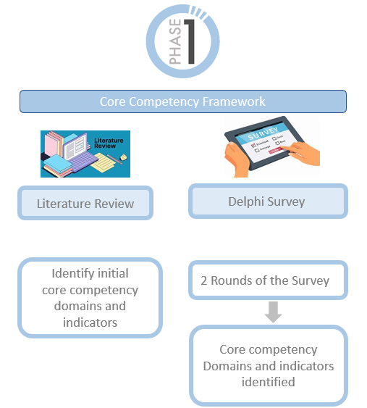
9

Slide 14
Question 4
What CORE knowledge and skills
do you think Level 2 bereavement support providers should have?

Slide 15
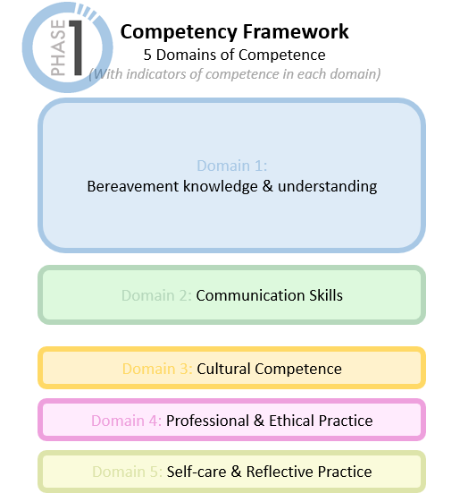
Output
10

Slide 16
KNOWLEDGE: a Level 2 helper knows ..
SKILL: a helper at level 2 can…
that grief is a normal and appropriate response to loss
that grief is not something to be ‘fixed’
the range of responses to grief, including emotional, physical, cognitive, spiritual, behavioral and psychosocial responses
there is no one way to grieve and people express grief differently
contemporary understandings of bereavement allowing them to validate a person’s grieving experience
that for many, grief gradually eases, although intense feelings may arise at anytime
the variety of factors that may impact how grief is experienced
that family dynamics and relationships have an impact on bereavement experience
the potential for personal growth in bereavement
the resilience factors that might influence grief reactions
that everyone has needs after a death and some require additional support (i.e. how grief is understood in relation to the bereavement care pyramid)
the factors that may put a person at risk for encountering difficulties in their bereavement
how to recognize when someone is experiencing complications in their grieving (e.g. traumatic response, prolonged grief disorder, mental health issue etc.) and is beyond the scope of practice of a Level 2 service provider
the value of accurate grief information for bereaved people
be with/ sit with a person who may be upset, distressed, angry, desolate, silent in their grief...
use bereavement knowledge to validate a person's experience (e.g referring to the range of responses to loss; explaining ‘grief bursts’ and the implications of Dual Process Model and other frameworks)
educate and explore ways of living with, and coping with, grief – (eg ways of thinking about grief, prompting activities in line with Continuing Bonds, self care etc...)
identify when a person may need support beyond the scope of practice of a Level 2 service provider
direct a person to extra resources (e.g. website, podcasts, written material etc...)
11

Slide 17
KNOWLEDGE: a Level 2 helper knows ..
SKILL: a helper at level 2 can…
Knowledge (n=8)
the various components that support effective communication (e.g. physical space, establishing trust, clear language, non-verbal communication etc.)
Skill (n=12)
listen actively to a person’s story
Skill (n=3)
be aware of their own cultural bias (including unconscious bias) and assumptions when working with a service user
Knowledge (n=6)
culture (e.g. beliefs, customs and social behaviours) influence a person’s grieving
Skill (n=6)
support with compassion and maintain professional boundaries
Knowledge (n=10)
where the scope of practice of a Level 2 service provider sits on the overall structure of bereavement care (i.e. Bereavement Care Pyramid)
Knowledge (n=8)
the value of routine service provider support (e.g. debrief, peer support, formal supervision etc.) in promoting and maintaining selfcare.
Skill (n=5)
Be aware of your own bias, assumptions and triggers based on your own bereavement experience when working with service user
11

Slide 18
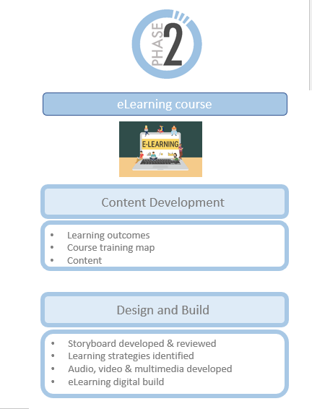
Inform
Output
12

Slide 19
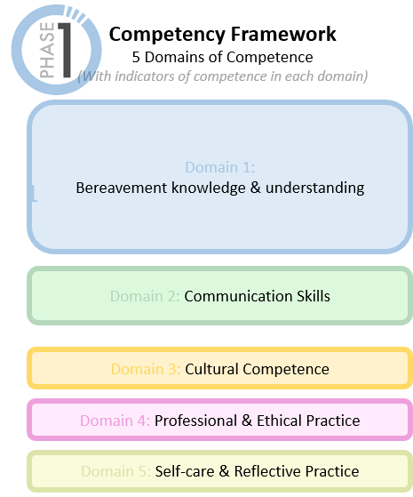
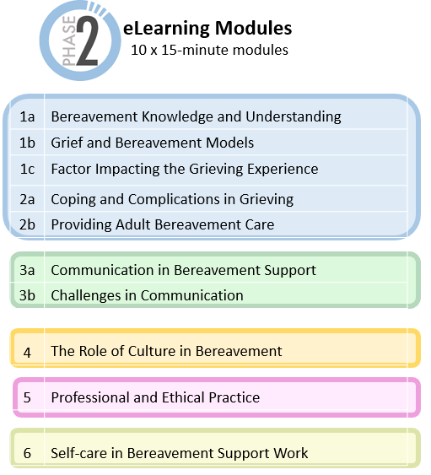
Inform
13

Slide 20
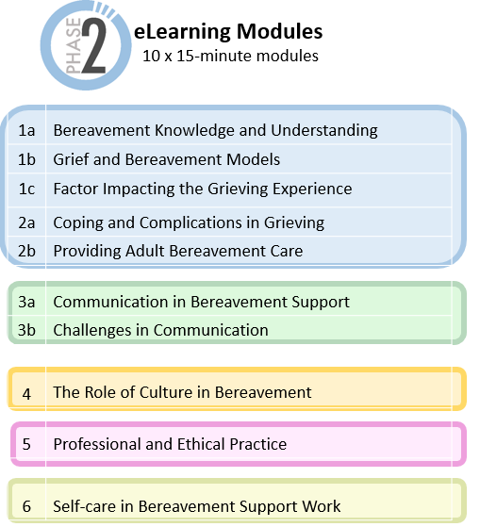
This eLearning course will provide the learner with the first step towards meeting the competencies outlined in the Competency Framework
APPLICATION
The organization should engage in activities to help the learner apply this knowledge in their role in supporting a bereaved person (i.e. application).
This might include,
Working through case studies and scenarios specific to their organisation
Practice opportunities and opportunities to demonstrate competence.
The organisation
KNOWLEDGE AND UNDERSTANDING
The eLearning programme will provide introductory-level learning to each of the competence domains outlined in the framework. The first step towards meeting the competencies outlined in the Competency Framework
Throughout the eLearning programme, the learner will participate in knowledge check exercises.
eLearning
Programme
14

Slide 21
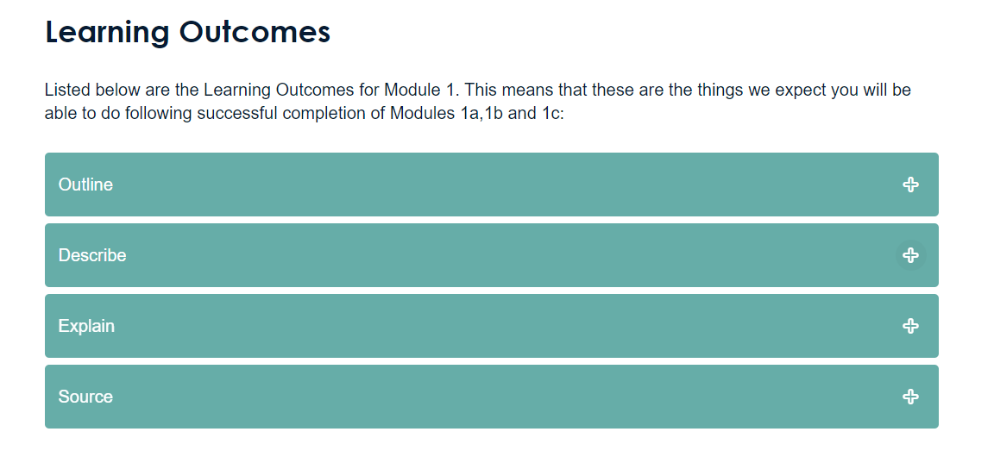
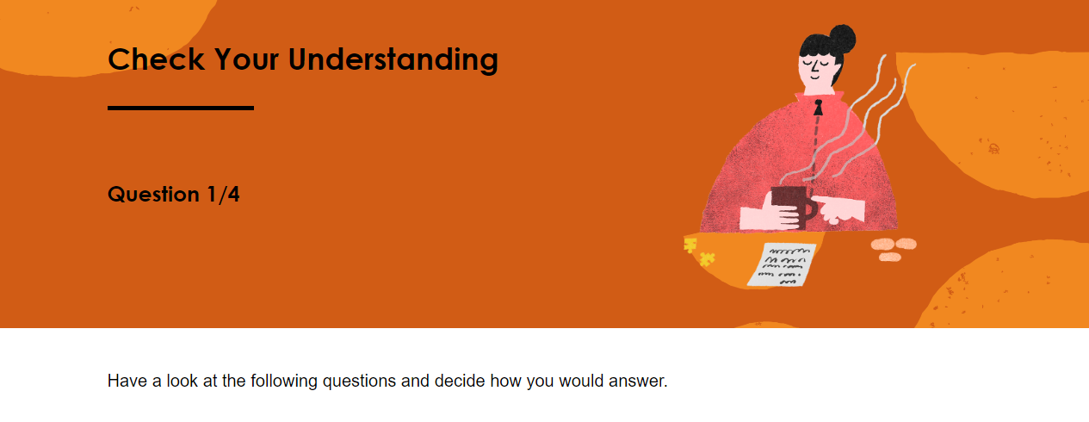
15

Slide 22
Survey Feedback
​
Pilot took place August 2024
37 of those provided completed the survey
16

Slide 23
Who completed the survey?
Other (n=3): Nurse. Lecturer, mental health
17
Answered: 37

Slide 24
How likely is it that you would recommend this eLearning Programme as an introduction to bereavement, to a colleague who will soon be joining your service, and will be providing bereavement support at Level 2 (i.e. provides emotional and/or practical support to those who have been bereaved)? 1 = being very unlikely to 10 = highly likely
Net Promoter Score (NPS) is a simple, yet effective metric that measures customer satisfaction and loyalty by asking one key question: “How likely are you to recommend our company/product/service to a friend or colleague?
18
Answered: 37

Slide 25
How likely is it that you would recommend this eLearning Programme as an introduction to bereavement, to a
colleague who will soon be joining your service, and will be providing bereavement support at Level 2
(i.e. provides emotional and/or practical support to those who have been bereaved)? 1 = being very unlikely to 10 = highly likely
Net Promoter Score (NPS) is a simple, yet effective metric that measures customer satisfaction and loyalty by asking one key question: “How likely are you to recommend our company/product/service to a friend or colleague?
73%
19
Answered: 37

Slide 26
Experience & Engagement with the eLearning
100% | This programme was a positive experience
97% | I found this programme engaging | undecided = 1
I found it an excellent course, very clear and concise information. Very important key information. Also the format was great, mixture between different elements, videos, questions, flip pages, etc made it more interactive and kept engagement.
……grounds the information shared and creates a strong foundation for learners to go forward with. The scenarios and stories within the training also humanise all the information so that it can be connected with on a human level which, I think, is much more deeper understood by people then just academic content.
The programme gave me a chance to think about how I might handle certain calls, refreshed my knowledge and showed the value of having theory to support people which can be translated into daily lived experience.
It’s important that people working with grief are on the same understanding. This course has lots of interesting facts and resources.
20

Slide 27
Course Navigation
92% | The registration process was straightforward | undecided = 1, disagree = 2
95% | It was easy to move from page to page in each of the modules | undecided = 1, disagree = 1
89% | I could easily look back on previous pages in the module | disagree = 4
100% | I thought the knowledge checks were straightforward
89% | It was easy to access the Resource Section at the end of each module | undecided = 2, disagree = 2
89% | I could easily move from one module to the next | undecided = 1, disagree = 3
92% | Overall, this programme was easy to navigate | undecided = 2, disagree = 1
Resources
97% | We would like to hear your overall impression of the Resource Section of this programme (note % refers to rating of good to excellent) | fair = 1
21

Slide 28
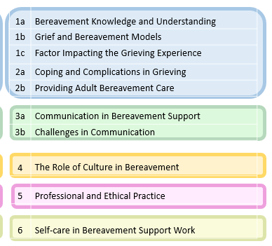
Time taken to complete modules
Majority took less than 25 mins to complete each module
22

Slide 29
73%
thought there were other organisations or groups who would benefit from this eLearning Programme
All employers (inclu. HR training)
Nurses (GPN, PHN tec)
GPs (doctors)
Hospital staff
Chaplains
Counsellors
Social workers
Gardai
Helpline volunteers
Anyone working with grief…..
Schools
Family Resource Centres
Regional volunteer centres
Day Care Centres (e.g. older adults)
Cancer support centres
Hospital
Hospice
Prison
Social care and support workers
(addiction, older adults, homeless, disability, asylum seekers, young people/youth groups etc..)
I think everyone who is either starting off bereavement work or general emotional support roles would benefit. I could see how counselling and psychotherapy students would find this very helpful.
Many have highly skilled workers who regularly support people in the community who are bereaved and would welcome this training
GPNs would benefit from as they see patients and are generally the ones who can identify patients that are struggling.
16

Slide 30
I felt this was a very well thought out programme and gives a really good overview of grief and appropriate interventions at level 2, expectations and boundaries for the volunteer. I would be delighted to use this programme as part of initial training and recruitment of new bereavement volunteers.
Your overall impression of the course.
% rated course as good to excellent
It is an excellent programme, pitched at the right level for those working at Level 2 of framework for Adult bereavement care pyramid.
There is some good information in the programme, but it needs to be longer and have more included in it. There is a danger, despite the messaging that this will be used as sufficient training. I also think that training in this area required a face to face and experiential component that e-learning cannot address.
very comprehensive and
essential training
I did find new information and new ways of approaching conversations and giving support even though I'm an experienced volunteer with years of experience which was great.
24

Slide 31
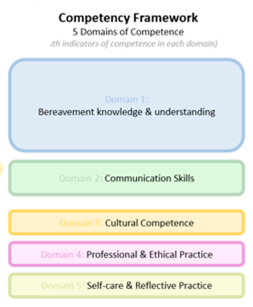
What Next?
25

Slide 32
Question 5
Would your service find the competency framework useful?

Slide 33
Want to learn more?
Amanda Roberts
Bereavement Development Manager
Irish Hospice Foundation
amanda.roberts@hospicefoundation.ie
26

