Slide 1
My Grief My Way:
An intervention development study
David Gillanders, Anne Finucane and Anne Canny University of Edinburgh
The University of Edinburgh is a charitable body, registered in Scotland, with registration number SC005336
www.ed.ac.uk

Slide 2
THE TEAM
Dr Anne Finucane (Co-PI), University of Edinburgh Dr David Gillanders (Co-PI) University of Edinburgh Dr Anne Canny, University of Edinburgh
Dr Emily Harrop, Cardiff University Dr Lucy Selman, Bristol University Dr Donna Wakefield, NHS South Tees
Dr Brooke Swash, University of Chester Dr Ray Owen, Consultant
Ms Tamsin Burnett, Marie Curie Hospice Edinburgh Ms Kelly Maton, Marie Curie Information and Support
Prof. Michael Cholbi, University of Edinburgh (Philosophy) Dr Juliet Spiller, Marie Curie Hospice Edinburgh
M.G.M.W. Project Advisory Group

Slide 3
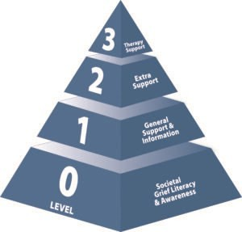
Bereavement support needs in the UK
Grieving is a normal, adaptive, healthy process
30% in need of additional support (e.g. peer support or volunteer led)
10% need specialist support
Est. 3.5m bereaved each year in the UK
350,000 need specialist support (Level 3)
Over 1m need extra support (Level 1 & 2)
Ref: Who Needs Bereavement Support? A Population Based Survey of Bereavement Risk and Support Need (Aoun et al. 2015)

Slide 4
Development of an online Acceptance and Commitment Therapy
(ACT) intervention to improve ability to cope and quality of life
after bereavement
Rapid literature review Qualitative data Stakeholder workshops Lived experience group
Prototype design
Volunteer training
Finalise intervention
Prototype production
Intervention refinement
Logic model
development
Share intervention
Prototype testing
Stakeholder Engagement Public Involvement (PPI)

Slide 5
PHASE 1: LOGIC MODEL DEVELOPMENT
A logic model is a graphic which represents in a simplified form your understanding of how an intervention produces its outcomes
Shared understanding
Informed by formal and informal knowledge.

Slide 6
My Grief My Way (MGMW) Logic model development

Slide 8
WHAT’S THE CHANGE MECHANISM?
Acceptance and Commitment Training
Psychological Flexibility

Slide 9
The ACT model: Psychological Flexibility
AWARE
Psychological Flexibility
OPEN
ENGAGED

Slide 10
The ACT model: Psychological Flexibility
Be present
Psychological Flexibility
Do what
matters
Open up

Slide 11
PHASE 2: INTERVENTION PROTOTYPE
Engaging and accessible:
relationship with the site, video, language, imagery, poetry (from the heart)
Real people’s stories
edited to show common stuck points of grieving
(overwhelm, avoidance, expectations, meaning & purpose, unexpected or traumatic deaths, physical impacts)
Understanding and normalising a wide range of responses
ACT skills – OPEN, AWARE and ENGAGED
Specific strategies for self-support – wellbeing, lifestyle, sleep, cooking, exercise

Slide 12
CORE ELEMENTS
With Volunteer Support or as a Self-directed Intervention
Bereavement Support Volunteers
Four two-hour training sessions introducing the ACT model
Four 90 minute supervision / consultation sessions

Slide 13
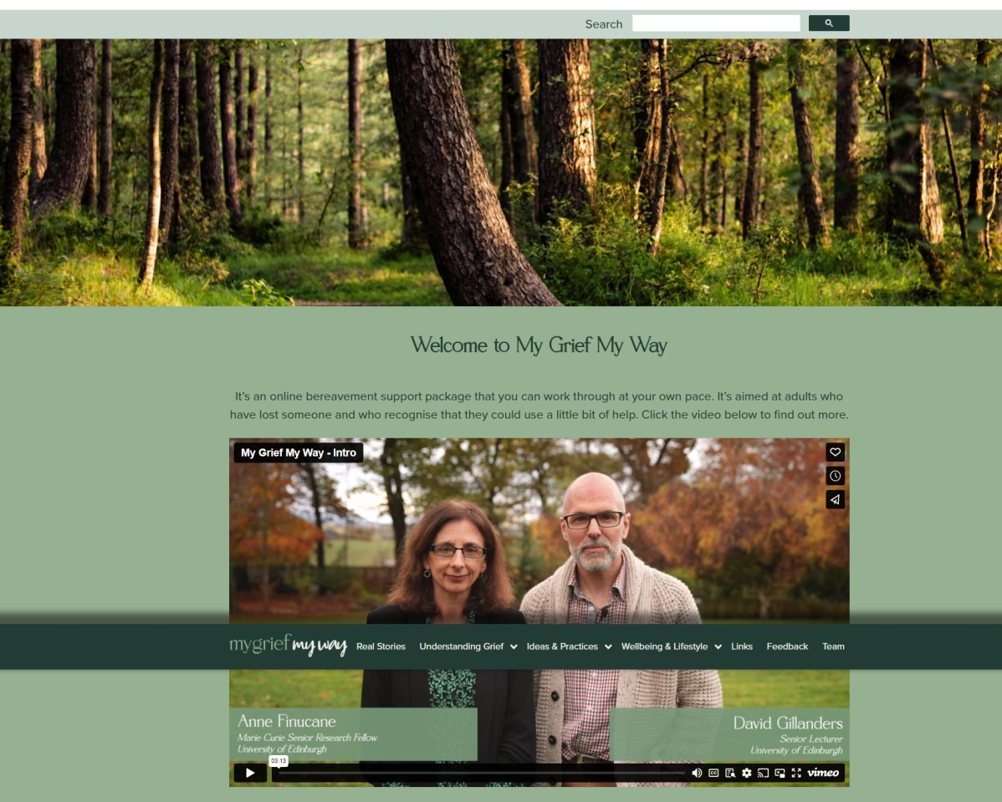
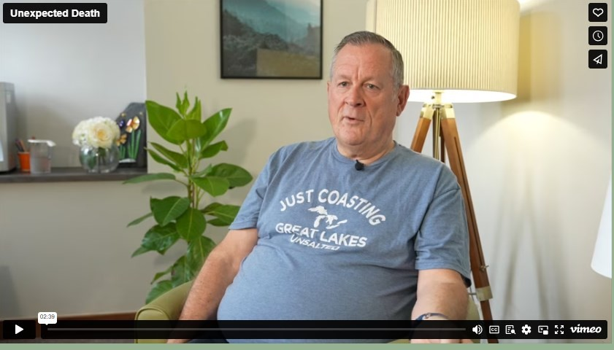
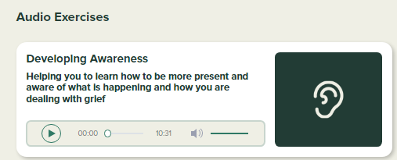

Slide 14
PHASE 3: USER TESTING AND REFINEMENT
Mixed methods evaluation
Interviews with bereaved people – experience of using the site
Focus groups with bereavement support volunteers – experience of training and of supporting others
Feasibility data
Online questionnaire – pre and post intervention: Standardised measures

Slide 15
QUANTITATIVE FINDINGS
Small n (only 27 participants total, 20 provided both pre and post measures)
Baseline analysis – no difference between those who completed post questionnaires and those that did not
Time between pre and post – mode = 49 days (7 weeks) (Range 41 – 111 days)

Slide 16
QUANTITATIVE FINDINGS
Measure | Pre Mean (/D) | Post Mean (/D) | _{t} (df=19) | p | d | Effect
Warwick Edinburgh Wellbeing | 37.8 (5.8 | 43.5 (7.2) | 4.3 | <.001 | .82 | Large
Adult Attitudes to Grief Scale | 20.8 (4.0) | 19.2 (5.1) | 1.6 | .06 | .33 | Small
Coping with grief | -4.5 (8.1) | -1.5 (9.3) | 2.1 | .023 | .67 | Medium
Social Support | 16.3 (4.7) | 17.9 (4.1) | 1.5 | .07 | .83 | Large
Psychological Flexibility | 20.5 (4.9) | 21.9 (4.6) | 1.6 | .07 | .64 | Medium

Slide 17
QUALITATIVE FINDINGS - PARTICIPANTS
Acceptability
Website
Engagement
Content
“Yes, I think it's very user friendly and I think it's easy to access and I think it quite clearly lays out you know, where you can find everything.”
Accessibility
Real stories
Volunteer Support
“I'm an amateur at going on to computers and doing things and if
I could do it, anybody could do it.”
Language / Aesthetic
Video
Client Benefit
Supportive
Ideas and
Practices
Timing
Flexible
Variety
Ongoing use
Technical Aspects
Suggestions

Slide 18
QUALITATIVE FINDINGS - PARTICIPANTS
Acceptability
Website
Engagement
Content
“Yes, I think it's very user friendly and I think it's easy to access and I think it quite clearly lays out you know, where you can find everything.”
Accessibility
Real stories
Volunteer Support
“I'm an amateur at going on to computers and doing things and if
I could do it, anybody could do it.”
Language / Aesthetic
Video
Client Benefit
Supportive
Ideas and
Practices
Timing
“I guess I felt there was people caring for you. So, it did give you
that you were caring and that you weren't alone. It was there
whenever you wanted it.”
Flexible
Variety
Ongoing use
Technical Aspects
Suggestions

Slide 19
QUALITATIVE FINDINGS - PARTICIPANTS
Acceptability
Website
Engagement
Content
Accessibility
Real stories
Volunteer Support
Language / Aesthetic
Video
Client Benefit
Supportive
Ideas and
Practices
Timing
Flexible
Variety
Ongoing use
“But to do it in my own time, in my own space in my own home, that worked really well for me. It’s a valuable tool.” (CR16)
Technical Aspects
Suggestions
The University of Edinburgh is a charitable body, registered in Scotland, with registration number SC005336
www.ed.ac.uk

Slide 20
QUALITATIVE FINDINGS - PARTICIPANTS
Acceptability
Website
Engagement
Content
“It's hearing other people, real people's stories it makes you think
ohh, wow I'm not alone you know.”
Accessibility
Real stories
Volunteer Support
Language / Aesthetic
Videos
Client Benefit
Supportive
Ideas and
Practices
Timing
Flexible
Variety
Ongoing use
Technical Aspects
Suggestions

Slide 21
QUALITATIVE FINDINGS - PARTICIPANTS
Acceptability
Website
Engagement
Content
“It's hearing other people, real people's stories it makes you think
ohh, wow I'm not alone you know.”
Accessibility
Real stories
Volunteer Support
“I like that you don’t have different people there. Because I get used to it. I think if I there were a lot of different people speaking in those little videos, I wouldn’t want that. I want to be familiar with somebody.”
Language / Aesthetic
Videos
Client Benefit
Supportive
Ideas and
Practices
Timing
Flexible
Variety
Ongoing use
Technical Aspects
Suggestions
The University of Edinburgh is a charitable body, registered in Scotland, with registration number SC005336
www.ed.ac.uk

Slide 22
QUALITATIVE FINDINGS - PARTICIPANTS
Acceptability
Website
Engagement
Content
Accessibility
Real stories
Volunteer Support
“I like that you don’t have different people there. Because I get used to it. I think if I there were a lot of different people speaking in those little videos, I wouldn’t want that. I want to be familiar with somebody.”
Language / Aesthetic
Videos
Client Benefit
Supportive
Ideas and
Practices
Timing
“I did like doing the practices. I like a pen in my hand and
writing things down.”
Flexible
Variety
Ongoing use
“Oh, it’s definitely the meditation. Definitely that it’s okay to stop and to have time that’s yours and to just ground yourself. That was wonderful.”
Technical Aspects
Suggestions
The University of Edinburgh is a charitable body, registered in Scotland, with registration number SC005336
www.ed.ac.uk

Slide 23
QUALITATIVE FINDINGS - PARTICIPANTS
Acceptability
Website
Engagement
Content
“She had a lovely way, a lovely voice, sounded very warm, not condescending. She was naturally a warm person. I could tell by speaking to her. Yeah. And she was very caring. And she could hear what I was saying.”
Accessibility
Real stories
Volunteer or
Self Directed
“I didn’t really want to talk much or get involved with other people particularly, and I kind of thought the website would be good.”
Language / Aesthetic
Video
Client Benefit
Supportive
Ideas and Practices
Timing
Flexible
Variety
Ongoing use
Technical
Aspects
Suggestions

Slide 24
QUALITATIVE FINDINGS - PARTICIPANTS
Acceptability
Website
Engagement
Content
“She had a lovely way, a lovely voice, sounded very warm, not condescending. She was naturally a warm person. I could tell by speaking to her. Yeah. And she was very caring. And she could hear what I was saying.”
Accessibility
Real stories
Volunteer or
Self Directed
“I didn’t really want to talk much or get involved with other people particularly, and I kind of thought the website would be good.”
Language / Aesthetic
Video
Client Benefit
Supportive
Ideas and Practices
Timing
“From 6-7 weeks ago until now… what an improvement and I think that My Grief, My Way has played a big part in that, you know.”
Flexible
Variety
Ongoing use
“Yeah, I realise how strong I am. And how honest I am with myself. Being open with myself about my feelings and, you know, being aware of the impact of what I'm feeling and how it has an impact on me.”
Technical
Aspects
Suggestions

Slide 25
QUALITATIVE FINDINGS - PARTICIPANTS
Acceptability
Website Content
Engagement
“So yes, initially it was, am I ready for this? Can my emotions cope with this? Then I dipped in, listened to the stories, realising that this is ok, this situation. This could help me. And then I went back in and engaged with the exercises.”
Accessibility
Real stories
Volunteer or
Self Directed
“I was very interested in the study and thought I’d be able to do it, but things just happened. Life just got in the way and I was so stressed. I wasn’t in a good place but I feel more able to have
another go.”
Language / Aesthetic
Video
Client Benefit
Supportive
Ideas and Practices
Timing
Flexible
Variety
Ongoing use
Technical
Aspects
Suggestions

Slide 26
QUALITATIVE FINDINGS - PARTICIPANTS
Acceptability
Website
Engagement
Content
“I obviously talk to my family and they all knew I was going on site to do this My Grief My Way. And they’re very supportive. ‘Oh, go ahead mum, that’ll be good’. And I told them all what a good experience it is and I have enjoyed it. It’s certainly
something that I’ll keep up with.”
Accessibility
Real stories
Volunteer or
Self Directed
Language / Aesthetic
Video
Client Benefit
Supportive
Ideas and Practices
Timing
“The thing is, I'm looking at this (MGMW) not only for bereavement and grieving, but for life in general... Ohh yes, I was gonna ask you that. Do you like lock me out or can I keep it?”
Flexible
Variety
Ongoing use
Technical
Aspects
Suggestions

Slide 27
Next steps for My Grief My Way
Pathways to adoption
Impact grant funding
Sustainability plans (e.g. Licensing, training)
Signposting or integration
Further research and evaluation
Larger samples
Effectiveness versus control
Adapt and evaluate with other populations
Prioritise uncertainties

Slide 28
Dr Anne Finucane
Marie Curie Senior Research Fellow, University of Edinburgh
a.finucane@ed.ac.uk
@annefinucane.bsky.social
Dr David Gillanders
Senior Lecturer in Clinical Psychology, University of Edinburgh
David.gillanders@ed.ac.uk @davidgillanders.bsky.social
Dr Anne Canny
Research Fellow, University of Edinburgh
anne.canny@ed.ac.uk

