Slide 1
The 'Truth' About Suicide
Dr Rachel Gibbons
Consultant Psychiatrist, Psychoanalyst, Group Analyst | Chair of the Royal College of Psychiatrists Working Group on the Effect of Suicide and
Homicide on Clinicians | Vice-Chair Psychotherapy Faculty | Co Chair of the Patient Safety Group

Slide 2
There is only one philosophical question… and that is suicide
Albert Camus

Slide 3
The only way out is through

Slide 4
To help a truly suicidal person you have to approach them with an open heart…
Chaplain of Beachy Head

Slide 5
Truths
About Suicide

Slide 6
1.
Suicide is not an accident
Suicide is not an accident
It is a result of complex universal unconscious mental mechanisms that we do not understand
It can be highly determined

Slide 7
2.
You will never know why someone has died by suicide

Slide 8
Impulsive vs
3.
premeditated

Slide 9
4.
You do not know what is going
on in someone
else’s mind

Slide 10
5.
Everyone is shocked and surprised by the death

Slide 11
6.
Suicide result from an incapacity to mourn

Slide 12
Pathway to Suicide
1.
2.
3.
4.
5.
Pre-suicidal vulnerability
Trigger loss event
Pre-suicidal state
Trigger event
Suicide act
Gibbons, R., 2024. Understanding the psychodynamics of the pathway to suicide: International Review of Psychiatry, pp.1-9

Slide 13
7.
Suicide is a human
condition not a
mental health condition

Slide 14
8.
Suicide prevention challenging in any individual case but not on a population or conceptual level

Slide 15
9.
Suicide is an acting out event
You act out when you cannot put your emotional experience into words

Slide 16
An act like this is prepared within the silence of the heart, as is a great work of art. The man himself is ignorant of it. One evening he pulls the trigger or jumps
Albert Camus

Slide 17
Facts or Truths about suicide
1. Suicide is not an accident
You will never know why someone died by suicide
It is either impulsive or premeditated
You do not know what is going on in someon elses mind.
Everybody is shocked by the death
Suicide appears to result from an incapacity to mourn
Suicide is a human condition and not a mental health condition
Suicide prevention is a public health issue and talking about it reduces the risk
Suicide is an acting out event
Suicide is not an accident

Slide 18
10.
No one is to blame for someones death by suicide
Blame is a non-mentalizing word
It only allows for one - and the complexity and uncertainty of the situation are not considered.
Responsibility is a mentalizing word

Slide 19
It’s is our belief that we can predict and prevent individual suicide that makes us the architect of our own downfall following the suicide of a patient.
We then take suicide of a patient as our own failure The truly suicidal then pose a risk to us
…and It makes us less likely to approach them with an open heart
Gibbons, R., 2023. Eight ‘truths’ about suicide. BJPsych Bulletin, pp.1-5

Slide 20
The Impact of Suicide on the Mind of the Bereaved (Including Staff)

Slide 21
The Multiple Impacts of suicide
Shocking annihilatory loss
Uncertainty
Fracturing of fragile construct of life
Projected into by the person who has died- suicide acting out
Destructive nature
Leads to a fragmentation of the mind
Complex bereavement- anger
Delusion generated
Image Jenny Saville

Slide 22
‘the delusion is found applied like a patch over the place where originally a rent had appeared in the ego's relation to the external world’.
Freud: Neurosis and Psychosis
“Black things” Odilon Redon

Slide 23
Pattern of Response
Initially shocked
Within short space of time a delusional narrative is constructed
The bereaved as the protagonist
Obsessional ‘I have made a mistake – I am to blame’
Guilt/shame/humiliation
Important transitional point- sensitive to external response
Gradually more realistic development
Premonition by Henryk Weyssenhoff

Slide 24
Staff Suffer Disenfranchised Grief
There is not enough grief to go round
“I have no right to feel grief because the families grief is so much worse”
“If I ask for any space for my feelings then it will take away, or compete with, the families grief”
Gibbons, R., 2024. Someone is to blame: the impact of suicide on the mind
of the bereaved (including clinicians). BJPsych bulletin, pp.1-5.
Hope George Friderick

Slide 25
The Effect of Suicide on Staff
Profound unacknowledged trauma
External responses (inc: organisational and societal) can amplify or mitigate
The fear of persecution following suicide - lead to an overvalued interpretation of the role as predicting and preventing suicide.
This distorts the meaning of the work
The focus on working with patient to improve the quality of their life can be lost and open hearted engagement is not possible

Slide 26
Our Omnipotent Role
We see our task as doing the impossible
Controlling what cannot be controlled
Predicting and preventing individual suicide - at all costs
Even though there is no evidence that this can be achieved
AT THE COST OF OUR PRIMARY TASK
Atlas holding up the celestial globe Guercino

Slide 27
What Helps
Common Emotional Reactions:
Sadness, Guilt, Anxiety, Shame, Fear, Anger, Paranoia, Feelings of responsibility
Fear of making mistakes or being blamed by others.
Grief reactions, similar to bereavement
Impact on Wellbeing:
Effects can vary,
Questioning clinical skills are common
Looking After Yourself:
Connect with others and Be kind to yourself:
Maintain routine:
Seek professional support:
Use occupational health services, therapy, or confidential peer support.

Slide 28
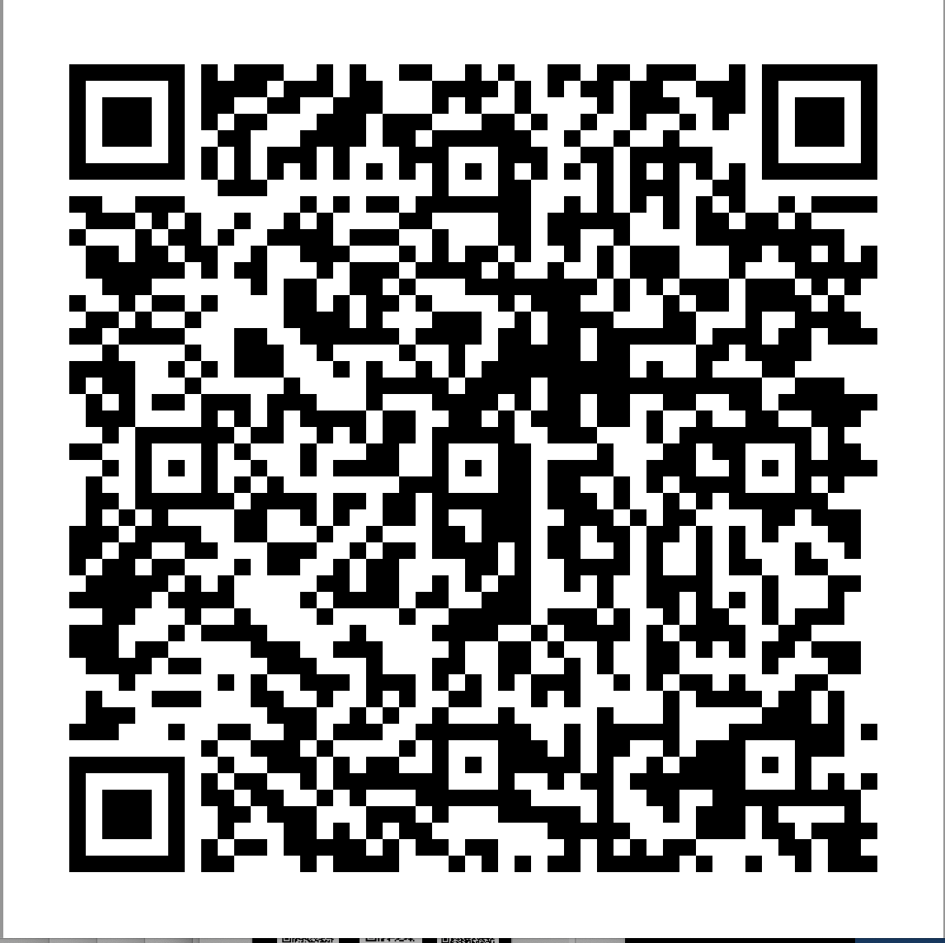

Slide 29
Aims of New Guidance
Recommend evidenced-based and best practice interventions to:
mitigate the impact of a patient death by suicide
improve the sustainability of mental health services increase staff wellbeing, progression with training, resilience and retention.
assist mental health and training organisations in their legal obligation of duty of care for their employees
Increase awareness of the impact that a death of a patient by suicide can have on professionals and to:
encourage transparent and open dialogue about the impact on staff of working with suicide risk and death.
facilitate expansion of suicide prevention and awareness training to include preparation for the emotional effects and the processes that follow the death of a patient by suicide.
Help support cultural transformation:
from one where individual clinicians may feel isolated and personally held responsible following a death, to a systemic understanding about the uncertainty and complex aetiology of suicide and its consequences on staff.
Improve the quality of patient care: by helping staff feel less anxious working with suicidality and in this way maintain their capacity to think clearly and provide safe, high-quality, care.
Increase the possibility of truly learning from these tragic events. To learn takes time, space for reflection and freedom from persecution.

Slide 30
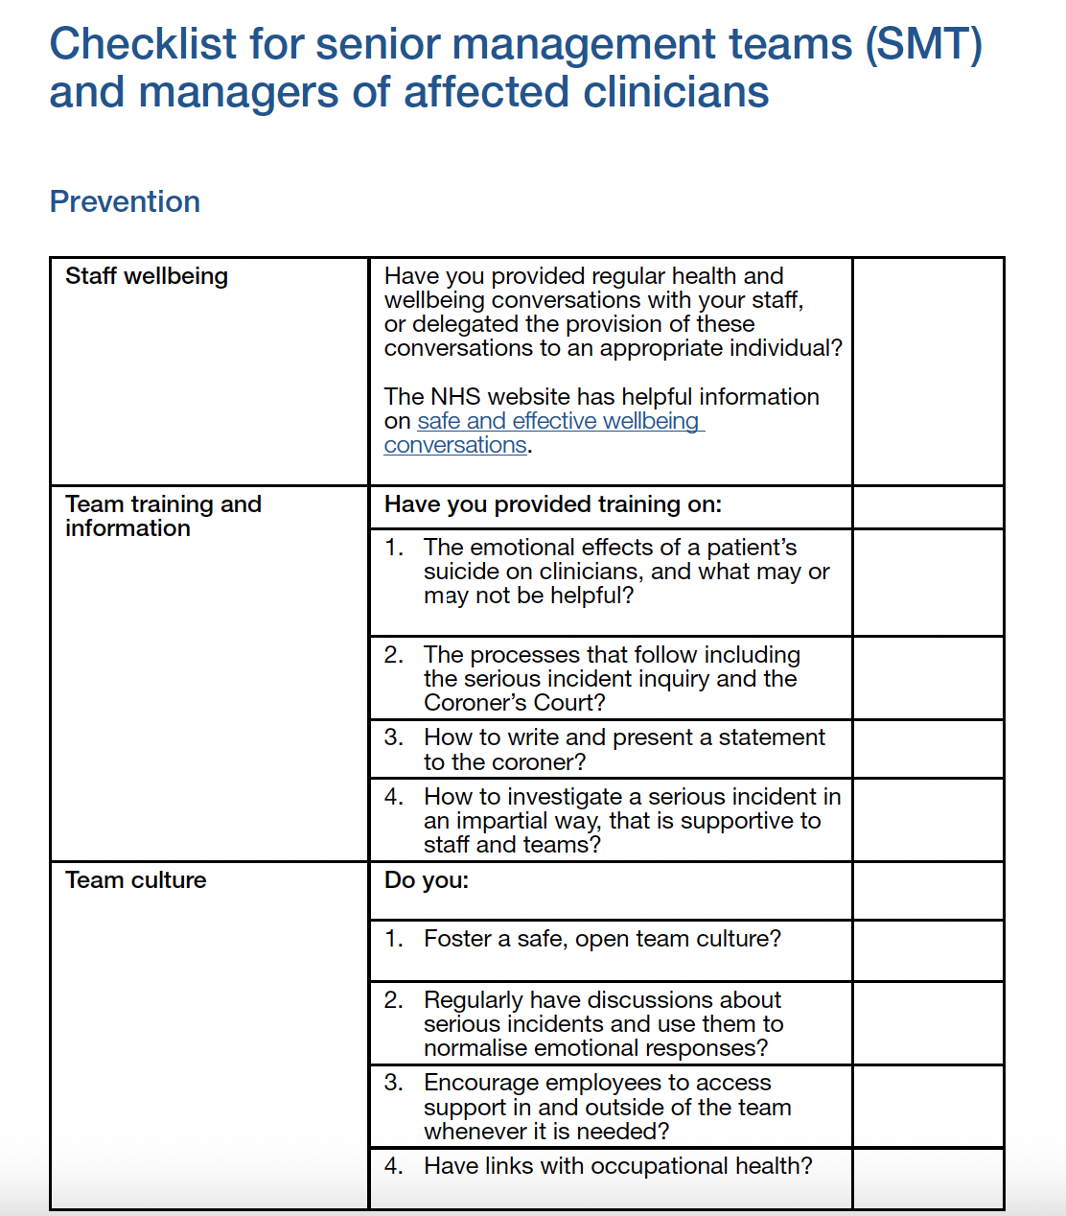
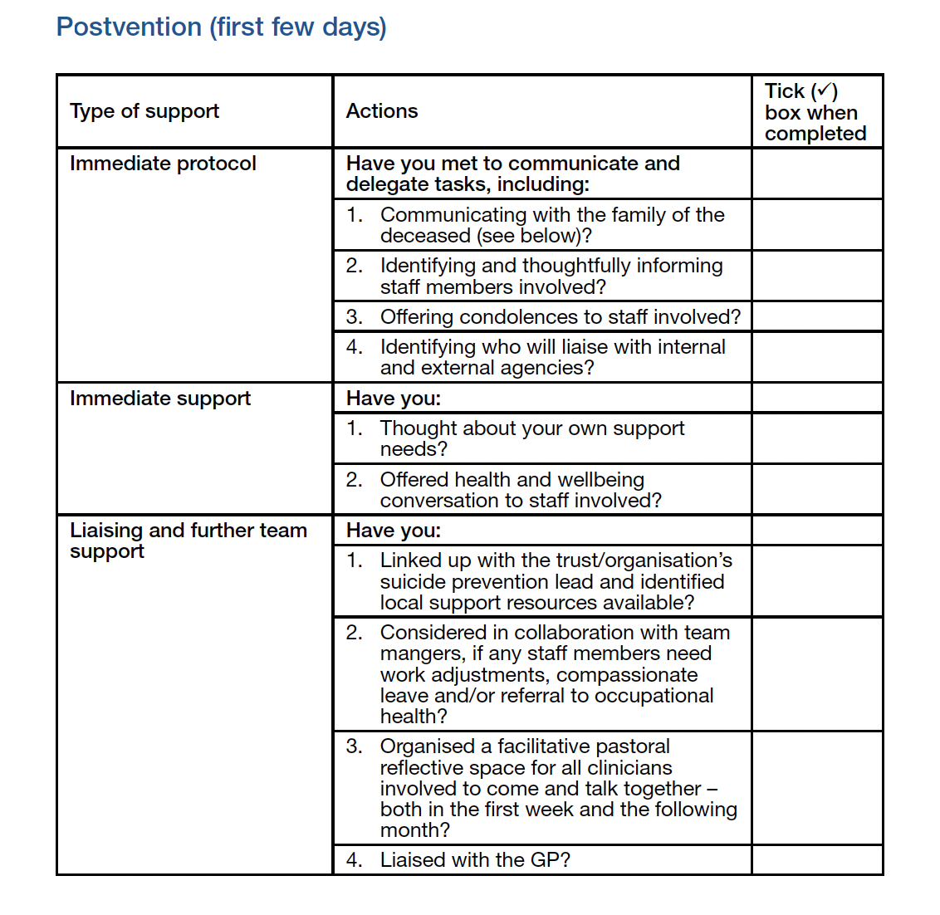

Slide 31
UK Recommendations
Organisational pastoral suicide lead role
2. Pastoral senior management support
3. Support for the processes following the death
4. Buddy systems and other individual support
5. Group psychological support including a organisational suicide group
6. Family liaison officer (FLO), service or similar
7. Training on the effect of patient suicide on clinicians and on the processes that follow
8. Resource availability
Modigliani

Slide 32
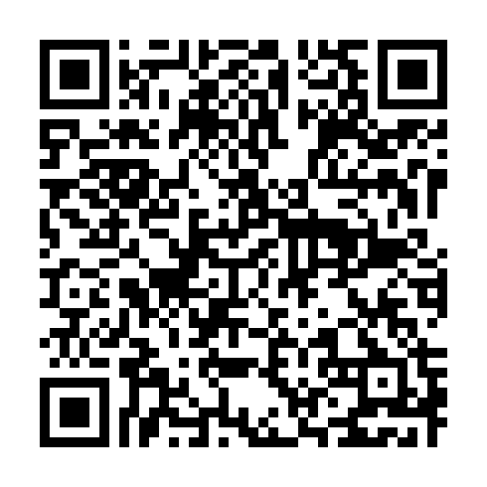
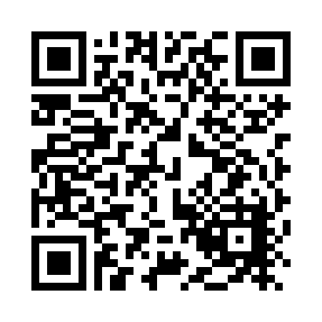
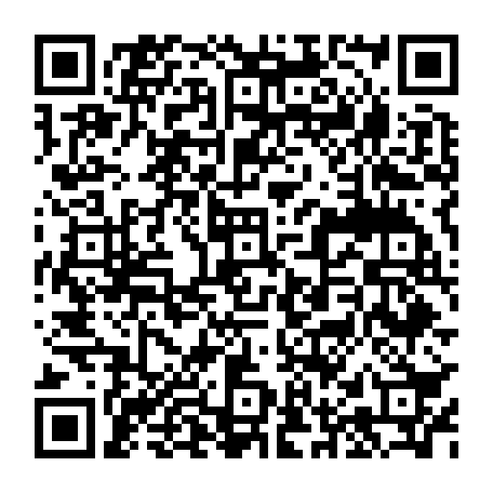
Gibbons, R., 2023. Eight ‘truths’ about suicide. BJPsych Bulletin, pp.1-5.
Gibbons, R., 2024. Someone is to blame: the impact of suicide on the mind of the bereaved (including clinicians). BJPsych bulletin, pp.1-5.
Gibbons, R., 2024. Understanding the psychodynamics of the pathway to suicide: International Review of Psychiatry, pp.1-9.
The ‘Truth’ about Suicide
The Pathway to Suicide
Someone is to Blame

