Slide 1


International Bereavement Education Conference
Bereavement in the modern world: Kindness in the chaos
MS Teams Tuesday 3 December 2024
Notes:
Title slide 1

Slide 2

DEATH IN PARADISE
- a particularly tragic event
George Fernie, Senior Medical Reviewer,
LLB MB ChB MPhil LLD (hc) FFFLM FRCGP FRCP (Edin) FRCP DFM
george.fernie2@nhs.scot
Notes:
Title slide 2

Slide 3








Centre for Contemporary
Coronial Law

Slide 4
Introduction
Arrangements for death certification and registration in Scotland changed in 2015
One of the main changes was the establishment of the Death Certification Review Service which is part of Healthcare Improvement Scotland. The review service checks on the accuracy of a sample of Medical Certificates of Cause of Death (MCCDs). An MCCD is the form a doctor completes when someone has died.
The aims of the Death Certification Review Service are to improve:
the quality and accuracy of MCCDs
public health information about causes of death in Scotland, and
clinical governance in relation to death certification.

Slide 5
Sankey diagram of number of cases and breakdown of case type and outcome in 2023/24

Slide 7
Secondary Function
Arrangements for authorisation of death or burial in repatriation cases in Scotland changed in 2015
Prior to that time, Scottish Government had responsibility for cremation only.
The Health and Social Care Directorates required attendance at SAH with original documentation prior to authorising disposal.
Abolition of cremation fees.
Remote submission of documents [post pandemic] .
Streamlining of process via eCMS.

Slide 8
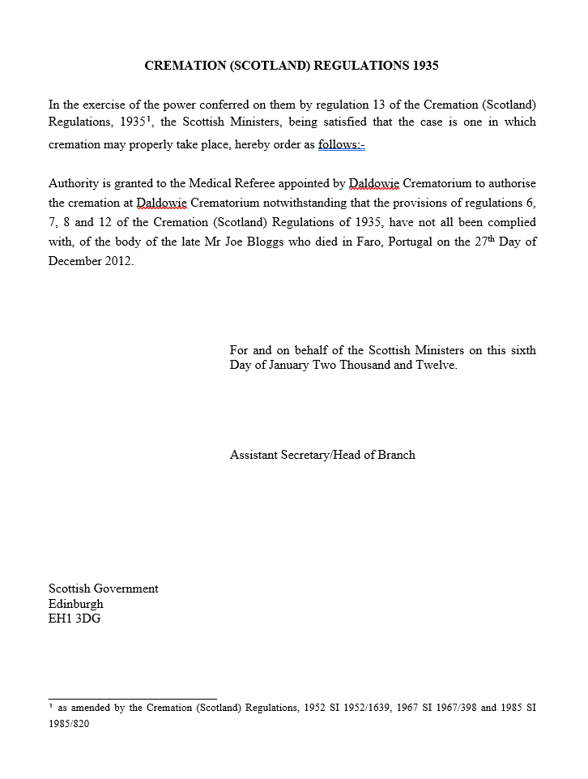

Slide 9
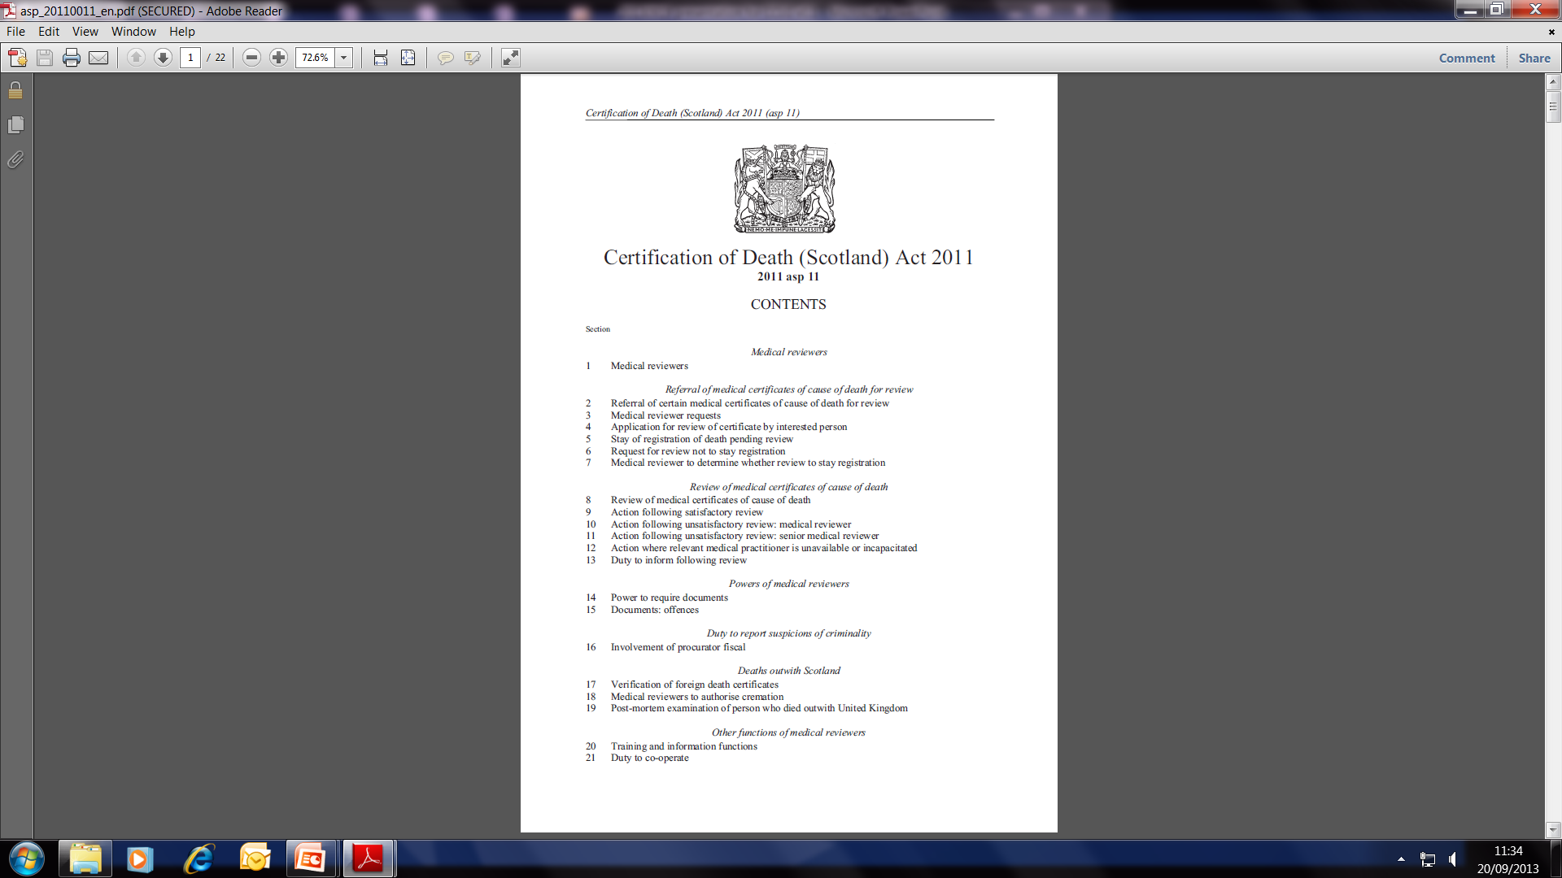

Slide 10
Referral of medical certificates of cause of death for review
4 Application for review of certificate by interested person
6 Request for review not to stay registration
10 Action following unsatisfactory review: medical reviewer
11 Action following unsatisfactory review: senior medical reviewer
Powers of medical reviewers
14 Power to require documents
15 Documents: offences
Duty to report suspicions of criminality
16 Involvement of procurator fiscal
Deaths outwith Scotland
17 Verification of foreign death certificates
18 Medical reviewers to authorise cremation
19 Post-mortem examination of person who died outwith United Kingdom
Other functions of medical reviewers
20 Training and information functions
21 Duty to co-operate

Slide 11
3.3 Cross-Border Transfers
Background
3.3.1 Whilst uncommon, it is not unusual in the UK that a death is registered in one country but the cremation or burial takes place in another country. It is difficult to determine precise numbers of cases, although it is likely to be in the low hundreds every year, where an individual will die in Scotland and be moved, after death, to another part of the UK, or vice versa, for the funeral.
3.3.2 Different legal systems operate across the UK and Scotland has a completely separate death certification and scrutiny process, registration, reporting to Crown Office Procurator Fiscal Service and disposal than currently operates in England and Wales, or in Northern Ireland. There is however a general principle across the administrations that each country will respect the policy and processes adopted by other countries.

Slide 12
3.4 Guidance on Repatriation of Deaths Abroad and Requests for Post Mortem
Repatriation of Deaths Abroad
3.4.1 s17 of the 2011 Act gives medical reviewers the power to check documentation related to deaths abroad where remains are being returned to Scotland for burial or cremation.
3.4.2 s25 of the 2011 Act makes it an offence for persons having charge of a cemetery or crematorium to dispose of a body without the required documentation; in cases where the death occurred outside the UK, the document required for disposal will be a certificate issued by a medical reviewer.

Slide 13
3.4 Guidance on Repatriation of Deaths Abroad and Requests for Post Mortem
Repatriation of Deaths Abroad
3.4.3 Anyone wishing to arrange the burial or cremation of a body in such a case must apply to the medical reviewer. A medical reviewer must, on the request of a relevant person such as the next of kin or funeral director, determine whether the documentation relating to an individual’s death is in order.
3.4.4 Medical reviewers will check whether the relevant documents are authentic and equivalent to the documentation which would be required to dispose of the body of a person who died in Scotland and, if so, will issue the aforementioned certificate.

Slide 14
Cross-Border Transfer into Scotland
3.3.4 Where a death is registered in another part of the UK and the deceased is then moved to Scotland for the funeral (including the associated burial or cremation),
that death would already have gone through the requisite review processes that exist in that country, and further review in Scotland will not be required.

Slide 15

Update: Cross-Border Repatriation to Scotland – 2024 Amendment Regulations
October 15, 2024 by funeral-industry-news |
Category Uncategorized
The issue
Although the requirement for deaths to be registered before burial or cremation in Scotland has been in place since 2015, the recent regulatory changes in England and Wales have brought to light that there has been some confusion over whether certificates issued by coroners can be accepted in place of certificates of registration of death.
What’s Changing
We advised we would review the 2015 Regulations to consider whether coroner authorisation should be accepted in Scotland to enable burial or cremation here where the death is subject to an ongoing coronial investigation in another part of the UK and where no certificate of registration of death is yet available.
We can now confirm that an amendment in these terms to the 2015 Regulations has been laid in the Scottish Parliament today, 15 October 2024, and will come into effect tomorrow, 16 October 2024.
The Registration of Births, Deaths and Marriages (Scotland) Act 1965 (Prohibition on Disposal of a Body without Authorisation) Amendment Regulations 2024

Slide 16
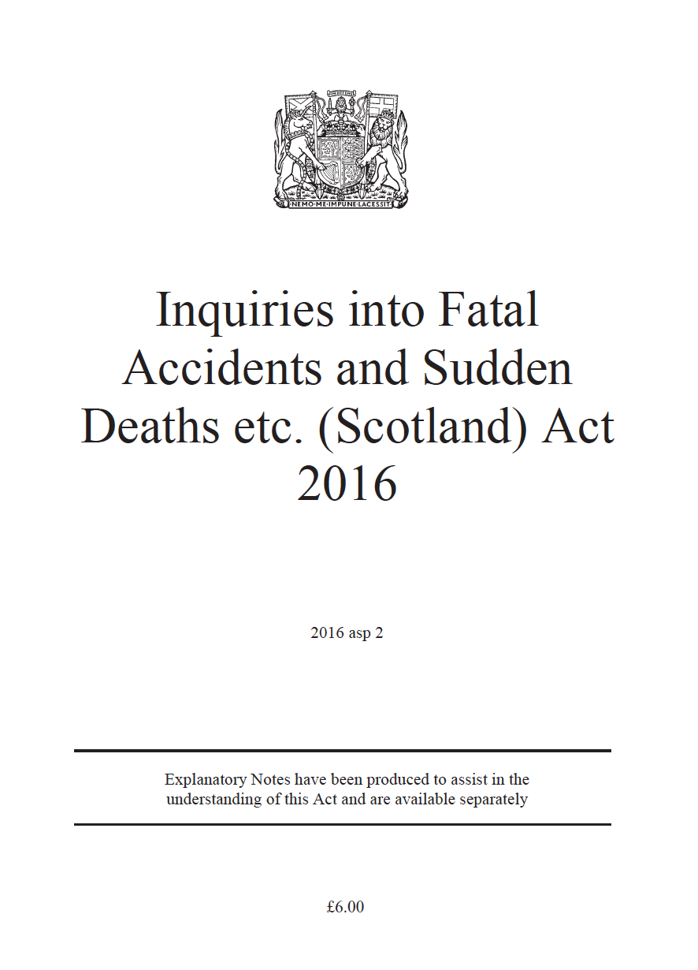

Slide 17
6 Inquiries into deaths occurring abroad: general
(1) Subsection (3) applies to the death of a person if—
  (a) the death occurred outwith the United Kingdom, and
  (b) at the time of death, the person was ordinarily resident in Scotland.
(2) But that subsection does not apply to the death of a person within section 12(2) or (3) of the Coroners and Justice Act 2009 (investigation in Scotland of deaths of service personnel abroad).
(3) An inquiry is to be held into a death to which this subsection applies if the Lord Advocate—
  (a) considers that the death—
    (i) was sudden, suspicious or unexplained, or
    (ii) occurred in circumstances giving rise to serious public concern,
  (b) considers that the circumstances of the death have not been sufficiently
  established in the course of an investigation in relation to the death,
  (c) considers that there is a real prospect that those circumstances would be sufficiently established in an inquiry, and
  (d) decides that it is in the public interest for an inquiry to be held into the
  circumstances of the death.

Slide 18
Deaths outwith Scotland (repatriations)
The service is responsible for approving burial or cremation in Scotland, of people who have died abroad and are to be repatriated to Scotland.
In 2023/24, the service received 178 repatriation requests, of which,
▪ 121 (70%) were male, 57 (30%) were female
▪ 113 (63.5%) were individuals aged 60 years or older
▪ 59 people (33.1%) died in Spain
Two postmortem applications were approved.
Age | No of deaths |  | Repatriated from | No of deaths
0 - 19 | 3 |  | Spain | 59
20 – 39 | 13 |  | Cyprus | 17
40 – 59 | 49 |  | USA/Canada | 11
60 – 79 | 95 |  | Greece | 7
80+ | 18 |  | Italy | 7
 |  |  | Portugal | 7
Burial | Cremation
51 | 117

Slide 19
Deaths outwith Scotland (repatriations)
The service is responsible for approving burial or cremation in Scotland, of people who have died abroad and are to be repatriated to Scotland.
In 2022/23, the service received 191 repatriation requests, of which,
130 (68.1%) were males, 61 females
120 (62.8%) were individuals 60 years or older
A number of cases were reported to the PF -
Year (1/1 – 31/12) | Total reported to PF | PF - No Action taken | PF - Accepted
2021 | 12 | 9 | 3
2022 | 50 | 45 | 5
2023 | 20 | 15 | 5

Slide 20
19 Post-mortem examination of person who died outwith United Kingdom
(1) This section applies where—
(a) a person (“A”) dies outwith the United Kingdom,
(b) the body of A is to be disposed of in Scotland, and
(c) no cause of death is available.
(2) A medical reviewer may, on an application by a relevant person—
(a) assist the relevant person in making arrangements for a post-mortem examination of A’s body for the purpose mentioned in section 23(a) of the Human Tissue (Scotland) Act 2006 (asp 4), and
(b) meet the cost of such an examination.

Slide 21
Conclusion
Unified system of authorisation whether burial or cremation
Bereaved-centred focus
Respect for arrangements within other home nations
Revision of legislation to accommodate change
Extension of the role of COPFS to include other jurisdictions
Possibility of autopsy or second post mortem where no cause of death available
Free at the point of delivery
eCMS with better data
Linkage to National Hub [for child deaths]
MOU for deaths abroad

Slide 22
Keep in touch
www.healthcareimprovementscotland.org/deathcertification his.dcrs@nhs.scot
0300 123 1898
Healthcare Improvement Scotland
Death Certification Review Service
Delta House | 50 West Nile Street | Glasgow G1 2NP

