Slide 1
A right delayed is a right denied; proposal for right to palliative care in Scotland
3rd December 2024
NES Bereavement Conference

Slide 2
Current landscape of dying, death, and bereavement in Scotland
Existing evidence
In Scotland:
90% of people who die would benefit from palliative care
In context; 63,445 people died in 2023-24. Over 57,000 would have benefited from palliative support
317,225 people experienced bereavement in Scotland in 2023-24
1 in 6 people die in end-of-life poverty; equating to:
1 in 4 working age people
1 in 6 pensioners (an increase from 1 in 8 in 2019)
1 in 5 people die in fuel poverty at the end of life,
the majority of whom live in social housing (46% across
the UK)

Slide 3
What will dying, death, and bereavement look like in future?
More people will be dying at home
By 2040:
Up to 10,000 more people will need palliative support
Two thirds of all deaths will take place in people’s own homes, as well as care homes, and hospices
Multi-morbidities will have increased by over 80%
Over 85s will account for 45% of all deaths

Slide 4
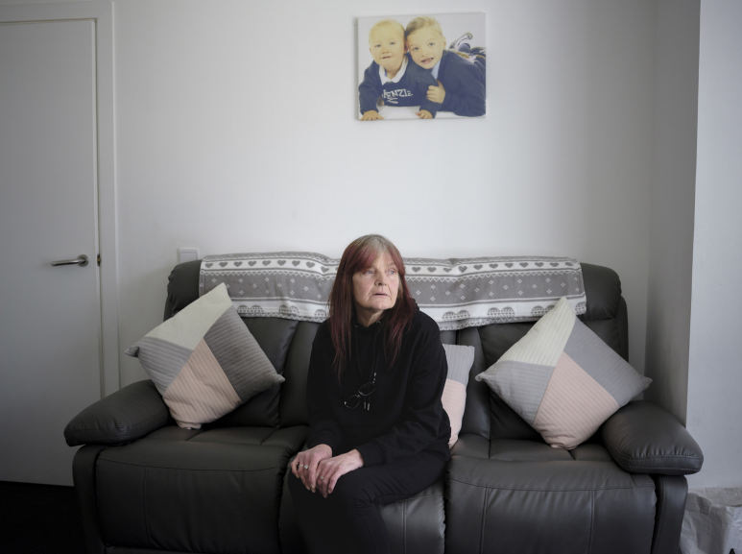
Donna, 56
“I don’t think I could be hurt any more than I have been hurt.”
“I was thinking the other day, maybe if they actually sat down and told me how ... about my liver and then my pancreas and all that, they’ve not really explained how my illness will go on, if you know what I mean? I would like somebody to sit down.”
©Margaret Mitchell for Dying in the Margins

Slide 5
What key issues have been identified to date?
More open conversations about dying, death, and bereavement
Rehumanising bereavement after Covid
Coordination and leadership of bereavement support
Bereavement support is intrinsic to everyone’s human rights
Agile services and approach

Slide 6
Why a right to palliative care?
Unmet need
Inequity and inequality
Trauma
Integration and partnership working
What opportunities and/or challenges would a right to palliative care bring to addressing unmet bereavement needs?
If, and how, should bereavement be defined as part of a right to palliative care?
What funding infrastructure is required to deliver bereavement support as part of a right to palliative care?
Who should be responsible and accountable for the delivery, implementation, and measurement of a right to palliative care?

Slide 7
Find out more about our work on Right to Palliative Care
1) Sign our petition: Marie Curie Campaigns
2) Share in your networks and on social media.
More information about a right to palliative care: Support the right to palliative care in Scotland (mariecurie.org.uk)

