Slide 1
Supporting difficult conversations around bereavement and grief and the importance of self- care
Jade Finlayson
Donna Hastings

Slide 2
Family Support Team at St Columba’s Hospice Care
Counselling
Bereavement Support
Bereavement Groups
Walking Groups
Social Work Support – future care planning/finances/housing/carer support/will’s/power of attorney
Spiritual Care
Support for parents/carers to explain the illness to children using age/development appropriate resources
Keepsake work which can include letters, little box thoughts, BignSmall, Keepsake boxes, Record Me Now, Photo Books about the story of the person’s life
Information and support for school – including staff awareness sessions on Childhood grief and Loss
Individual support for children and young people pre and post bereavement
Groups
Family Days

Slide 3
Holistic Care for Patients and Families
Our multi professional team
Family support team – child and family practitioners, Social workers, chaplain
Medical team
Rehab and Wellbeing Team – AHP’s and Complementary Therapists
Nursing
Community

Slide 4
Wider Impacts on Bereavement
Complexities in Families
Whose own grief/bereavement experiences
Individual grief responses and supporting this within a family
Trauma informed approach
Hospice environment and connection with own mortality
Whose role is Bereavement?
(breaking news, follow up call (where relevant), conversation, future support, information)

Slide 5
What Families say they need
Meeting patient and families needs – person centred approach
Information (not too much)
Timely appropriate support (MDT and Judgements)
Consistency, Continuity and communication across the teams (who needs to be involved)
Practical, Emotional, psychological, spiritual support when they need it
Signposting if required (reducing barriers to support)
Language, terms we use

Slide 6
Language, Terms and Euphonism's
Lost
Gone
Passed away
They wouldn’t want you to be sad/upset
Slipped away peacefully
Be Strong
Times a healer
I know how you feel
They put up a good fight
They are in a better place
Lost their battle
Gone to sleep
They are with God/Angels/star in the sky
AT LEAST!.......
They are out of pain now

Slide 7
Supporting difficult conversations with Patients and Families
Who’s role?
Saying the wrong thing – language/upset
Opening a can of worms
Making thing’s worse
Not saying anything
Trying to fix
Filling silence
Holding the Space
Tissues

Slide 8
What you might say
Offer specific practical support/information
Acknowledge the death/bereavement
I don’t know what to say but I am so sorry to hear this news.
Asking “do you want to talk?”
Arrange to call at a time that suits them
just letting someone speak is useful in itself
Ask what words/terms they would like you to use
Try not to rush in and share your own experiences straight away

Slide 9
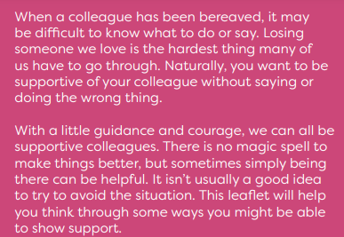
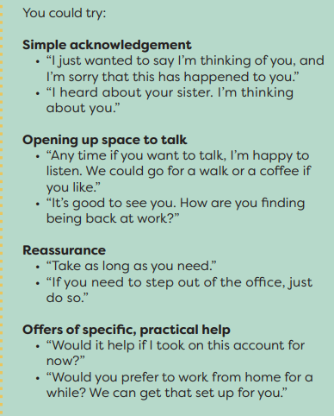
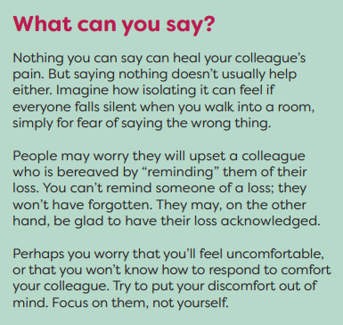
Supporting Colleagues with Bereavement
Being a supportive colleague | Good Life, Good Death, Good Grief

Slide 10
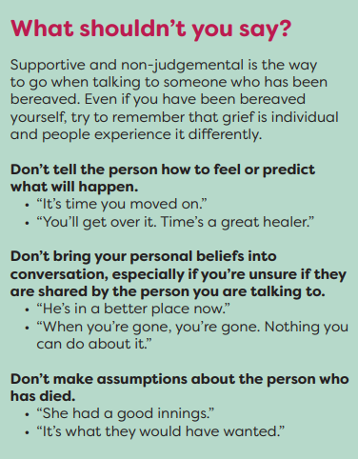
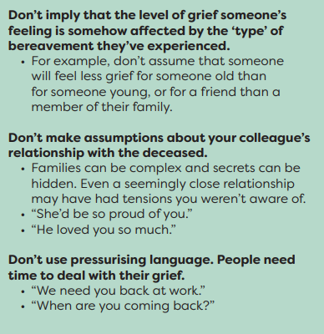
Points to consider
Being a supportive colleague | Good Life, Good Death, Good Grief

Slide 11
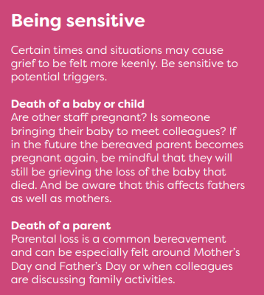
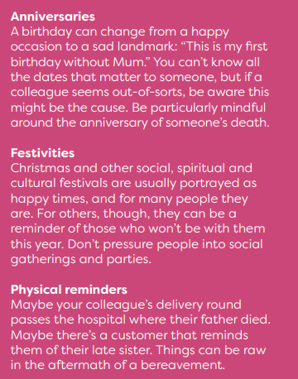
Points to consider
Being a supportive colleague | Good Life, Good Death, Good Grief

Slide 12
Self Care in the workplace
RBCS (Resilience Based Clinical Supervision
Huddles (including an opportunity for remembering patients)
Supervision
1:1’s
HR
Staff Wellbeing ~(including counselling, resources)
Chaplain (spiritual care)
Team Meetings

Slide 13
