Slide 1

Bereavement Education Programme
10 year anniversary event
Thursday 18th September 2025
Chairs: Dr Graham Whyte & Dr Ken Donaldson, Associate Postgraduate Deans, Grief & Bereavement, NES
We are sensitive that the themes being discussed today may be upsetting for some people. Please attend in the way in which you are comfortable to be present.

Slide 2
Opening comments
Professor Emma Watson
Executive Medical Director, NES

Slide 3
A review of achievements over the last 10 years
Dr Clare Tucker
Senior Educator, NES

Slide 4
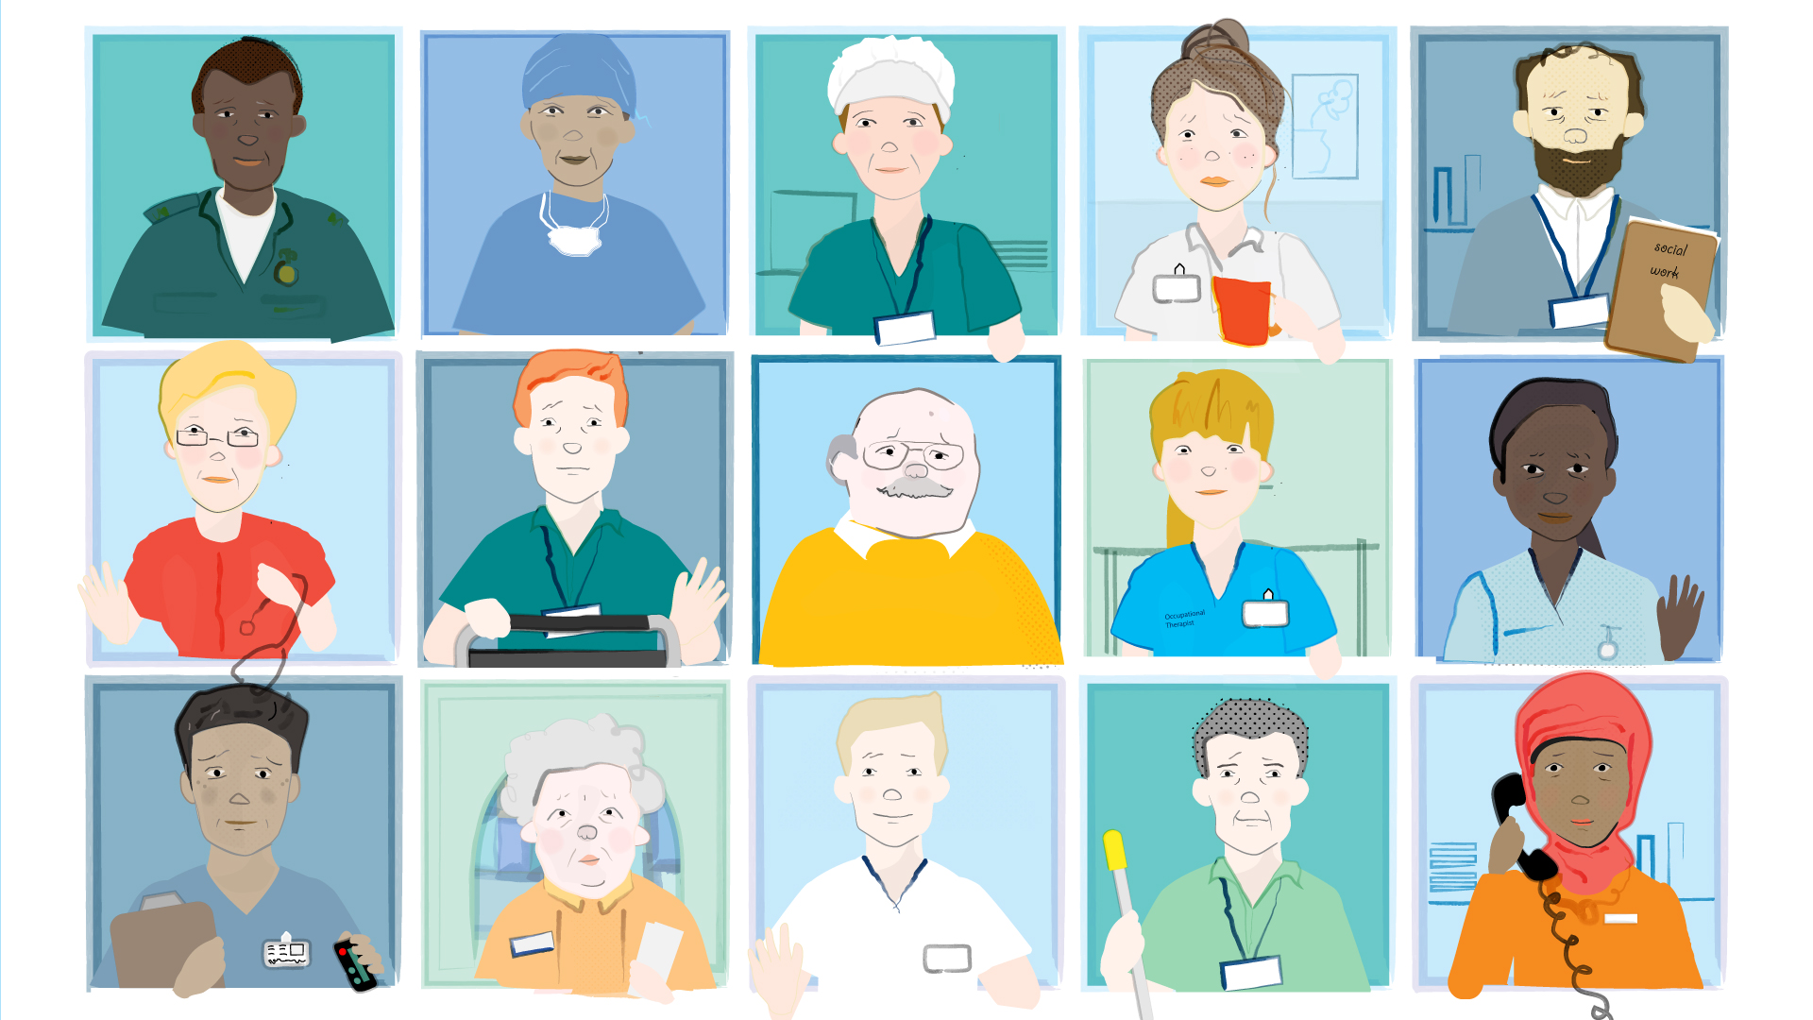
Aim
To equip health and social care staff with increased preparedness to undertake high-quality bereavement-related care & communication (whilst also considering their wellbeing), through a broad programme of interprofessional educational and workforce development initiatives.
Who is it for?
Primarily health & social care staff, but also reach across other public sector groups
Recent expansion and diversification to develop national resources for the public

Slide 5

Scoping & building an evidence base
Bereavement care & communication with those who are grieving is core business for staff across health and social care
If poorly handled, there can be the risk of causing additional harm, with negative impact on staff wellbeing
Training focusing purely on expected deaths not equipping professionals for range of death scenarios
Literature suggested there is a low prevalence of bereavement training with a corresponding high need for it

Slide 6
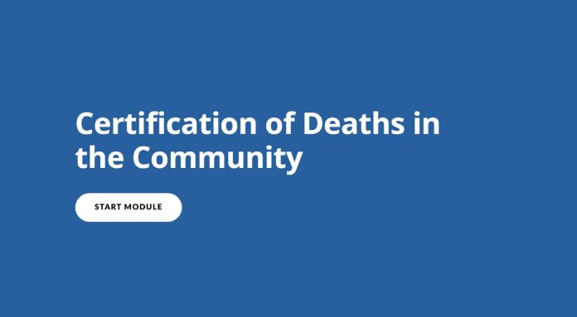
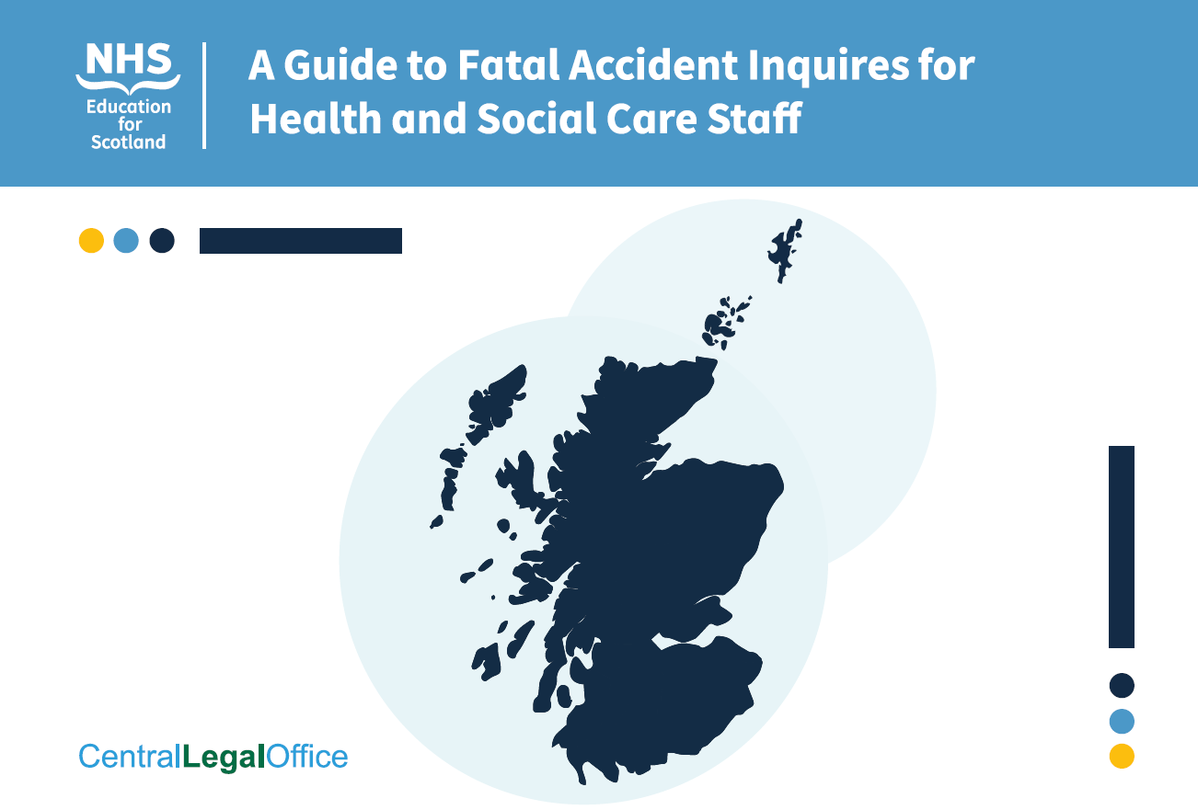
Death Certification & Fatal Accident Inquiry
Collaborative working with Death Certification Review Service (Healthcare Improvement Scotland), National Records of Scotland and SG
Range educational materials developed e.g. e-Learning modules on common errors and managing deaths in the community
Guide to FAI for health and social care staff, in conjunction with Central Legal Office

Slide 7
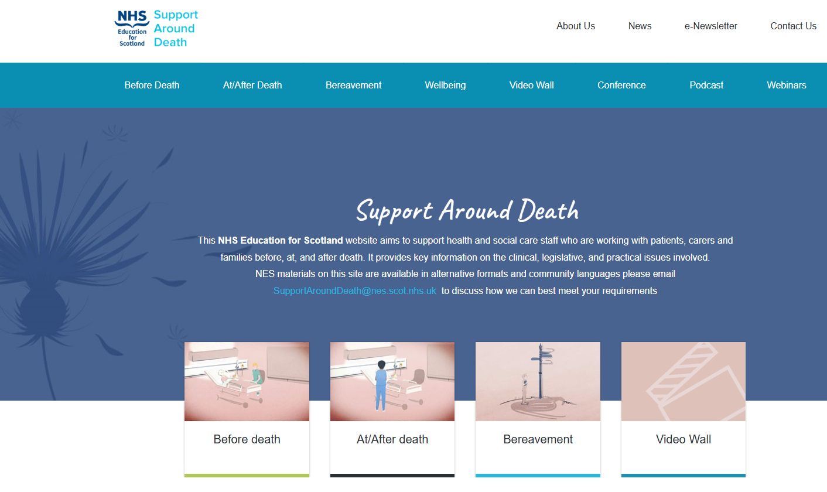
Development of SAD website
Practical, clinical & legislative info
Care around time of death & bereavement

Slide 8
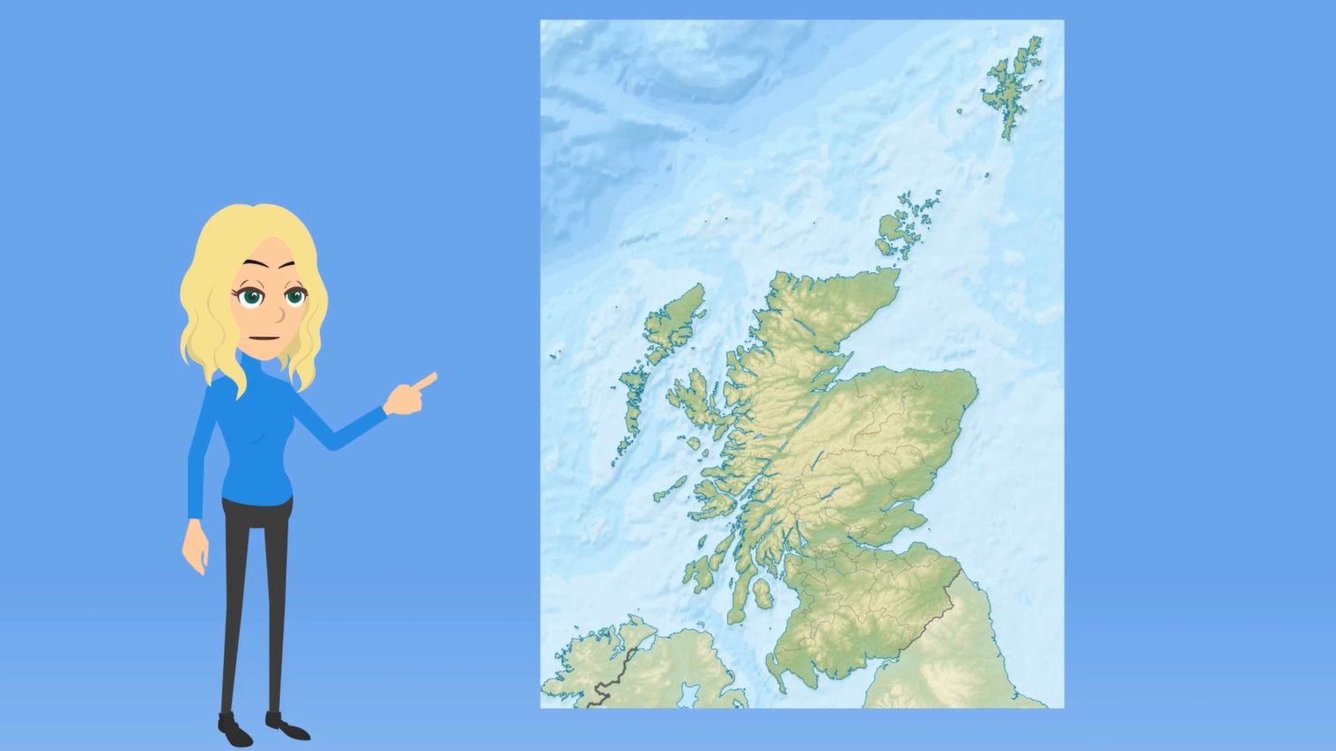
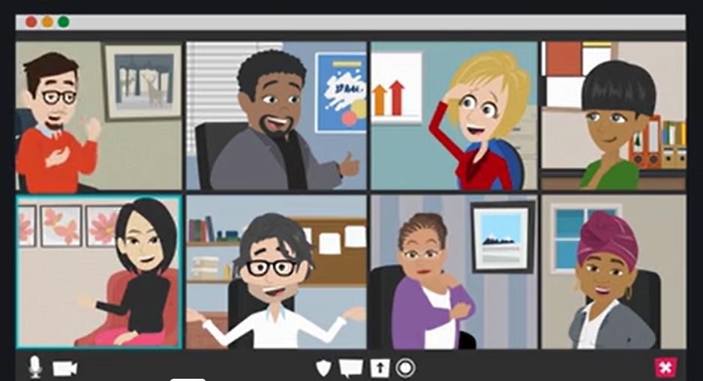

Supporting NHS Boards
Bereavement Strategic Lead & Coordinator Network
Support via hosting quarterly meetings, disseminating information, providing opportunity for peer support
Through involvement with the Network, it is hoped that members will:
  Share and promote good practice and innovation - local, regional, and national levels
  Learn about topical issues that can inform and influence local, regional and national practice
  Provide expert input and feedback to develop and influence policy, strategy, and educational resources
  Practice peer support and networking
  Hear about opportunities to volunteer as an ambassador for bereavement work within NHSScotland
  Advocate on behalf of patients, families, carers and staff
Find out more in this short animation: https://vimeo.com/951062024

Slide 9
Animated film development
Bite-sized learning
Rapid introduction to key principles
Addressing gaps in existing resource provision & topics often not addressed
Over 100k views
Quick to view, including on a mobile device

Slide 10
Educational resources
Broadening range over time
e-Learning modules
Written resources, handouts & leaflets
Web content – SAD website & Turas Learn
Interview-based films
Actor-based case study films

Slide 11
Examples of topics covered
Anticipatory grief
Discussing dying
Supporting LGBT+ people around bereavement
Talking to children who are bereaved
Being with people who are bereaved
Delivering news of a death by phone
Death certification (Scotland)
Gender-based violence
Withdrawal of active treatment in ITU
Unsuccessful neonatal resuscitation
Ripples of grief
Supporting families around resuscitation
Coping with death and bereavement
Death of a colleague
Intrauterine death
Fatal accident inquiries (Scotland)
Body donation (Scotland)
Bereavement in remote & rural communities

Slide 12
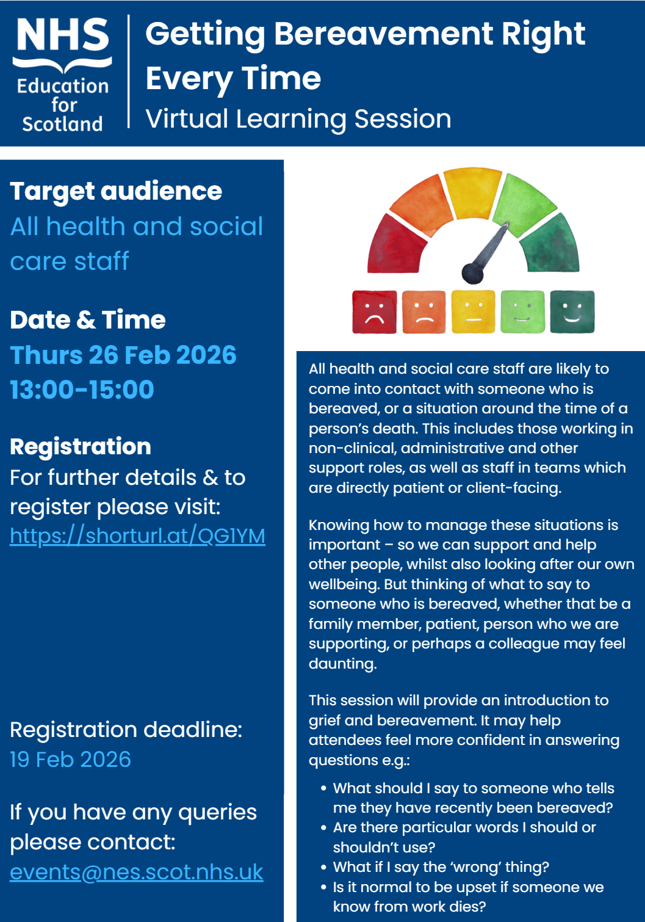
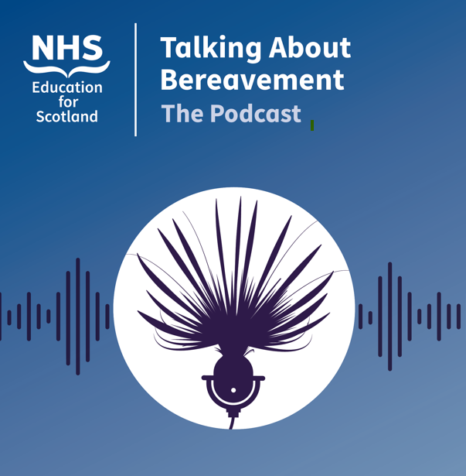
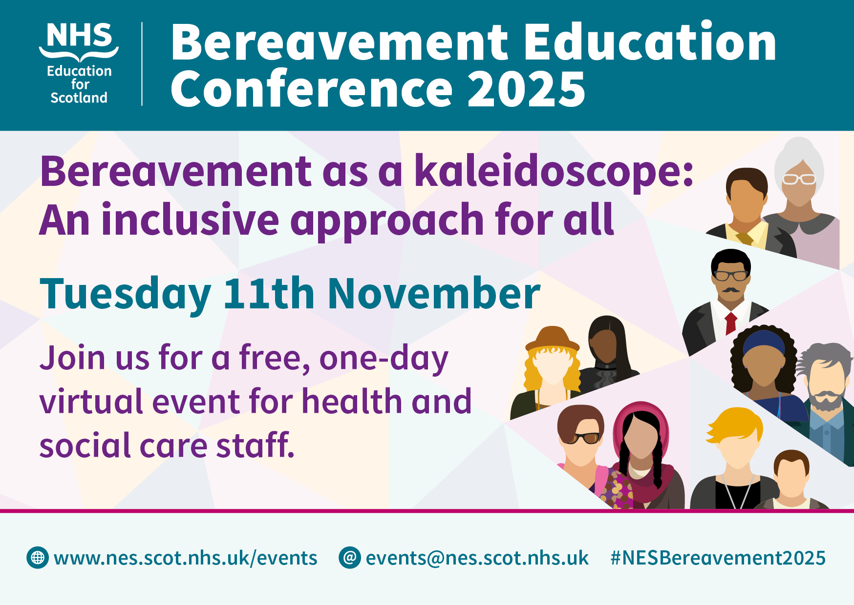
Learning Events
Annual conference
Podcast
Webinar programme
Delivery of training

Slide 13
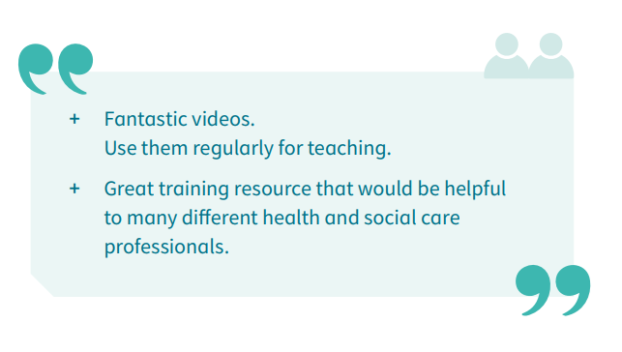
Recognition, Reach & Impact
National, UK and international interest – raising profile of bereavement education
E.g. recognition as a unique programme of work, request to use materials, and invitations to present to groups and networks
Multiple conference presentations / workshops (inc. internationally)
Influencing curricula
Supporting development of a more positive culture toward bereavement and those who are grieving (trauma-informed, person-centred, compassionate)
Focus on minority and potentially marginalised communities

Slide 14
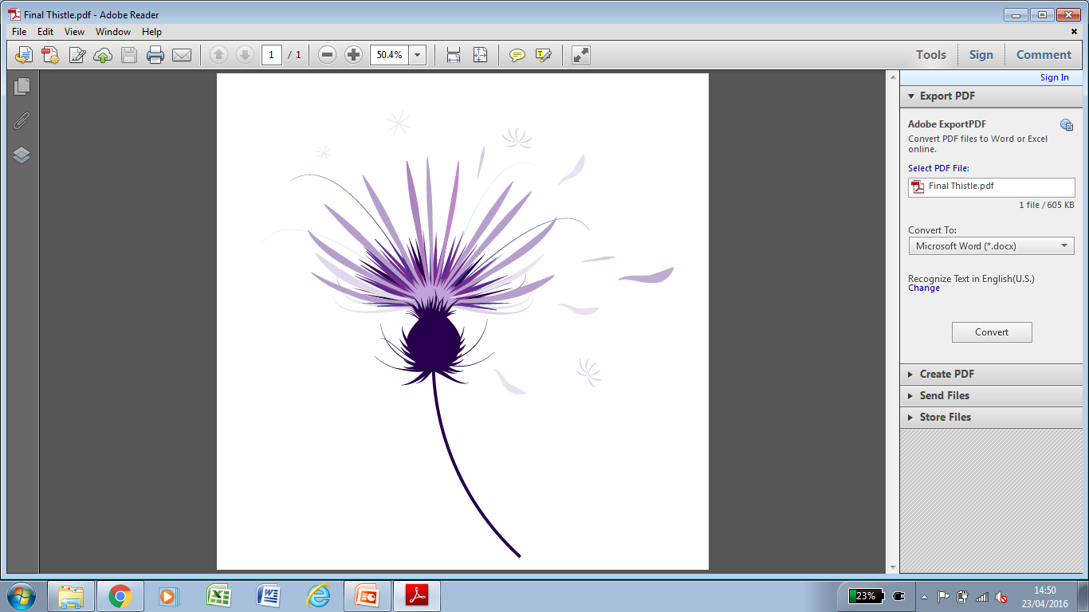

Involvement in other projects
Development of thistle image for SG ‘When Someone Has Died Leaflet’ – become a nationally recognised symbol, used in different ways, e.g.
  Bereavement Charter logo
  Symbol on health and social care materials (e.g. belongings bags / signage)
Contributing educational component to wider bereavement agenda in Scotland e.g. Bereavement Charter for Children and Adults in Scotland

Slide 15
Discussing dying animation
Discussing dying on Vimeo

Slide 16
Perspectives from stakeholders
Dr George Fernie
Senior Medical Reviewer, Death Certification Review Service, Healthcare Improvement Scotland

Slide 17
Perspectives from stakeholders
Dr Donald Macaskill
CEO, Scottish Care
https://vimeo.com/1120095815

Slide 18
Perspectives from stakeholders
Paul Graham
Head of Spiritual Care and Wellbeing,
NHS Lanarkshire
https://vimeo.com/1120096674

Slide 19
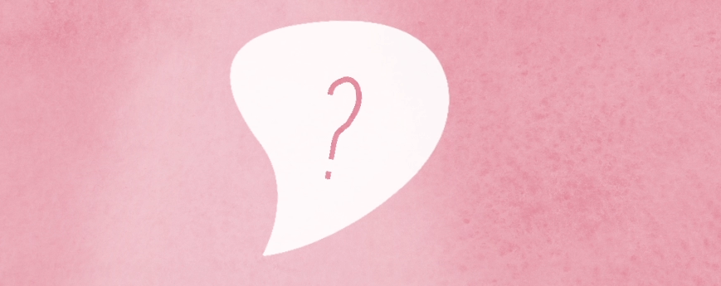
Quiz!
Test your knowledge of the NES Bereavement Education Programme

Slide 20
Anticipatory grief animation
Anticipatory Grief

Slide 21
Perspectives from stakeholders
Mark Evans
Head of Service for Spiritual Care and Bereavement Services, NHS Lothian / Professional Advisor Spiritual Care, Scottish Government
https://vimeo.com/1120116178

Slide 22
Perspectives from stakeholders
Dr Natalie Smee
Consultant Neonatologist, NHS Grampian

Slide 23
Looking ahead
Becky McCoo
Project Officer, NES

Slide 24
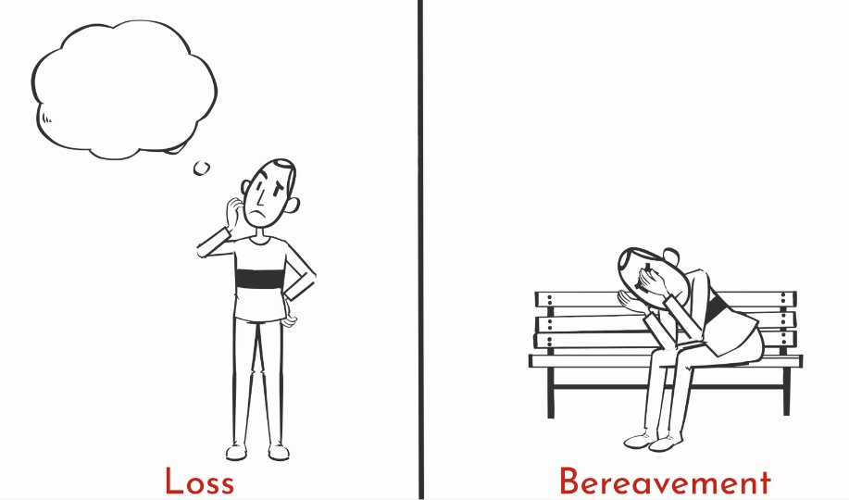
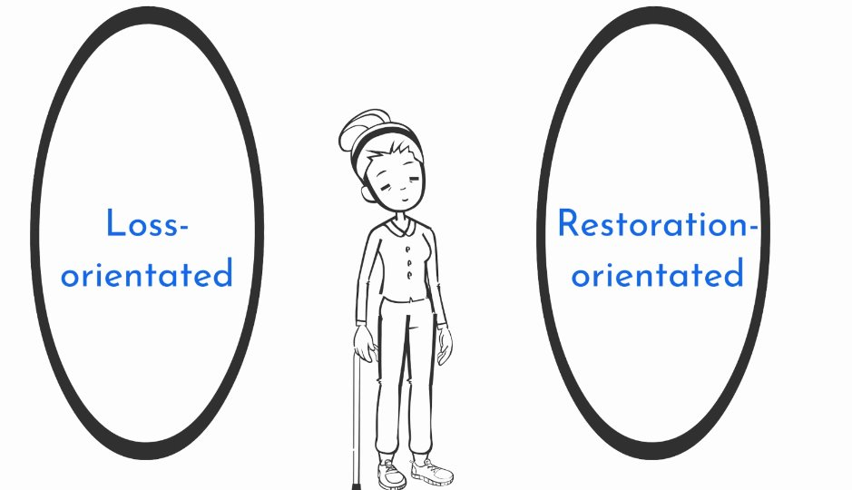
Current work, e.g.
Bereavement ‘basics’ e-Learning modules. 6 new e-Learning modules will be launched:
Exploring Bereavement: Where to Begin
Exploring Bereavement: Theories and Foundations
Exploring Bereavement: Processes and Procedures After a Death
Applying Bereavement Knowledge: Anticipatory Grief
Applying Bereavement Knowledge: Supporting Others
Applying Bereavement Knowledge: Staff Wellbeing
Five animations have been developed to sit within module 2 that explores grief models and theories.
Expect to develop some short bite-sized offerings alongside longer content.
Opportunity to develop additional modules covering broader topics in the future (capacity and funding dependent). E.g. supporting children who are bereaved, bereavement following suicide.

Slide 25
Current work, e.g.
​
Perinatal mortality resource​
The Scottish Government has commissioned us to create educational resources around perinatal mortality.
Two initial scoping meetings held with a variety of stakeholders.
Work is currently underway to identify authors of the e-Learning modules content.

Slide 26
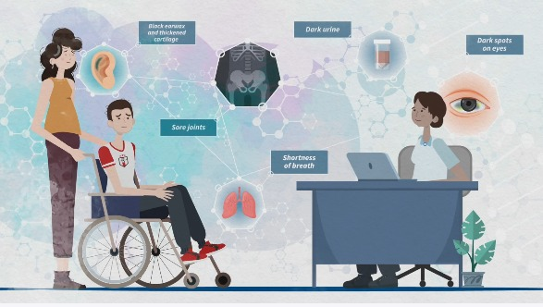
Building on skills developed
Initial broadening of remit from medics to all health and social care staff.
Now again broadening out with the establishment of Educational Projects Advisory Team (EPAT) in recognition of skills of team.
Can apply skills developed outwith the bereavement context.
Broad range of subject experts inputted over 10yrs - continue to build on connections
Examples of recently completed work:
  Neonatal cooling
  Rare conditions

Slide 27
Dr Martina Rodie
Consultant Neonatologist, NHS Greater Glasgow & Clyde

Slide 28
Questions?
Opportunity to share your experiences of the NES Bereavement Education Programme

Slide 29
Keep in touch / find out more
Podcast: ‘Talking about Bereavement’ https://shorturl.at/eYHYA
Website: http://www.sad.scot.nhs.uk/
Quarterly e-Newsletter: http://www.sad.scot.nhs.uk/e-newsletter/
Email: SupportAroundDeath@nes.scot.nhs.uk
Launched today – latest episode: listen to the team reflecting in more detail on the last decade.

