Slide 1


‘Contextualising the Review of the
Medical Certificate of Cause of Death’
Thursday 9 May 2024
Dr C George M Fernie
george.fernie2@nhs.scot
Notes:
Title slide 1

Slide 2
Introduction
Objectives
Contextualise the review of the MCCD
Reviewing the Medical Certificate of Cause of Death – getting it right first time for families
Reminder on the Advance Registration Process
A reflection on the management of adverse events (including fatal accident inquiry and reporting to the Procurator Fiscal)
What the Death Certification Review Service has achieved in the first 9 years

Slide 3
When did Tom Luce take evidence for the report of a fundamental review? Was it –
2000
2002
2005
2007
2010

Slide 4
When did Tom Luce take evidence for the report of a fundamental review? Was it –
2000
2002
2005
2007
2010

Slide 5
What proportion of deaths are randomly scrutinised in the new Scottish system?
4%
7%
12%
28%
34%

Slide 6
What proportion of deaths are randomly scrutinised in the new Scottish system?
4%
7%
12%
28%
34%

Slide 7
How many deaths occur each year in England and Wales? Is it -
5,000
50,000
650,000
1 million
5 million

Slide 8
How many deaths occur each year in England and Wales? Is it -
5,000
50,000
650,000
1 million
5 million

Slide 9
How many deaths were reported to the Coroner -
14,400
20,400
140,000
210,000
340,000

Slide 10
How many deaths were reported to the Coroner -
14,400
20,400
140,000
210,000
340,000

Slide 11
How many Coroners’ Inquests were completed in England & Wales in 2015 -
16,000
26,000
36,000
46,000
56,000

Slide 12
How many Coroners’ Inquests were completed in England & Wales in 2015 -
16,000
26,000
36,000
46,000
56,000

Slide 13
How many Fatal Accident Inquiries were held in Scotland in 2015 -
10-20
20-40
50-70
70-90
100

Slide 14
How many Fatal Accident Inquiries were held in Scotland in 2015 -
10-20
20-40
50-70
70-90
100

Slide 15
Introduction
Arrangements for death certification and registration in Scotland changed in 2015
One of the main changes was the establishment of the Death Certification Review Service which is part of Healthcare Improvement Scotland. The review service checks on the accuracy of a sample of Medical Certificates of Cause of Death (MCCDs). An MCCD is the form a doctor completes when someone has died.
The aims of the Death Certification Review Service are to improve:
the quality and accuracy of MCCDs
public health information about causes of death in Scotland, and
clinical governance in relation to death certification.

Slide 16
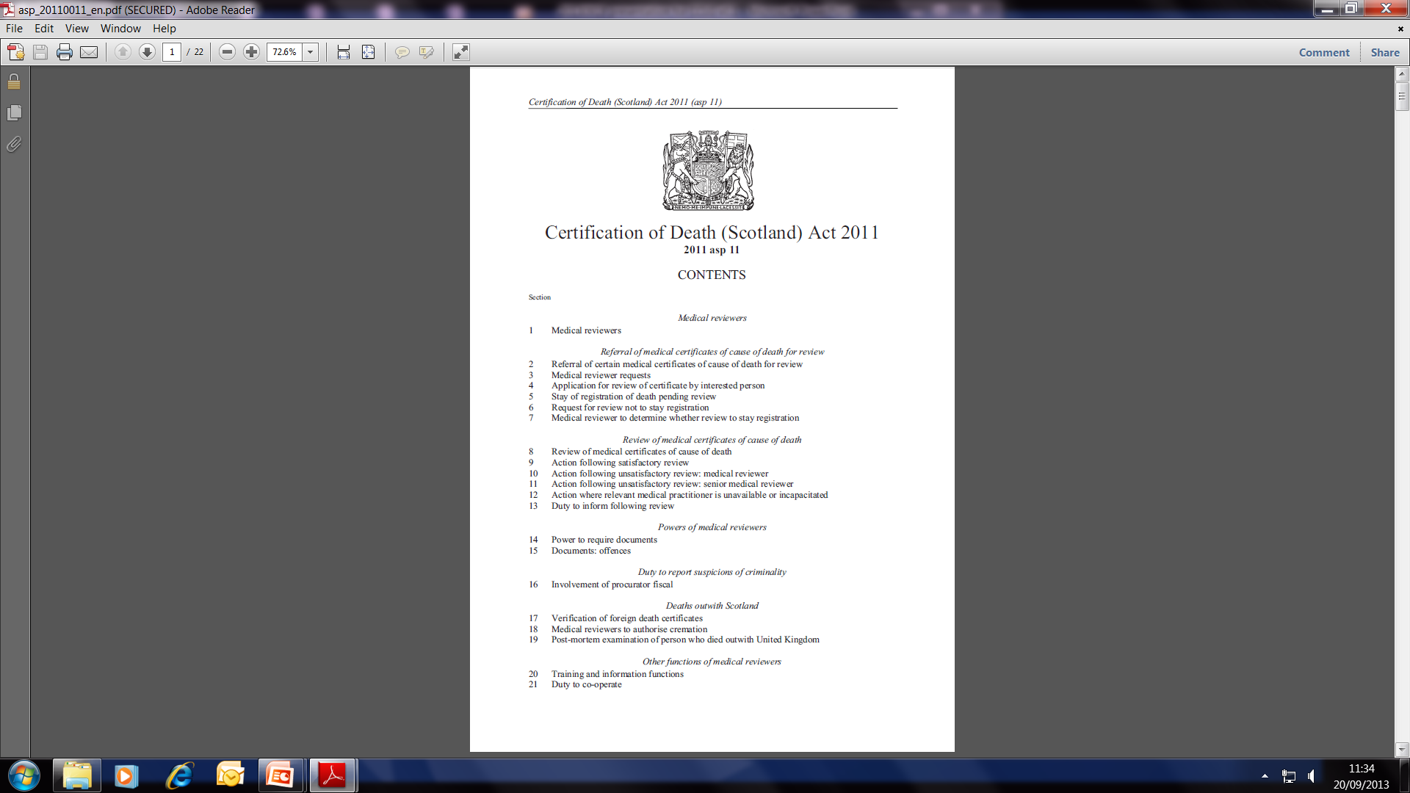

Slide 17
Referral of medical certificates of cause of death for review
4 Application for review of certificate by interested person
6 Request for review not to stay registration
10 Action following unsatisfactory review: medical reviewer
11 Action following unsatisfactory review: senior medical reviewer
Powers of medical reviewers
14 Power to require documents
15 Documents: offences
Duty to report suspicions of criminality
16 Involvement of procurator fiscal
Deaths outwith Scotland
17 Verification of foreign death certificates
18 Medical reviewers to authorise cremation
19 Post-mortem examination of person who died outwith United Kingdom
Other functions of medical reviewers
20 Training and information functions
21 Duty to co-operate

Slide 18
The review
Level 1
Check GMC and CHI
Look up ECS and eKIS
Review the MCCD
Speak to certifying doctor or another member of the team
1 working day to complete
Level 2
Review medical records
  All or part hospital / GP records
  Care home records
Plus level 1 review
3 working days to complete

Slide 19
How many reviews did DCRS undertake in 2022-2023 -
2000
3000
4000
5000
6000

Slide 20
How many reviews did DCRS undertake in 2022-2023 -
2000
3000
4000
5000
6000

Slide 21
Advice line
Title | Advice
Date & Time | 15/04/2019 11:35
Caller Details
Telephone Number | 01506222222
NHS Board | NHS Forth Valley
Method | Telephone
CHI number | 0101341336
Enquiry Description | Would like to discuss cause of death; 85 yr old found in house; nil suspicious. PMH COPD, HTN, Smoker
Category | GP Clinical Advice
Outcome | agreed 1a prob MI Part 2 smoking; HTN; COPD
PF Involvement | Advised does not need to be reported to PF
Advice provided by | Medical Reviewer
Status | Closed

Slide 22
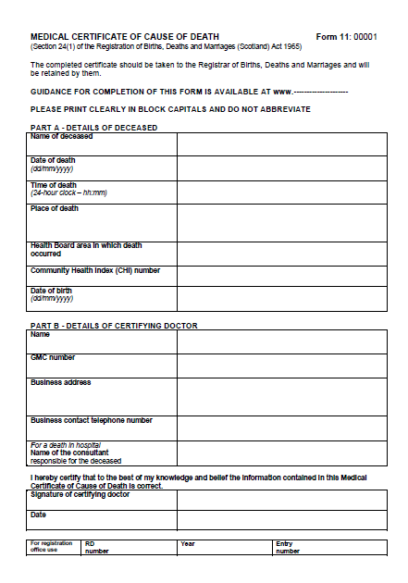
6 August 2014

Slide 23
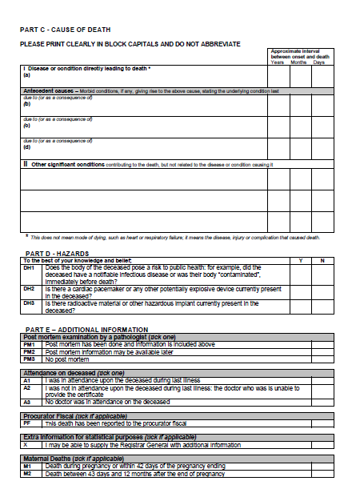

Slide 25
CERTIFICATE OF CAUSE OF DEATH
Any registered medical practitioner who was in attendance on the deceased during his last illness must, within seven days after the death of the person, transmit to a qualified informant or to the district registrar a certificate signed by him stating to the best of his knowledge and belief the cause of death¹
¹ Registration of Births, Deaths and Marriages (Scotland) Act 1965 (c 49), s 24(1)

Slide 26

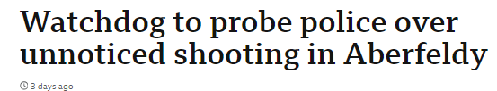
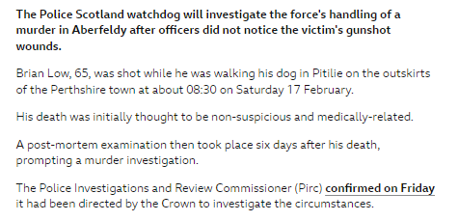
Friday 1 March 2024
https://www.bbc.co.uk/news/uk-scotland-tayside-central-68453836

Slide 27
IN ORDER METRIC
8 Review of medical certificates of cause of death
(3) Following a review under subsection (1) the medical reviewer must come to a view on whether the certificate is in order.
(4) For the purposes of this Act, a certificate is in order where a medical reviewer is satisfied, on the basis of the evidence available to the medical reviewer, that—
(a) the cause (or causes) of death mentioned represents a reasonable conclusion as to the likely cause (or causes) of death, and
(b) the other information contained in the certificate is correct.

Slide 28
ADVANCE REGISTRATION
7 Medical reviewer to determine whether review to stay registration
(3) The medical reviewer may determine under subsection (2)(a) that it is appropriate to register the death before the review (or further review) is completed only where the medical reviewer is satisfied that—
(a) the circumstances of the case justify such registration, and
(b) there are no obvious indications that the medical certificate of cause of death is
not in order

Slide 29
ADVANCE REGISTRATION
If the Medical Certificate of Cause of Death you bring to the registrar is selected for review, but the funeral has to take place within a certain timescale, you can apply for advance registration.
If a request for advance registration is successful, the death can be registered and the funeral can take place before the review is completed.
Applications for advance registration will be considered in special circumstances such as:
religious/cultural (such as faith requirements to bury a person’s body quickly)
compassionate (where delays would cause significant and unnecessary distress), and
practical/administrative (for example, family have travelled from abroad to attend the funeral).
We will assess your request for advance registration, along with the content of the MCCD. We will usually be able to confirm if the funeral can proceed within two hours of the request being made.
Further information on advance registration can be found in the following information leaflet:
Death Certification Review Service information leaflet (PDF, 400K)

Slide 30
ADVANCE REGISTRATION

Slide 31
How many AR requests did DCRS receive in 2015-2016 -
57
107
207
307
507

Slide 32
How many AR requests did DCRS receive in 2015-2016 -
57
107
207
307
507

Slide 33
How many AR requests did DCRS receive in 2022-2023 -
73
173
273
373
573

Slide 34
How many AR requests did DCRS receive in 2022-2023 -
73
173
273
373
573

Slide 35
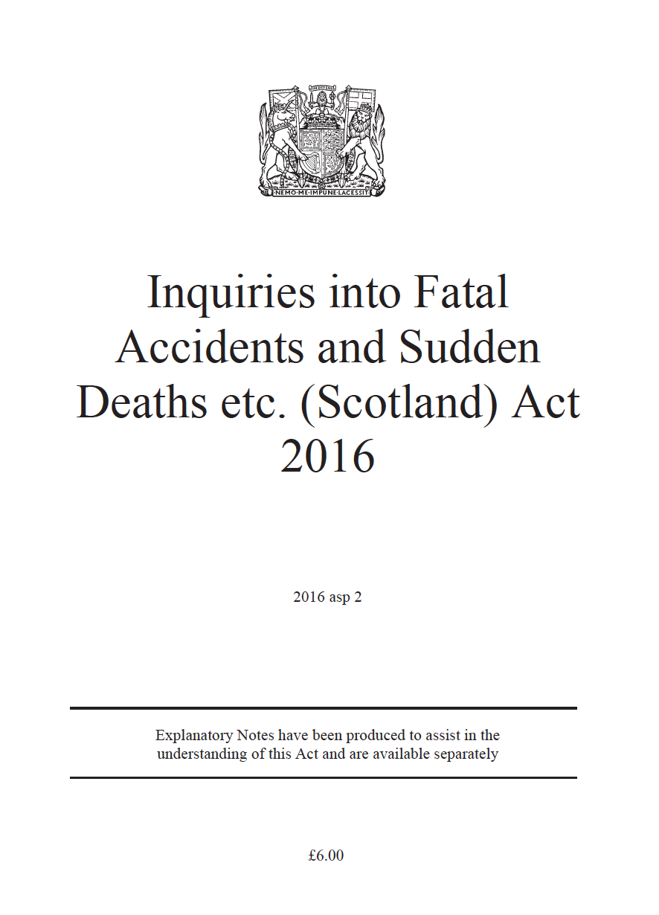

Slide 36
2 Mandatory inquiries
(1) An inquiry is to be held into the death of a person which—
  (a) occurred in Scotland, and
  (b) is within subsection (3) or (4).
(2) Subsection (1) is subject to section 3.
(3) The death of a person is within this subsection if the death was the result of an accident
which occurred—
  (a) in Scotland, and
  (b) while the person was acting in the course of the person’s employment or
  occupation.
(4) The death of a person is within this subsection if, at the time of death, the person was—
  (a) in legal custody, or
  (b) a child required to be kept or detained in secure accommodation.
(5) For the purposes of subsection (4)(a), a person is in legal custody if the person is—
  (a) required to be imprisoned or detained in a penal institution,
  (b) in police custody, within the meaning of section 64 of the Criminal Justice
  (Scotland) Act 2016,
  (c) otherwise held in custody on court premises,
  (d) required to be detained in service custody premises.
(6) For the purposes of subsections (4)(b) and (5)(a) and (d), it does not matter whether the
death occurred in secure accommodation, a penal institution or, as the case may be,
service custody premises.

Slide 37
4 Discretionary inquiries
An inquiry is to be held into the death of a person which occurred in Scotland if the Lord Advocate—
(a) considers that the death—
(i) was sudden, suspicious or unexplained, or
(ii) occurred in circumstances giving rise to serious public concern, and
(b) decides that it is in the public interest for an inquiry to be held into the circumstances of the death.
(2) Subsection (1) does not apply to a death within section 2(3) or (4).

Slide 38
REPORTING YEAR | NUMBER OF CONCLUDED FAIS | MANDATORY FAIS | DISCRETIONARY FAIS | FAI FOR MULTIPLE DECEASED WHERE BOTH MANDATORY AND DISCRETONARY
2019/20 | 57 | 55 | 1 | 1
2020/21 | 58 | 55 | 3 | 0
2021/22 | 42 | 38 | 4 | 0
2022/23 | 51 | 41 | 10 | 0

Slide 39
Reports to the Procurator Fiscal
Sudden, suspicious, accidental and unexplained deaths including deaths which may give rise to public anxiety, are required to be reported to the Procurator Fiscal.
Our medical review team found 228 (3.9%) of all certificates reviewed by the service during the past year should actually have been reported to the Procurator Fiscal.
The most common reasons for failing to report to Procurator Fiscal were for fracture or trauma (42%) and Industrial disease (34%) where they caused or contributed to the death. Other common categories include infectious disease (18%), concerns over care (2%) and choking (2%).

Slide 42
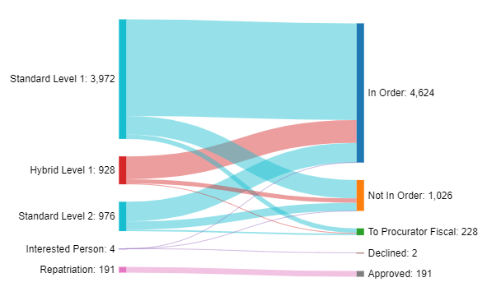
Sankey diagram of number of cases and breakdown of case type and outcome in 2022/23

Slide 43
Deaths outwith Scotland (repatriations)
The service is responsible for approving burial or cremation in Scotland, of people who have died abroad and are to be repatriated to Scotland.
In 2022/23, the service received 191 repatriation requests, of which,
130 (68.1%) were males, 61 females
120 (62.8%) were individuals 60 years or older
55 people (28.8%) died in Spain.
Two post-mortems were approved.
Age | No of deaths |  | Repatriated from | No of deaths
0 - 19 | 7 |  | Spain | 55
20 - 39 | 19 |  | Turkey | 20
40 - 59 | 45 |  | USA/Canada | 15
60 - 79 | 97 |  | Greece | 11
80+ | 23 |  | Cyprus | 10
Male | Female
130 | 61

Slide 44
Deaths outwith Scotland (repatriations)
The service is responsible for approving burial or cremation in Scotland, of people who have died abroad and are to be repatriated to Scotland.
In 2022/23, the service received 191 repatriation requests, of which,
130 (68.1%) were males, 61 females
120 (62.8%) were individuals 60 years or older
A number of cases were reported to the PF -
Year (1/1 – 31/12) | Total reported to PF | PF - No Action taken | PF - Accepted
2021 | 12 | 9 | 3
2022 | 50 | 45 | 5
2023 | 20 | 15 | 5

Slide 45
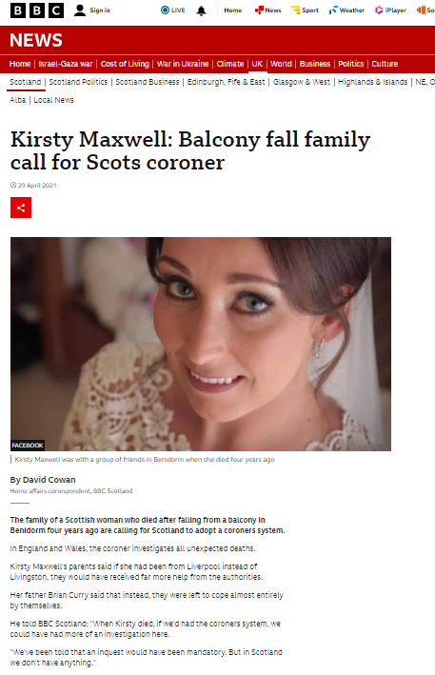
https://www.bbc.co.uk/news/uk-scotland-56929802

Slide 46
19 Post-mortem examination of person who died outwith United Kingdom
(1) This section applies where—
(a) a person (“A”) dies outwith the United Kingdom,
(b) the body of A is to be disposed of in Scotland, and
(c) no cause of death is available.
(2) A medical reviewer may, on an application by a relevant person—
(a) assist the relevant person in making arrangements for a post-mortem examination of A’s body for the purpose mentioned in section 23(a) of the Human Tissue (Scotland) Act 2006 (asp 4), and
(b) meet the cost of such an examination.

Slide 47
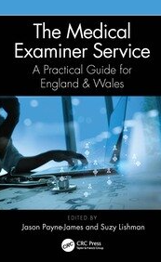

Slide 48
Enlightened Decisions
Although the Act would permit a charge to be levied, the bold decision was that the delivery of the reviews would be free at the point of delivery in the same way as envisaged for other aspects of the NHS when it was first conceived. Doing so was in distinction to the Medical Examiner system in England and Wales, albeit they had an aspiration to review all the non-coronial MCCDs. When the new arrangements were implemented throughout the country, fees for cremation certificates were simultaneously abolished.
Another difference is that the service is independent of the territorial health boards whence the certificates are produced, ensuring impartiality and embracing clinical governance as a core function.
This does not mean one system is better or worse than the other, of course, but it is different, in the same way as the National Health Service has diverged across the home nations of the United Kingdom.

Slide 49
Conclusions
Scotland was the first of the home nations to reform medical certification of cause of death, which took place in 2015. This was done on time and under budget despite requiring a new IT system connecting two different governmental departments, National Records of Scotland and the NHS.
Notwithstanding the complexity, the new process has successfully improved the quality and accuracy of these important documents ensuring families have a much clearer understanding of why their loved ones died as well as providing improved public health data, which is something that assumed much greater significance with the unpredicted pandemic of 2020.
Importantly, all this has been done without imposing unnecessary delays on the ability to make funeral arrangements or impinge significantly on clinicians’ ability to look after patients due to the educational approach that lies at the heart of the service.

Slide 50
The monthly percentage of MCCDs found to be ‘not in order’ has seen a sustained improvement of –
10.5%
21.5%
30.5%
51.5%
60.5%

Slide 51
The monthly percentage of MCCDs found to be ‘not in order’ has seen a sustained improvement of –
10.5%
21.5%
30.5%
51.5%
60.5%

Slide 52
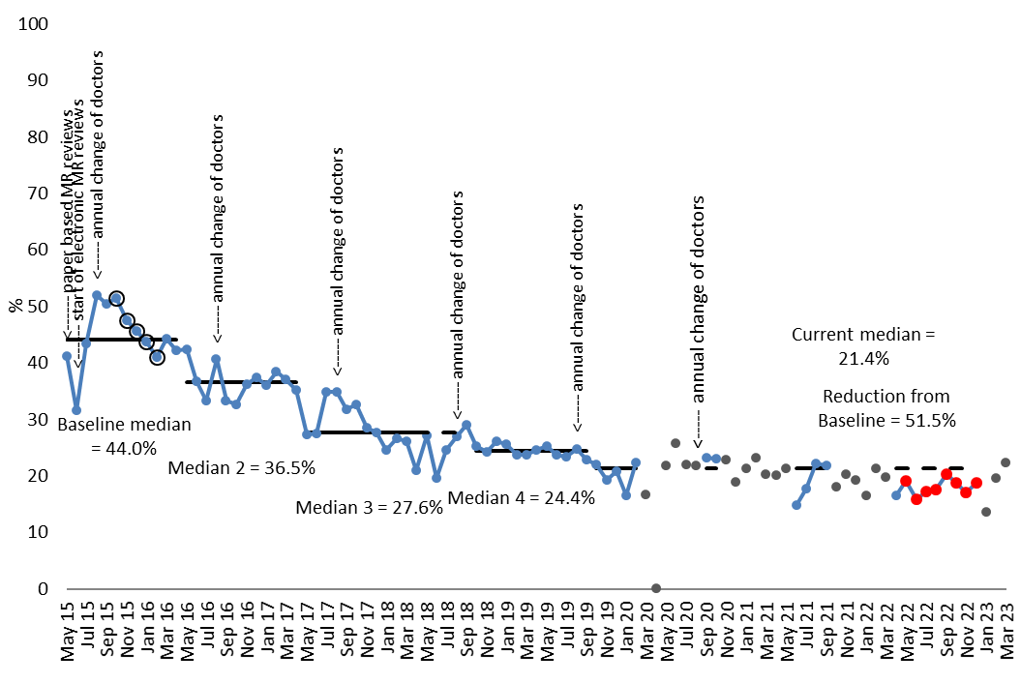

Slide 53
Keep in touch
www.healthcareimprovementscotland.org/deathcertification his.dcrs@nhs.scot
0300 123 1898
Healthcare Improvement Scotland
Death Certification Review Service
Delta House | 50 West Nile Street | Glasgow G1 2NP

