Slide 1
Bereavement in the workplace: Supporting yourself and others
Gemma Edwards
Scottish Clinical Leadership Fellow
Neonatal ST7
Lynne Innes
Senior Educator Bereavement Education Programme, NHS Education for Scotland
Healthcare Chaplain – Staff Support NHS Fife
We are sensitive that the themes being discussed today may be upsetting for some people. Please attend in the way in which you are comfortable to be present.

Slide 2
Outline
Background to this piece
Colleague experiences
Literature base
Short film
Discussion

Slide 3
Background
Death of a colleague in the workplace is rare, when it does happen those responding may never have encountered this before
Strong bonds often form between those working in health and social care settings
Consideration of learning points from colleagues and friends who have experienced the death of a colleague

Slide 4
What makes this setting challenging
Group encompasses caring professions who work closely with each other
There may be a need for usual service for patients or clients to continue as normal
Individuals may feel worried that they don’t know the right thing to say
Individuals may feel they should be able to cope with bereavement due to their job
There may be a hierarchy of roles and grades creating a barrier

Slide 5
Supporting others and ourselves
Lynne Innes
Senior Educator
Bereavement Education Programme
NHS Education for Scotland
Healthcare Chaplain - Staff Support
Department of Spiritual Care
NHS Fife
Thursday 14th March 2024
SupportAroundDeath@nes.scot.nhs.uk www.sad.scot.nhs.uk @NES_Bereavement
Notes:
5

Slide 6
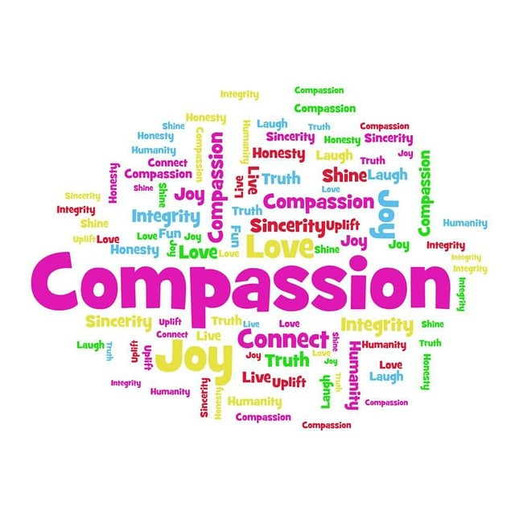
Self-Compassion is not selfish – it’s essential…
Taking good care of yourself means the people in your life receive the best of you, rather than what is left of you.
Lucille Zimmerman
Self-compassion means being warm, self-soothing and understanding towards ourselves in situations where we suffer.
Michael West
Image: Pixabay free to use

Slide 7
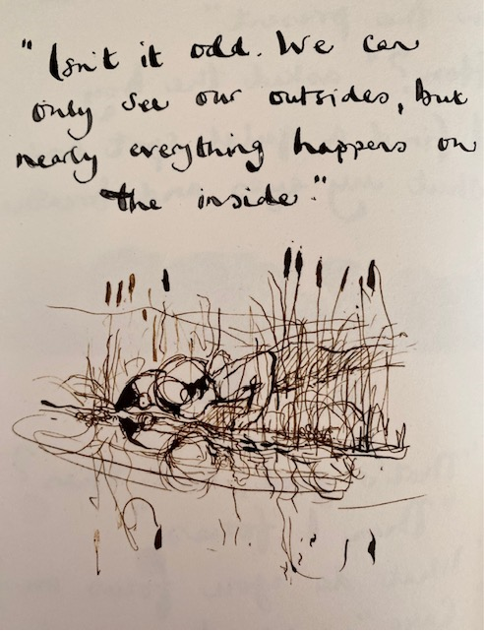
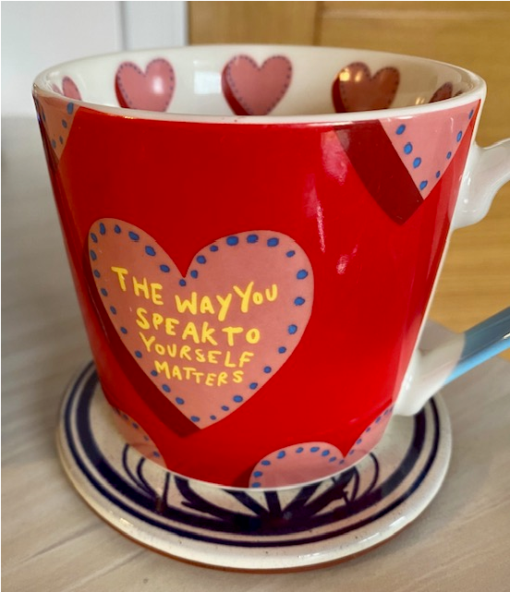
Self - compassion
Our relationship with ourselves – our inner world or inner voice
How we think
Internally talk to ourselves – story telling
Judge ourselves
Accept or reject our feelings and thoughts
How we experience emotions such as shame, joy, anger, love, anxiety and guilt
Reference: Compassionate Leadership (West, 2021)
Image: The Boy, the mole, the fox and the Horse, Charlie Mackesy, 2019

Slide 8
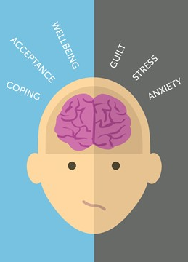
Self – compassion in practice
Attending to ourselves – be present
Understanding the challenges we face
Caring for ourselves – avoiding heroic self-denial
Tenderness, concern and love for ourselves – valuing ourselves
Helping or supporting ourselves – being our best selves
But…. what if that doesn’t quite work……
RAIN acronym is a guide for practising mindfulness and self-compassion in 4 steps
RAIN – Recognising, Allowing or Accepting, Investigating or Inquiring, Nurturing with self-compassion
Reference: Compassionate Leadership (West, 2021)
Image: NES Bereavement

Slide 9
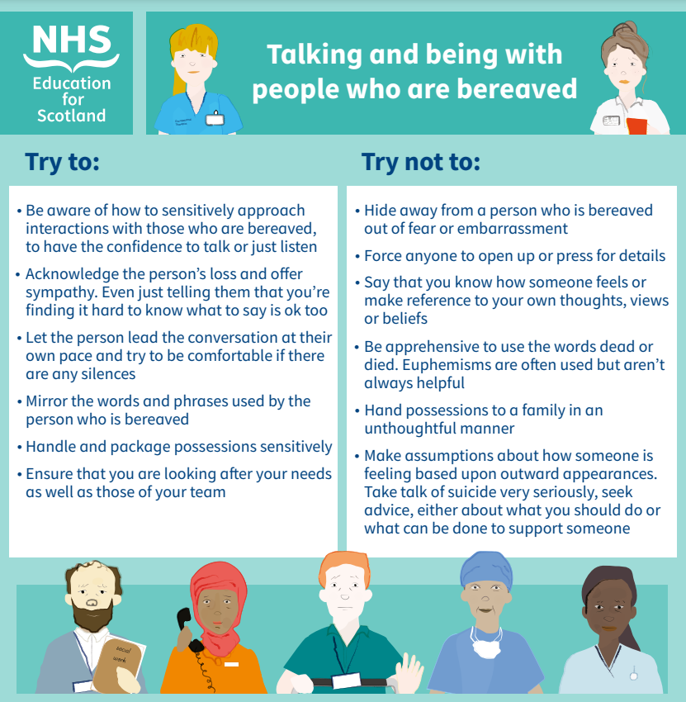
Talking and being with people who are bereaved

Slide 10
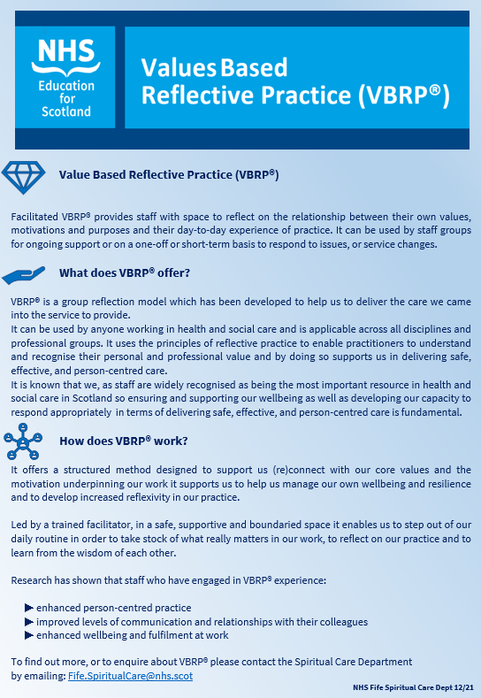
Group/team support
Values Based Reflective Practice
I notice
I wonder
I realise
Spaces for Listening
A space to gather with others to listen to each other equally
Pastoral Supervision
A regular, planned space to reflect on practice (soul, role and context together)

Slide 11
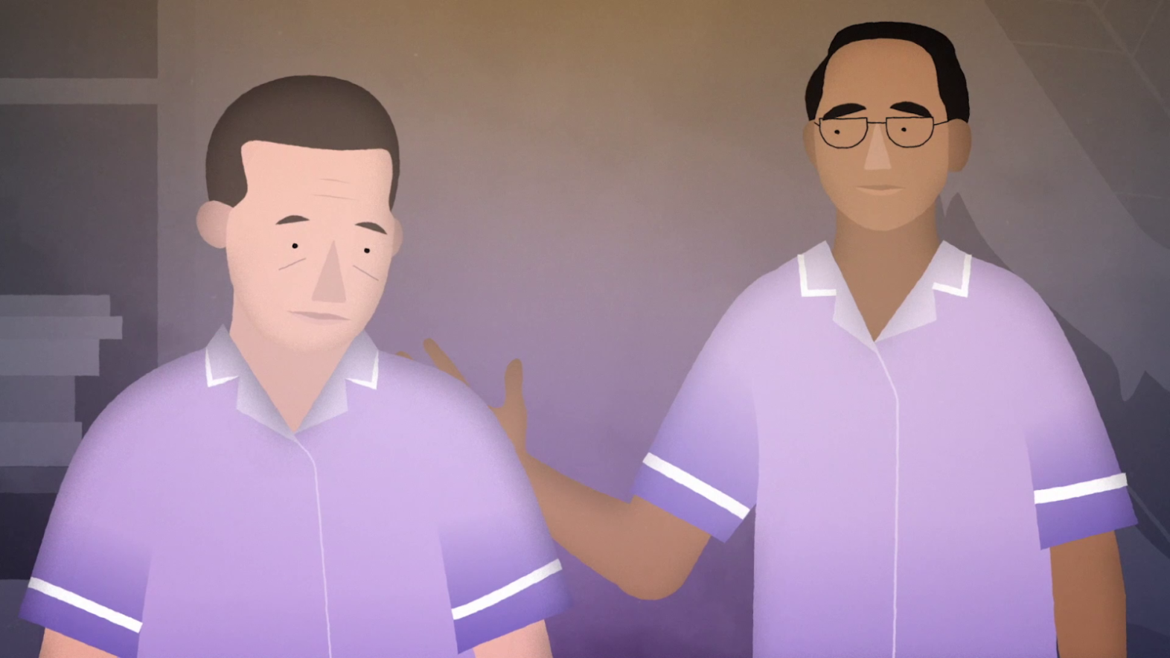
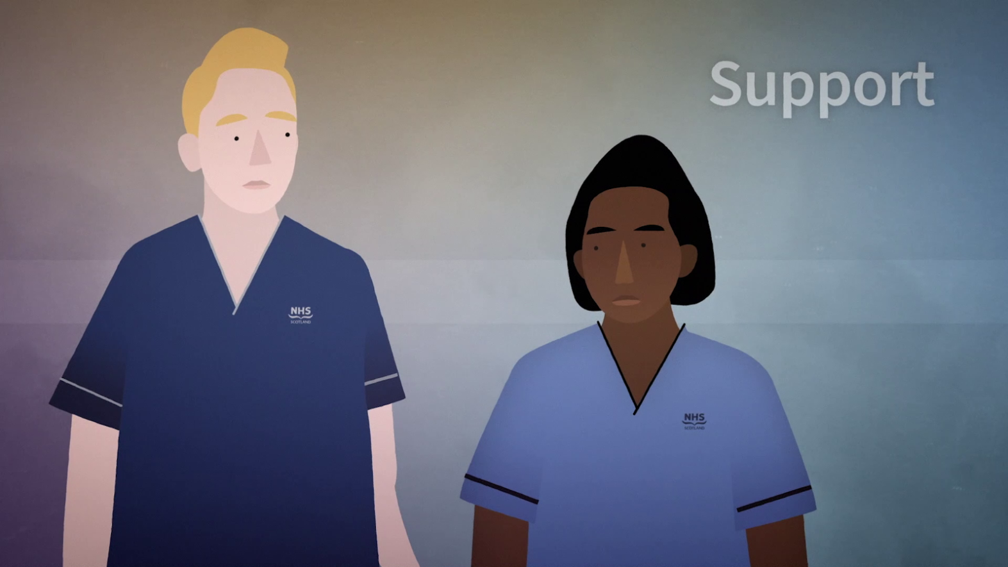
Sustaining our wellbeing
Plan for our wellbeing
To be able to look after others safely and effectively, we first have to take care of ourselves
Taking care of ourselves is a way to take a proactive approach to managing wellbeing
Enabling a compassionate and nurturing culture
Images: NES Bereavement

Slide 12
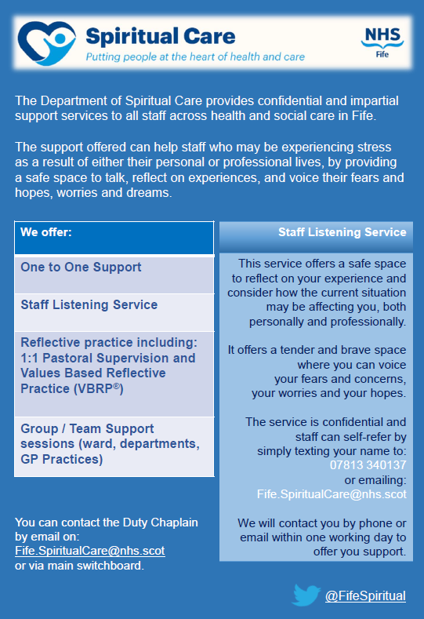
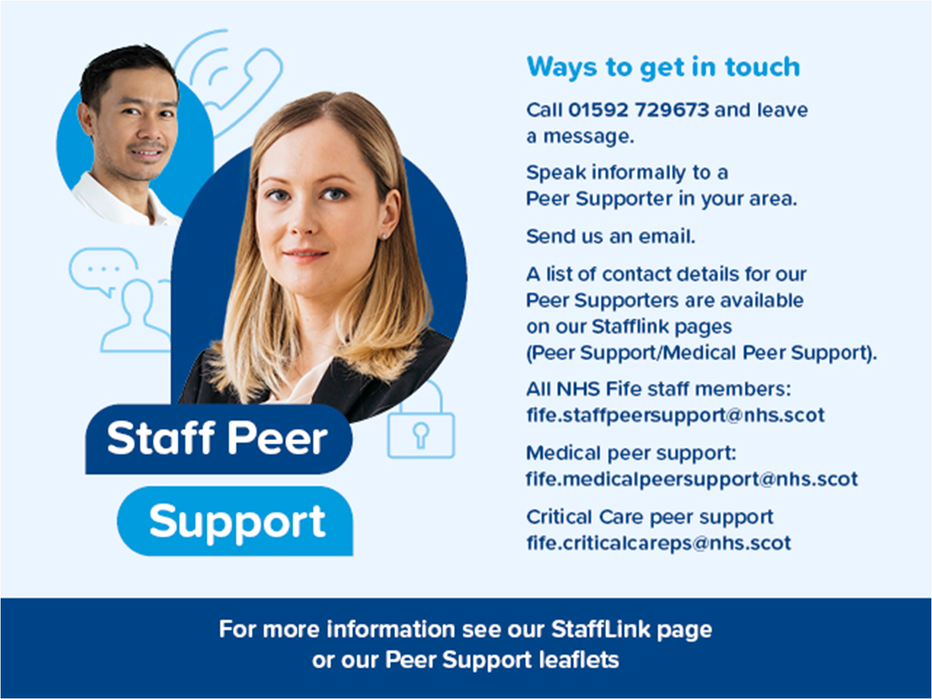
Sources of support

Slide 13
Sources of support
Examples include
National Wellbeing Helpline for everyone working in health & social care services Tel: 0800 111 4191
National Wellbeing Hub https://wellbeinghub.scot/
TURAS Learn Psychosocial mental health and wellbeing support pages - Taking care of myself
NHS Scotland Spiritual Care and Chaplaincy Departments within each regional NHS Board
Image: NES Bereavement

Slide 14
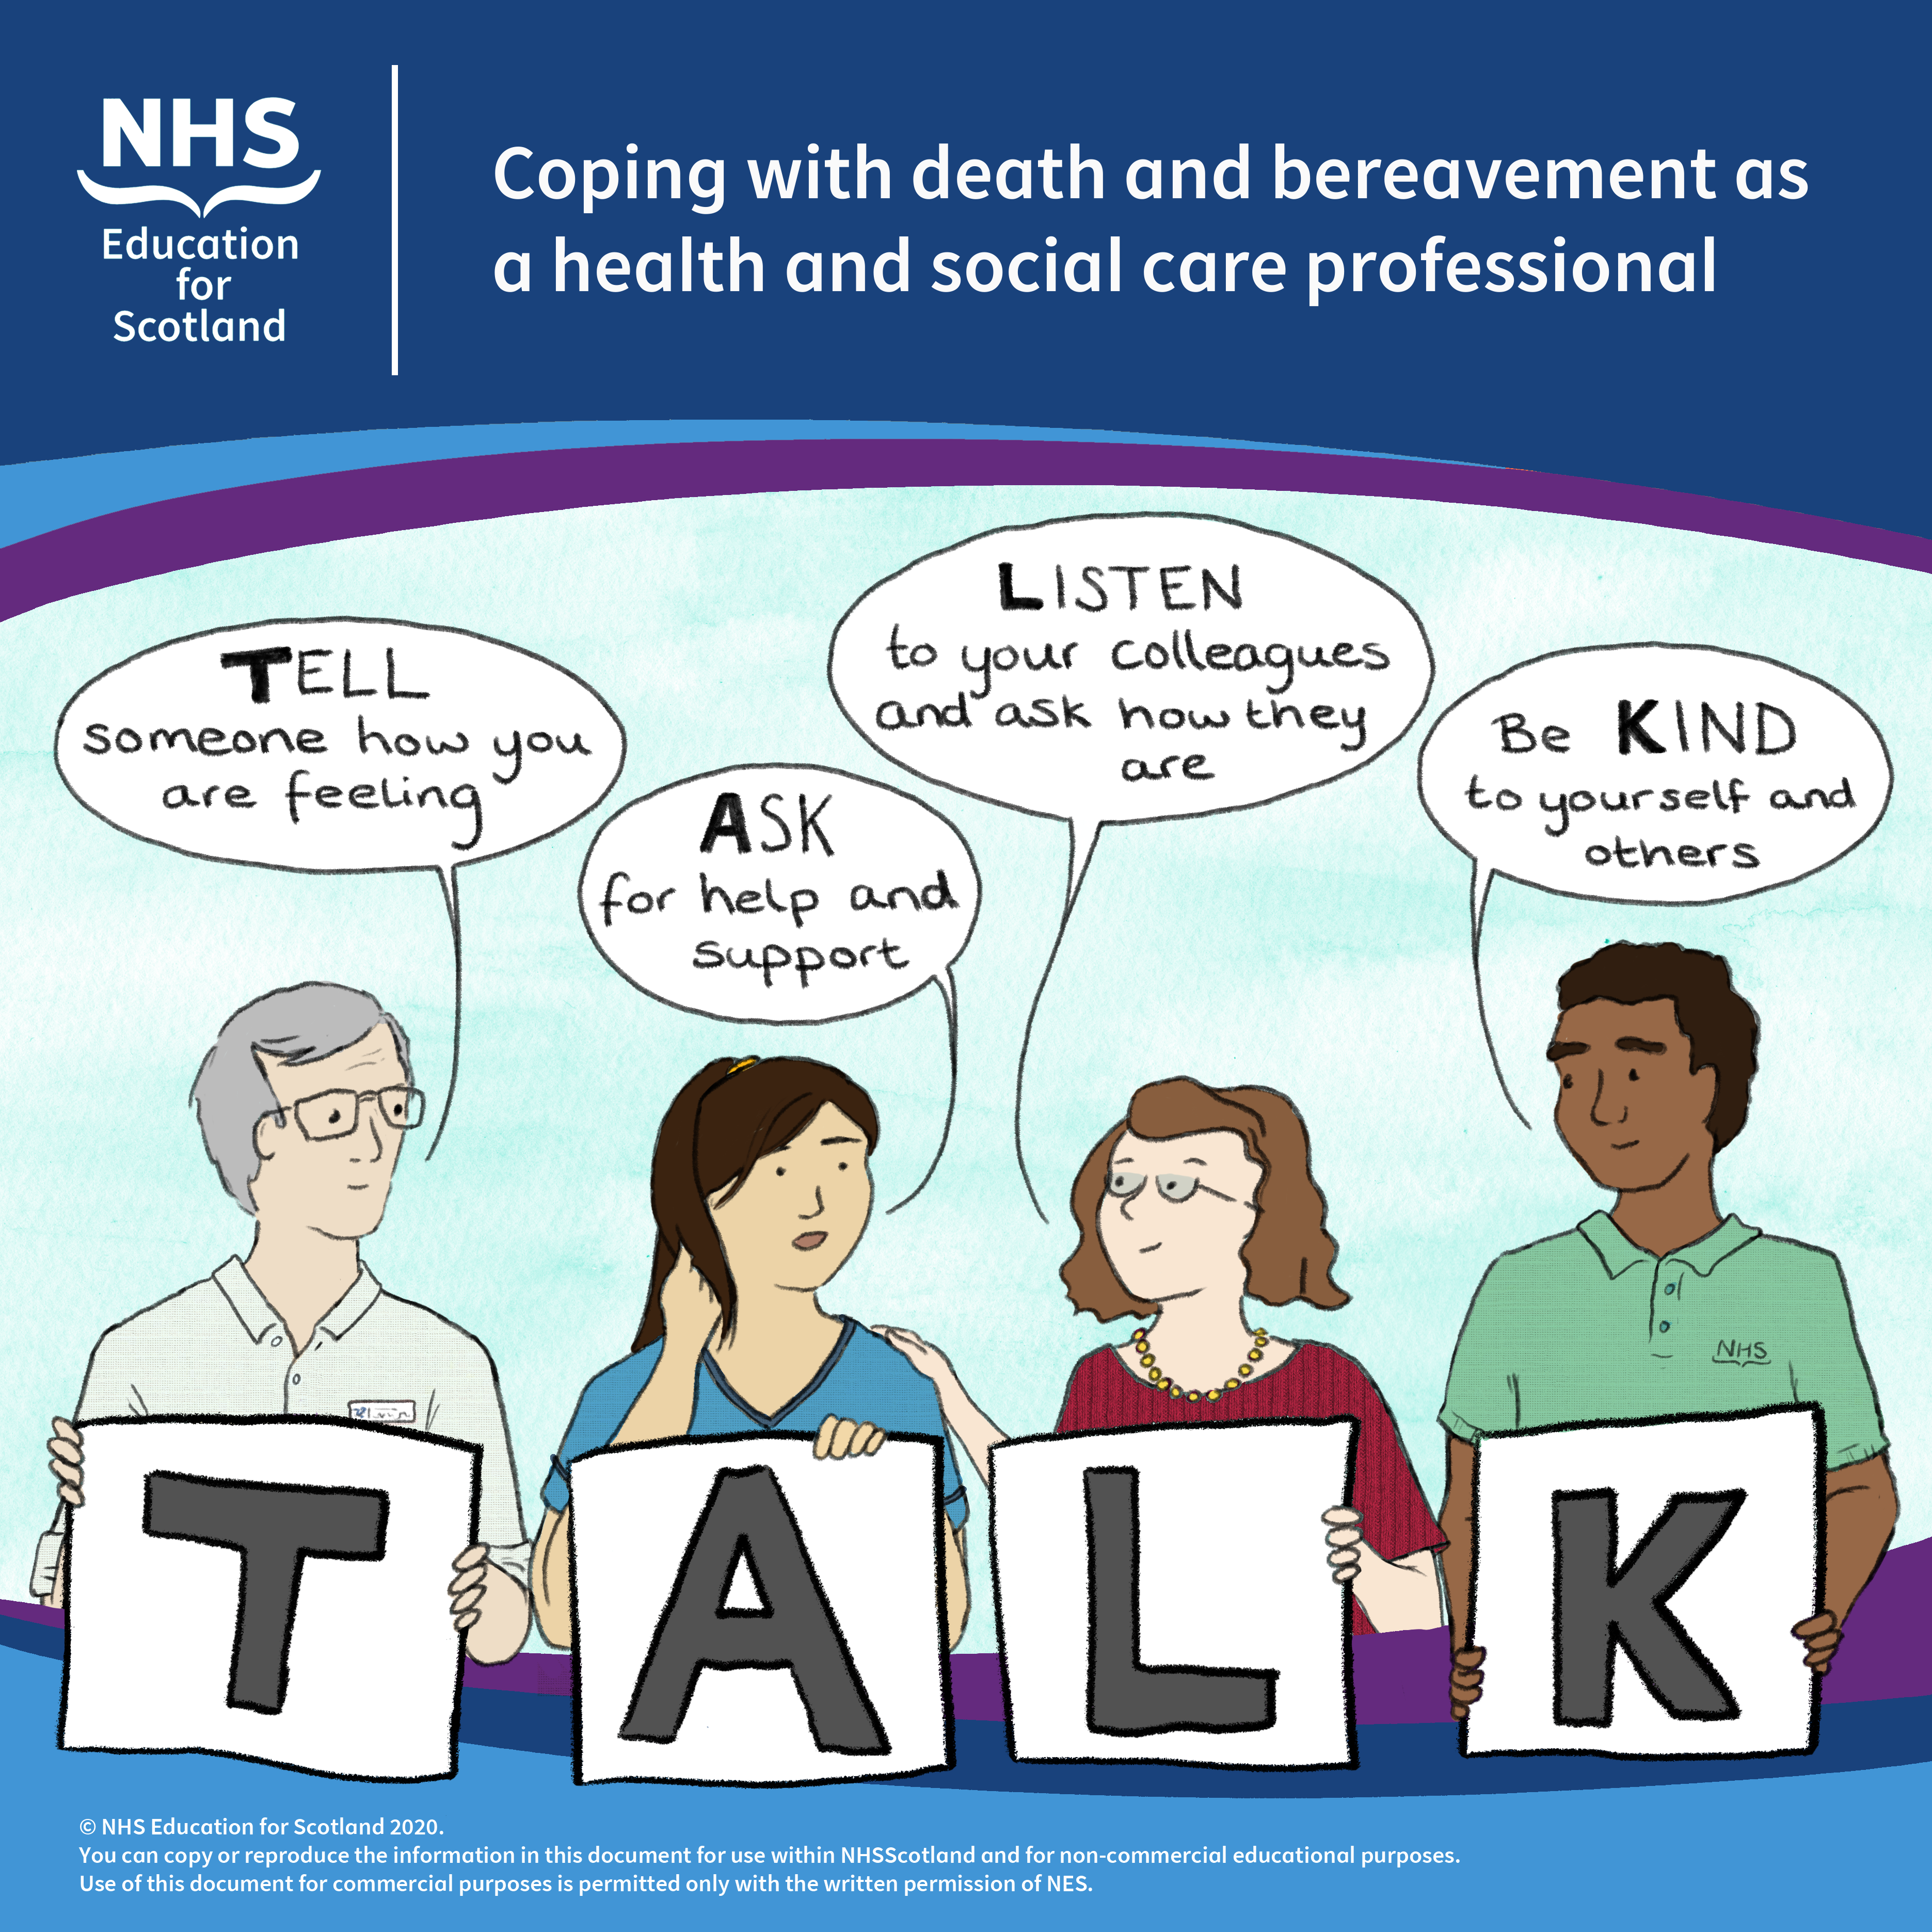
Supporting others
Support should aim to be compassionate
Enable sharing of grief and vulnerability
Encompass the physical, emotional, psychological and spiritual dimensions of wellbeing.
Development of an acronym explained in ‘Coping with death and bereavement’ film
Dedicated webpage https://www.sad.scot.nhs.uk/wellbeing/
Dealing with bereavement in the workplace
Communication with those who are bereaved

Slide 15
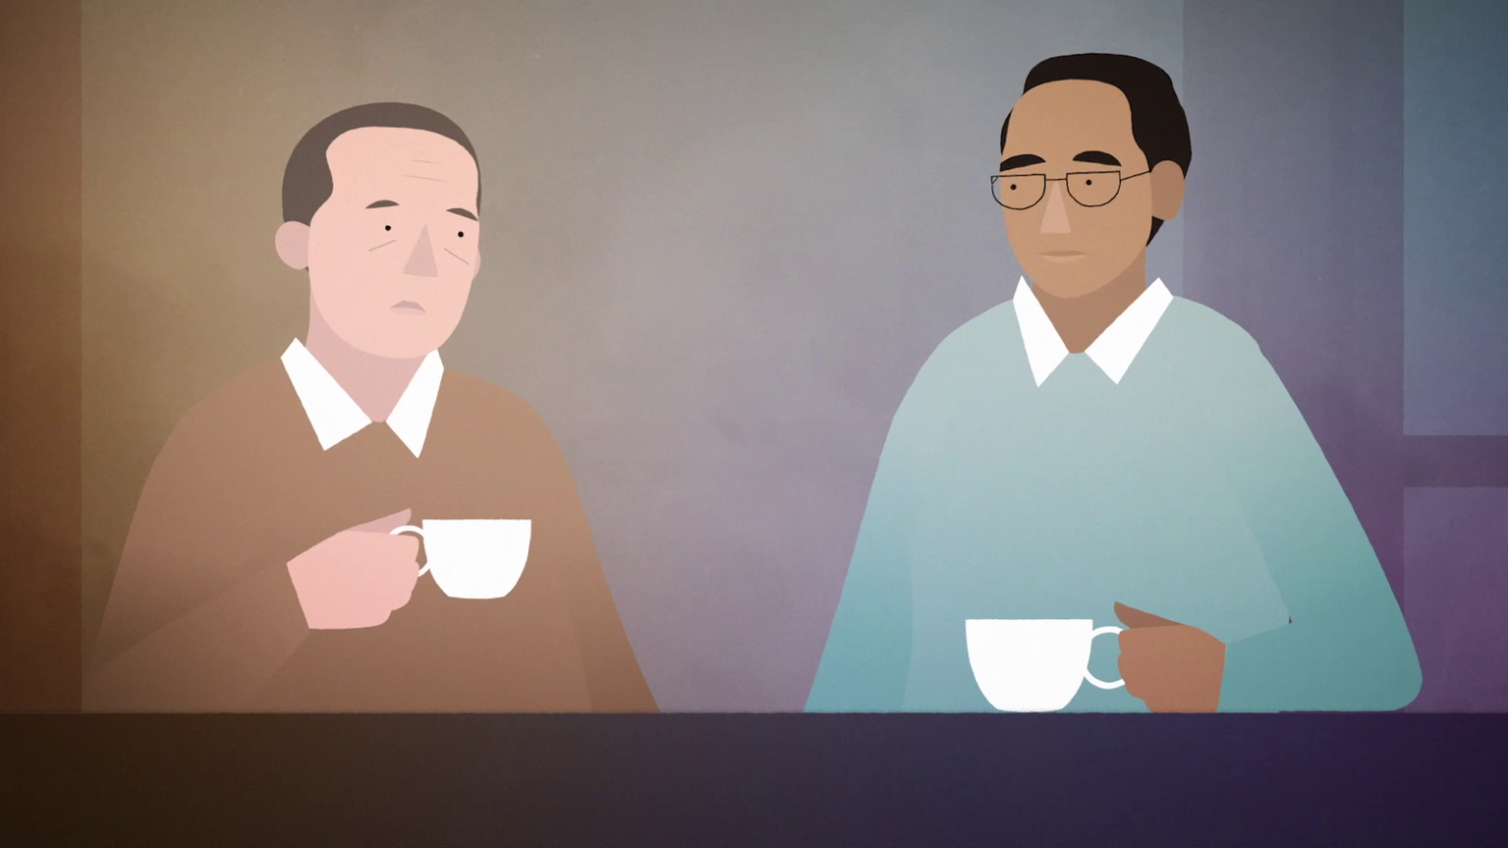
Supporting others
Maintain open communication with all staff
Build rapport
Actively listen
Acknowledge emotions
Be present in attention
Be sensitive to the needs of others
Try not to make assumptions
Create quiet spaces for people if they need to talk
Offer breaks for people to meet over coffee/lunch
Check in with people regularly
Signpost to other organisations for support

Slide 16
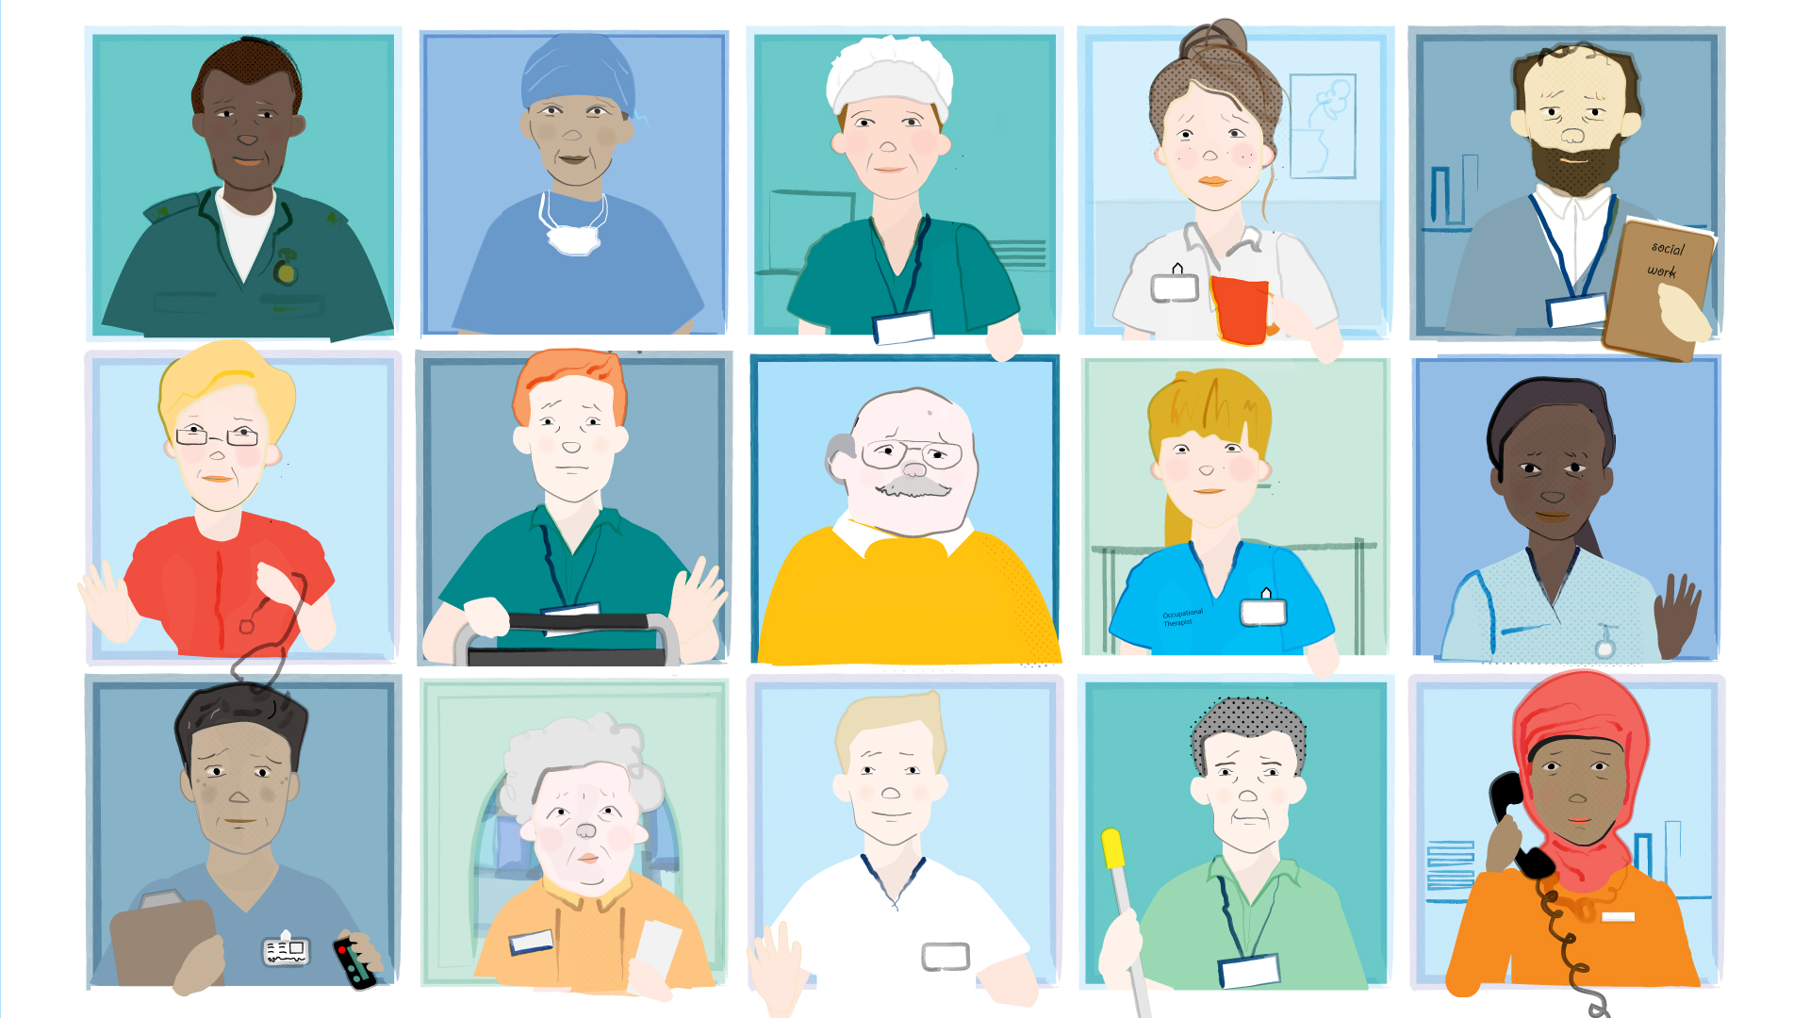
Pastoral or Spiritual Care Support
Connecting
Building relationships
Relational
Listening to what matters
Prompting and enabling space for reflection and reflexivity
Supporting growth
Compassionate presence
Providing & holding space
Love

Slide 17
Grief in the workplace - Literature
Articles screened for relevance and 17 selected for review
Grief in the workplace is often stifled, the sudden death of a colleague can be damaging and destructive for the team.
In this team environment, extreme and highly emotive experiences are frequently shared.
There may be a hierarchy and it may be confronting for junior staff to see senior staff grieving.
Complicated by concerns about financial or career implications of taking time off or showing vulnerability.

Slide 18
Understanding and Addressing Grief at Work
It is important for leaders to pay attention to their own needs while offering care to the team
Even in the workplace, grief is a healing process and individuals’ sadness will decrease at different rates
It may never return to how things were before, conversely not all staff will be affected
Try to avoid speculation and avoid making assumptions

Slide 19
Immediate responses
Consider who should be contacted, think about all member of the MDT, consider clients.
Individuals often try to suppress their grief responses, however this can be more disruptive and destructive to them and their workplace.
Bereavement isn’t an exclusively specialist subject. If you haven’t dealt with this before, working through a considerate and compassionate approach can support your team.

Slide 20
In the workplace
Recognise that often the workload must continue. Others may value the opportunity to support colleagues by being flexible with shifts if they can.
1
Ensure that anyone covering a shift is aware of the circumstances.
2
Consider additional cover over the funeral.
3
Consider a condolence book or internet page for team members to contribute, and having a quiet space available for reflection.
4

Slide 21
Suicide
Sometimes referred to as ‘grief with the volume turned up’
Some professions within health and social care at higher risk of suicide.
Approximately 400 people area exposed to the aftermath of every suicide.
May be complicated by stigma, fear of saying the wrong thing.
Team members may feel guilt at not recognising perceived warning signs.
Treat the death in the same way and focus on how the person lived rather than how they died.

Slide 22
Communication
Many individuals report feeling more connected to their team members who have also experienced the death of the colleague
There can be anxiety around returning to work, and both the practical and emotional consequences of their colleague’s unfilled position.
Use the opportunity to remind of any wellbeing or mentoring resources.
Remember that we access emails throughout the day and cannot control the environment a colleague receives the news in.
Don’t fear ‘reminding’ someone of a death, they won’t have forgotten.

Slide 23
Longer term
It can be helpful to create a memorial in the workplace.
Benefits of community/team meetings has been recognised.
Seeking social support from friends and colleagues is often the most popular and useful form of coping.
Meeting can allow colleagues to validate each others’ emotions and may facilitate any necessary adaptations to teamworking.
People grieve at different times in different ways, therefore beneficial to hold meetings at ongoing intervals.

Slide 24
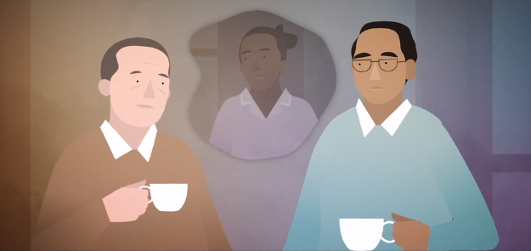
‘Compassion in a workplace affected by bereavement reduces anxiety, helps people feel valued, builds a collective capacity for healing and helps people resume a sense of normality’
- goodlifedeathgrief.org.uk
Summary

Slide 25
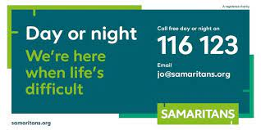
Discussion

