Slide 1
Body Donation in Scotland
A guide for Health and social care staff - in particular Doctors, Nurses, Mortuary staff, Chaplaincy staff, Care home staff and Admin staff involved in care after a person has died.
Wednesday 30th August 2023, 17.00-18.00

Slide 2
WELCOME!
This webinar will cover:
An overview of the body donor programme in Scotland
Consent processes and documentation
The role of health and social care staff following a person’s death
What happens after a person’s body is released by a university
Animation showcase

Slide 3
Speakers
Catherine Chadha
Senior Anatomy Technician, University of Edinburgh
Vivienne McGuire
Centre Manager, University of Dundee
Laura Sheils
Bequest Coordinator and Lab Manager, University of Edinburgh
Agnieszka Kruk-Omenzetter
Anatomy & Bequest Administrator, University of Aberdeen

Slide 4
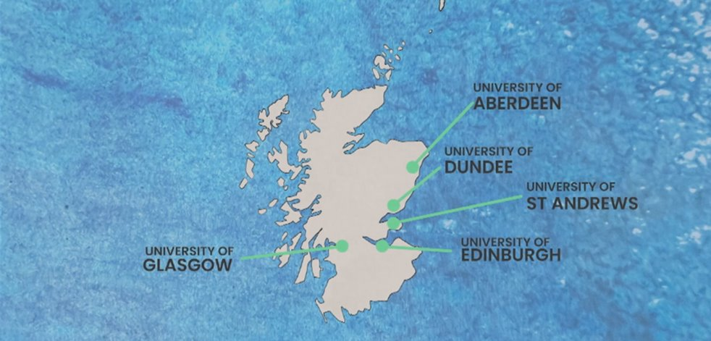
An overview of the body donor programme in Scotland

Slide 5
What is Body Donation?
When someone leaves their body to a Scottish university it is a generous decision that supports the training of students, medical professionals and scientists.
Body Donation improves students' knowledge and understanding of the structure and function of the human body and enables healthcare professionals to develop and improve surgical techniques, this also contributes towards the development of future developments in medical research.

Slide 6
A body donor may be used for: Anatomical examination: the study of the structure and function of the human body, that supports the training of medical students or healthcare professionals. Training and education: extending knowledge, developing existing skills and learning new surgical techniques.| Medical research: improving understanding of the human body and contributing towards the advancement of new treatments in health and disease.
All donated bodies are cared for by an experienced and compassionate team of Licensed Anatomists and Technicians. They ensure that donated bodies are treated, at all times, with the dignity and respect they deserve, whilst overseeing and approving the range of educational and research activities that the donations support.

Slide 7
The Law
The Anatomy Act (1984) and the Human Tissue (Scotland) Act (HTSA 2006) regulate the use of bodies donated for anatomical examination, education or training and medical research. It sets out the legal framework for the removal, retention and lawful use after death of human bodies and body parts.
A licence from the Scottish Government allows a university to perform Anatomical Examinations on donated bodies, and to store and use them for the purposes of education, training and research.

Slide 8
Consent processes and documentation
It is important that the individual and their next of kin or executors, as well as their health and social care providers, understand what’s involved in consenting to and facilitating body donation.
There are a few steps that must take place for a person to register for body donation while they are living, including completing, signing, and submitting the required documentation. This documentation is referred to as a Declaration of Bequest Form.
There is no upper age limit for donation and anyone over the age of 12 (with parental consent until aged 18) can choose to donate.

Slide 9
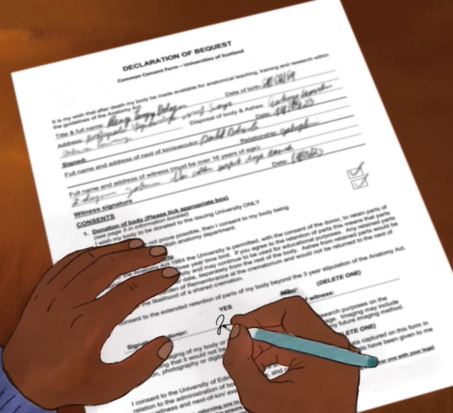
Declaration of Bequest Common Consent Form – Universities of Scotland Anatomy Act Scotland 1984 (as amended 2006)
Full Name and Title:
Address:
Date of Birth:
Signature: Date:
Full Name and Address of Next of Kin/Executor:
Relationship:
Full Name and Address of Witness (must be over 16 years of age):
Witness Signature: Date:

Slide 10
CONSENT
1. I wish my body to be donated to the issuing University only
or
Should the above not be possible, then I consent to my body being donated to another Scottish anatomy department.
2. Please tick the appropriate box
Under the Anatomy Act 1984 the university is permitted, with the consent of the donor, to retain parts of donated bodies past the three year time limit. If you agree to the retention of parts this means that parts may be kept by the university and may continue to be used for educational purposes. Any retained parts will be cremated at a later date, separately from the rest of the body. Ashes from retained parts would be dispersed in the garden of remembrance at the crematorium and would not be returned to the next of kin due to the likelihood of a shared cremation. If you do not wish parts to be retained and cremated separately please do not sign below.
I consent to the extended retention of parts of my body
Or
I do not wish retention of parts of my body beyond the 3 year stipulation of the Anatomy Act
Signed: Date:
Signed by Next of Kin/Executor: Date:
3. I consent to imaging of my body or body parts for educational and research purposes on the understanding that it would not be possible to identify me from the image. Imaging may include illustration, photography or digital imaging , X-ray , ultrasound , MRI or any future imaging method.
Or
I do not consent to imaging of my body or body parts for educational and research purposes.

Slide 11
Acknowledgement
The Bequest Coordinator will send an acknowledgement to the person directly to confirm safe receipt of the documentation and that the persons name is now on the Bequest Register.

Slide 12
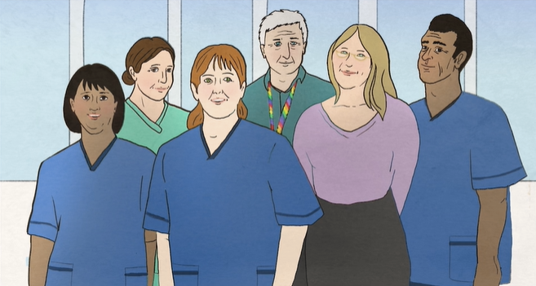
The role of health and social care staff following a person’s death

Slide 13
Understanding what happens after a person dies
The Bequest Coordinator will need to speak to the attending doctor or another member of suitable staff to discuss the donors details at the time of death.
Medical notes are often removed from wards relatively quickly following death, it can be helpful to have an understanding of the information that the bequest coordinator will need to ensure that this can be communicated without too much difficulty.

Slide 14
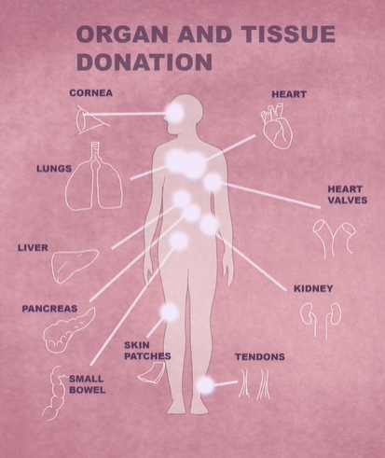
Many people who are considering Body Donation are also interested in registering, or have already registered, as an organ donor or with another service for tissue donation, i.e. brain bank donation. It is important that a donor understands the differences in registering for these types of donation, what this means for them and that each process for these donations are entirely separate.
A person can be registered as both organ and body donor. Organ donation should take priority but if doesn't prove possible, then body donation can be considered. Body Donation is entirely the person’s decision and, whatever they decide, it's important to make sure their donation decision is known to their immediate family and to those involved in their care or support.
The law around organ and tissue donation changed to an opt-out system in Scotland on 26th March 2021. Unfortunately, with the exception of the corneas, it is not possible to donate both organs for transplantation or disease specific research and the whole body to medical science.
More information on organ donation can be found here: https://www.organdonation.scot/

Slide 15
Suitable facilities
If a death occurs in a hospital the person can be cared for in the hospital mortuary until a decision is made within the usual recommended time period.
If, however, the death occurs at home or in another care facility, it would be advisable to allow the person to rest in a cool temperature room. It may be necessary to contact a funeral director with refrigerated facilities to care for the person in their mortuary until a decision has been made on acceptance. Universities can only accept donated bodies up to 3-5 days after death. Some universities have a shorter period of time in which they can accept.
The deceased can be visited by family members if they wish, whether at home, in a care home or in a hospital. If this was not possible and a funeral director has been appointed visiting or viewing can also take place at a funeral home - if there is still time before the person is transferred to the University.

Slide 16
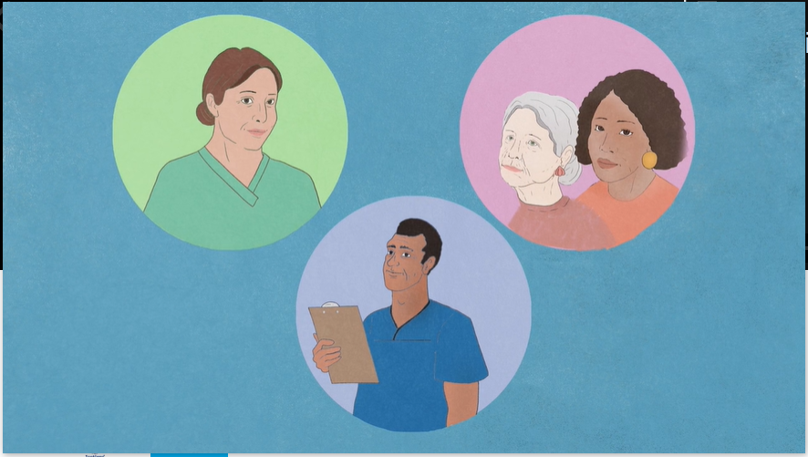
Facilitating communication
At the time of a potential donor’s death, or as soon as possible after death occurs; the family as well as the attending doctor are advised to call the bequest coordinator.
A decision regarding the suitability of each donation can only be made after the university has spoken to the attending doctor or other suitable medical staff.
This person will be asked a few questions, including the cause of death. An MCCD death certificate will usually be issued by the doctor (either in the hospital or the GP). The bequest coordinator will need confirmation of the MCCD being signed before they are able to accept a donor. There is no need to wait for the official death certificate issued by Registrar until after acceptance.
Each potential donor is considered carefully, on a case-by case basis, and the university may be unable to accept a donation for medical or logistical reasons. The final decision on acceptance is made by the Licensed Teacher of Anatomy.

Slide 17
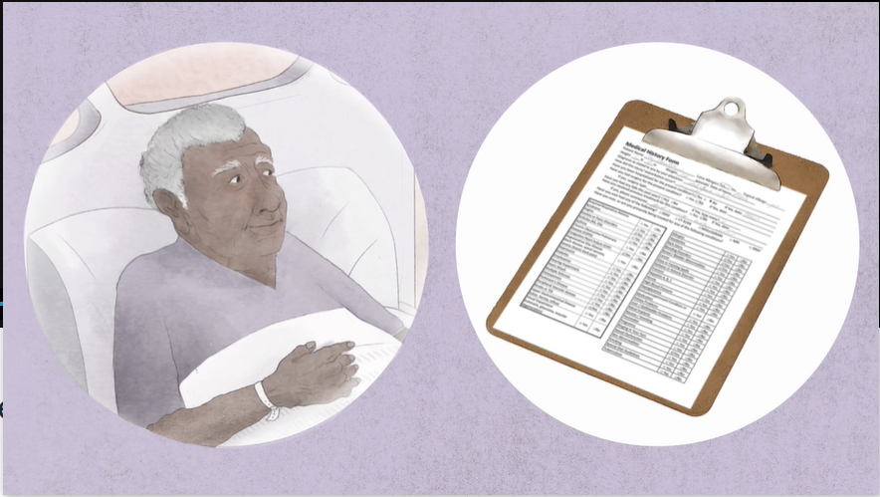
Medical history

Slide 18
​
You may be contacted by a university about the person’s body donation in the immediate days after the person dies. The Bequest Coordinator will ask a series of medical questions to the most appropriate person involved in their care at the time of death.
The attending doctor, consultant or senior member of the nursing/care team who is caring for the patient or the GP are often best placed to answer these questions and to interpret the medical information.
There are some circumstances that may make it difficult for a university to accept a donor.​
​
It is always recommended that the medical history is discussed with the Bequest Coordinator rather than discounting the person for donation based on previous experience. ​
​

Slide 19
What Questions will I be asked?
Cause of Death
Infectious or transmittable conditions
Height and Weight
Pacemaker
Recent Surgery
Cancer
Jaundice
Oedema
Wounds or sores
Dementia
Joint Replacements

Slide 20
Supporting families in Difficult circumstances

Slide 21
After a body donor is accepted

Slide 22
What happens after a person’s body is released by a university

Slide 23
Funeral arrangements
The safe keeping, preservation and examination of the donor is permitted for up to 3 years and at such time cremation or burial is required. Each university will usually make arrangements for a dignified cremation with no funeral service.
Families are able to request for ashes to be retained. This is discussed with the next of kin/executor at the time of death. The ashes may be scattered in the Garden of Remembrance at the Crematorium or collected by the next of kin/executor. All cremation costs are met by the university.
Should there be a wish to be buried, this would have to be arranged by the next of kin at the end of the examination period.
Where a body donor has consented to body parts being retained longer than the 3-year examination period there may be extended use of consented retained parts. The next of kin will also be asked to consent to this at the time of donor acceptance.

Slide 24
Annual Memorial Service
Each university holds an Annual Memorial Service to honour those who have donated their body to the university in the previous year. The donor’s family are invited to attend the service and meet with staff and students.
Each university also records the names of donors in a Book of Remembrance which may be viewed on request.
Families are welcome to contact the university at any time if they have any questions about their relative’s donation.

Slide 25
Key Points
It is not possible for someone else to register another person for body donation
A person can at any time remove themselves from the Bequest Register
Prioritise Organ Donation if possible
Note that a short medical history is required at the time of death
Next of Kin consent is also required
Importance of confirming with the family they need to call the University at the time of death.

Slide 26
01334 46 3596
bodydonation@st-andrews.ac.uk
0141 330 5397 bodydonation@glasgow.ac.uk
0131 651 5996 body-donations@ed.ac.uk
01382 388825 bodydonation@dundee.ac.uk
01224 274320
anat@abdn.ac.uk

Slide 27
Thank you

